Slide 1
Centralized Purchasing Module-Approvals

Slide 2
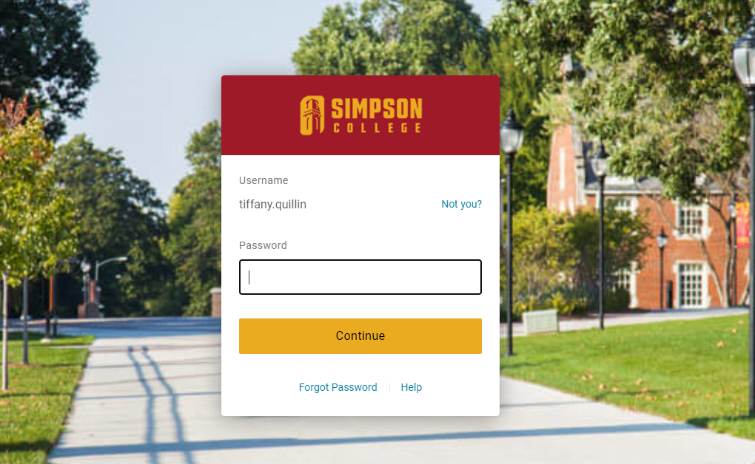
Step 1: Log into Simpson One Login

Slide 3
Step 2: Log into Self-Service

Slide 4
Step 3: Click on Financial Management

Slide 5
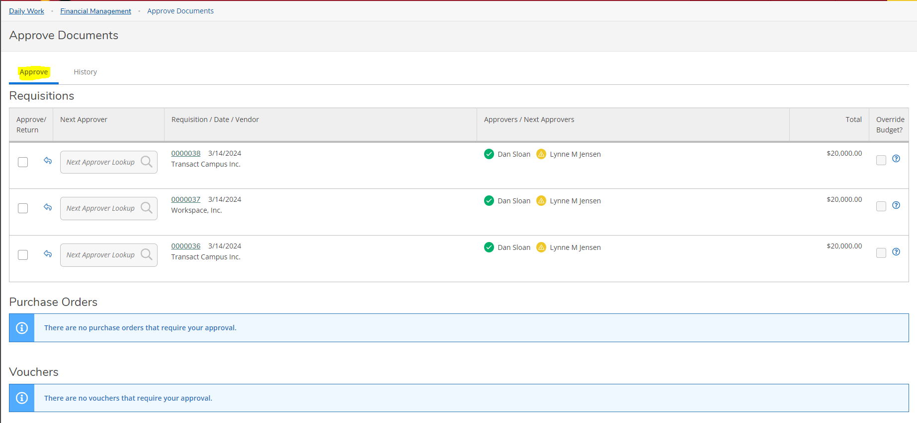
Step 4: Click on Approve Documents

Slide 6
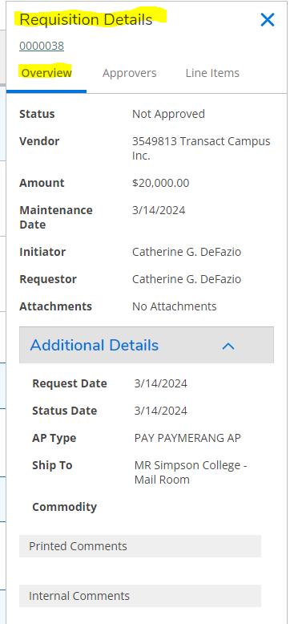
Clicking on the Requisition Number will bring up Requisition Details – you can click on the Overview, Approvers, and Line Items tabs. You can also expand on Additional Details.

Slide 7
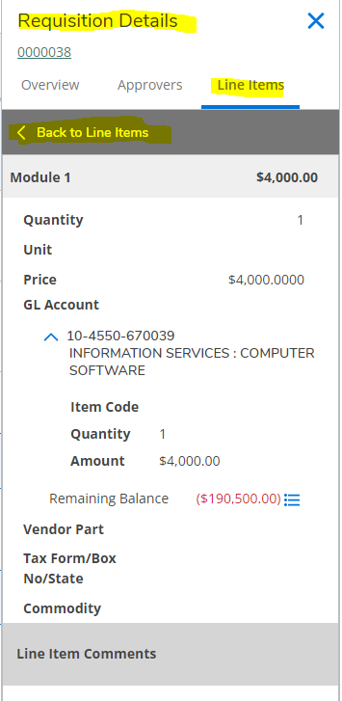
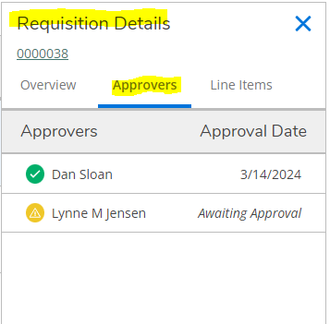
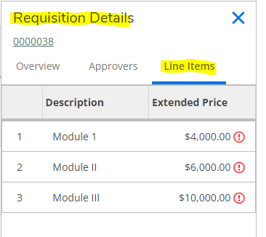
Click on the lines – and you can see more details:

Slide 8
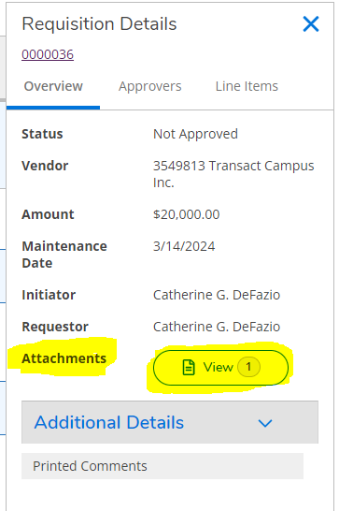
To view any documents attached, click the view button. You will then select the download button.

Slide 9
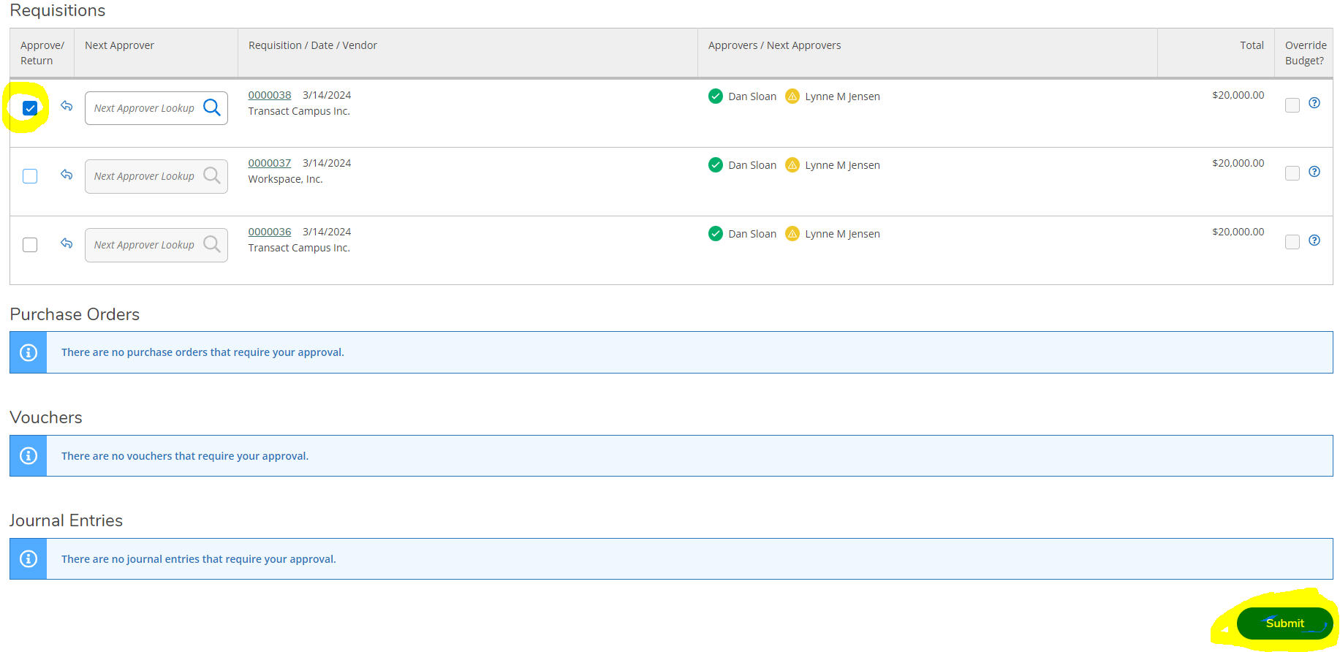
To approve, checkmark the Approve/Return box, and click on submit:

Slide 10
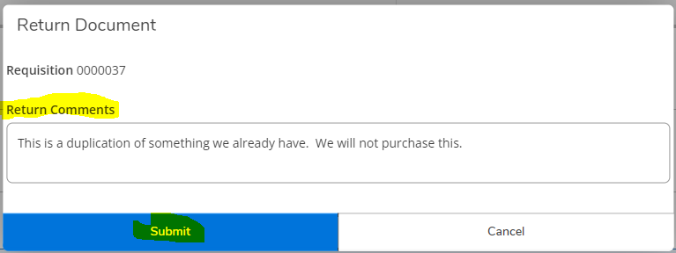
To Reject/Return, click on the arrow, and you will be prompted to enter a reason. Be as detailed as possible.

Slide 11
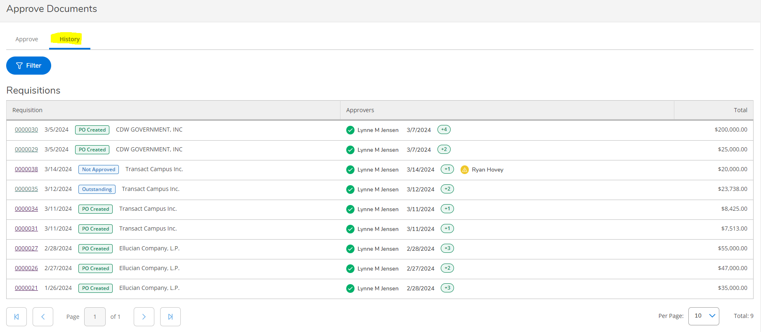
Under the History tab, you can see all you have already processed. You can filter, and you can click on the requisition number to see more details. You will see the current status (such as PO Created, Not Approved, or Outstanding).

Slide 12
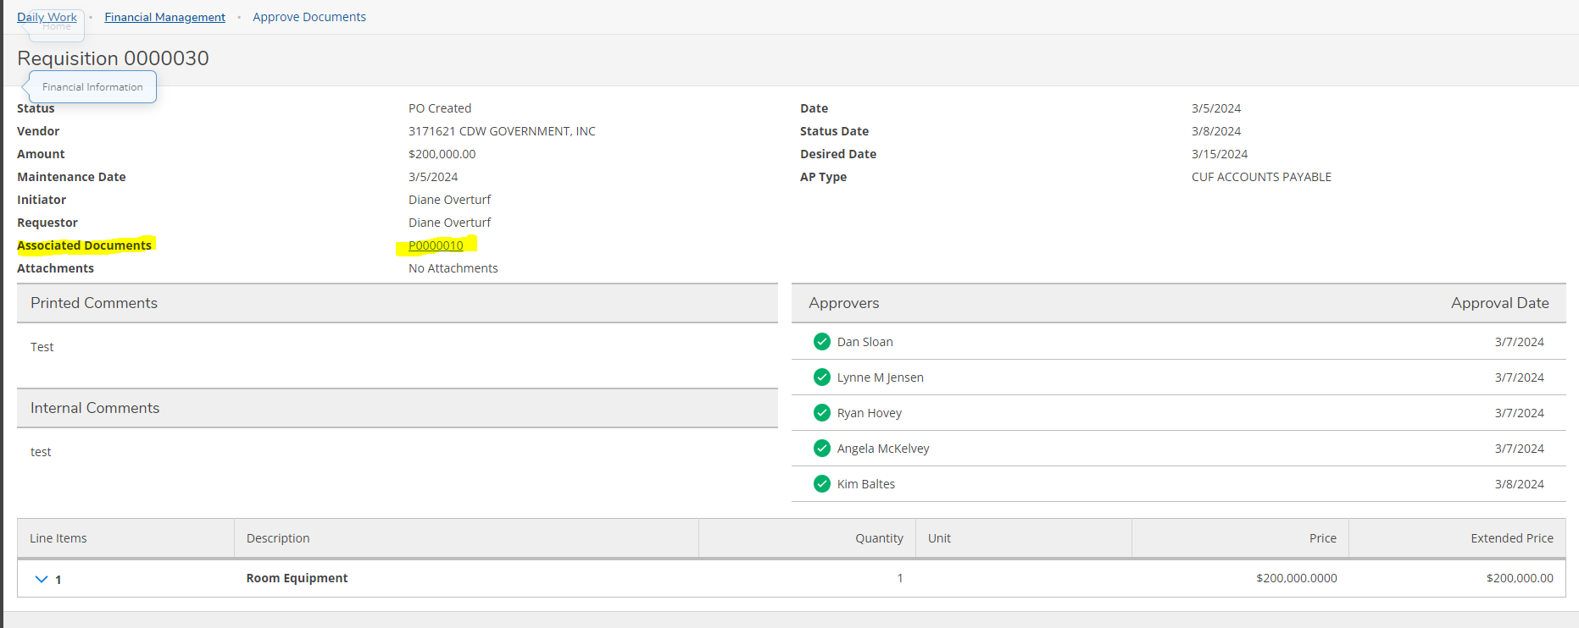
On the details page, you can find the Purchase order number, and the list of all the approvers:

Slide 13
Farther down on the history page, you can also see Vouchers that you have approved:

Slide 14
Prepay Accounts 10-0015-115100 Definition of Prepaid expense: is an asset on the balance that results from a business making payments for goods and services to be received in the future. Examples of Prepaid expense: memberships, maintenance contracts, subscriptions, insurance contracts

Slide 15
All expenses are Current Unrestricted In other words- all expenses must be paid out of Fund 10 & Fund 63 Expense accounts start with 67xxxx

Slide 16
Reminders: We cannot pay from a quote. We must have an official invoice before payment is processed. A requisition is created when goods/services are needed. A Payment Request is used for travel/reimbursement. New vendors will need to be set up Accounts Payable. A W-9 is required.
Travel/Reimbursement Checklist:
Completed Mileage/Travel Form
Mileage Figured Correctly (.67/mile)
Copies of ALL receipts
Gas, Hotel, Rideshare, Flights, Food, Registration, supplies, etc.
Copy of map confirming distance traveled (only needed for mileage reimbursements)
Approved by all required parties
Correct GL listed

Slide 17
Please reach out with any questions you might have. Jessica Danielson: Jessica.Danielson@simpson.edu Ext: 1317 Thank You.

