Slide 1
Videoscribe
The Teaching and Learning Center

Slide 2
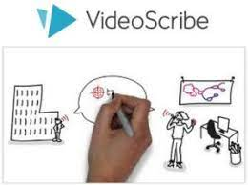
AGENDA
What is Videoscribe?
When to Use Videoscribe
Videoscribe in Action: Live Examples
How Videoscribe Works: the Process
How do I Access Videoscribe?
Q&A

Slide 3
What is videoscribe?
Video animation software
Gives people the ability to create animated videos easily
Over 11,000 images to choose from to support your video – just select, drag, and drop into place
Educational templates available if you’re not sure how to start
Has animated hand option to “write out” the text in your presentation

Slide 4
Potential ways to use videoscribe in your classroom:
Introducing yourself in a new, creative way (there is an introduction video template that already exists – just fill it in!)
Showing the classroom rules/expectations (there is already a pre-made template on Videoscribe for this purpose – you would just fill it in!)
Illustrating new topics and concepts for students
Tutorials and how-to videos for procedures in your class
Recap your lesson – create a 1-2 minute animated video illustrating the key takeaways from a certain class

Slide 5
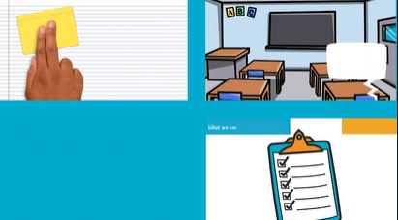
Different examples of videoscribe videos:
https://www.videoscribe.co/en/using-videoscribe/

Slide 6
How to create a presentation using videoscribe:
Log in
You can either create a project from scratch, or choose from a template

Slide 7
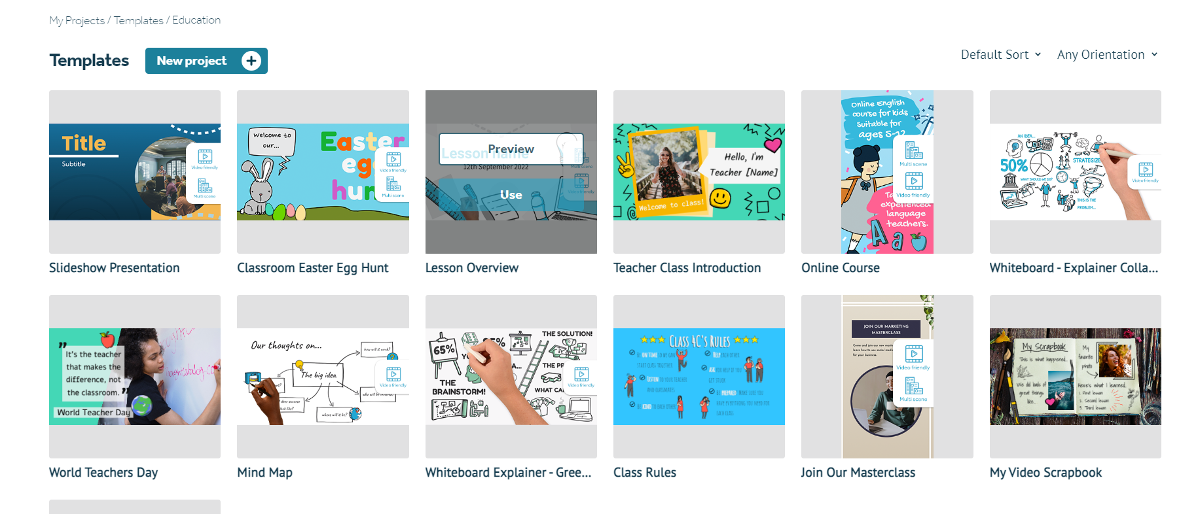
How to create a presentation using videoscribe:
You can view all the templates available in the “Education” section – for each template, you can click “Preview” just to see the flow of it, and if you like it, click “Use”

Slide 8
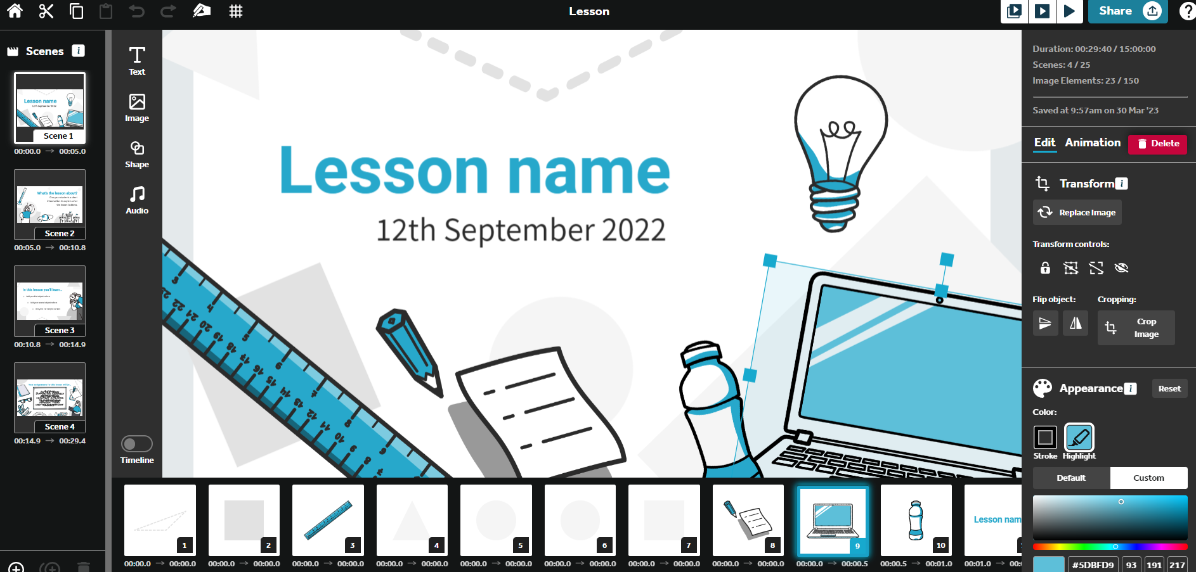
From there – you can customize everything that you want – images, audio, animation, text, etc.

Slide 9
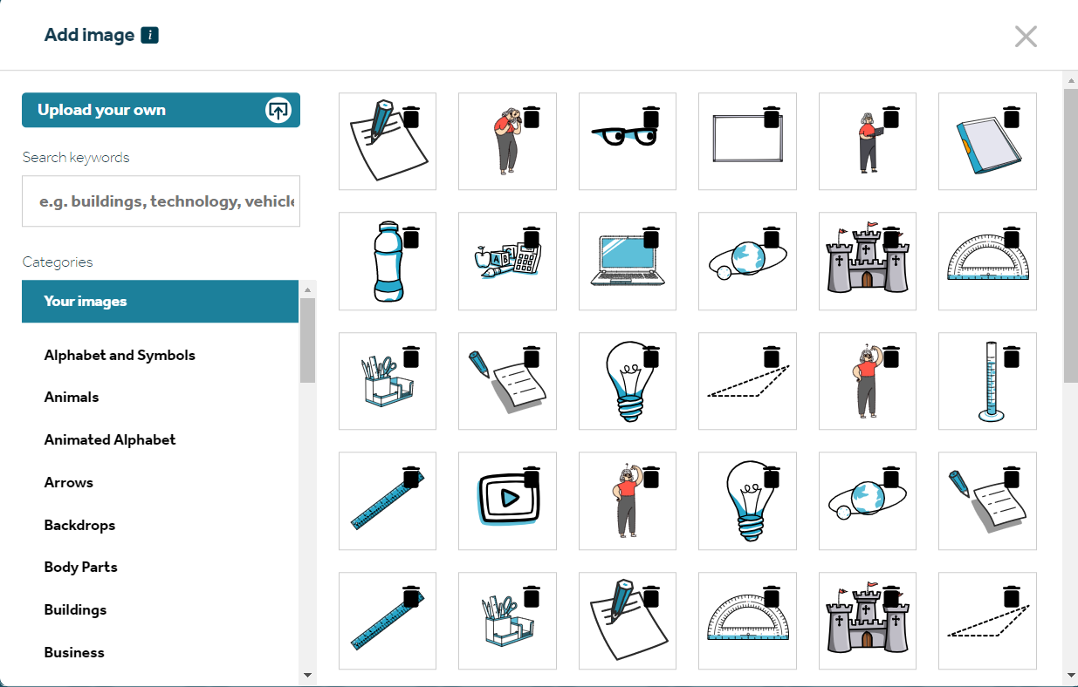
Image library – highly customizable

Slide 10
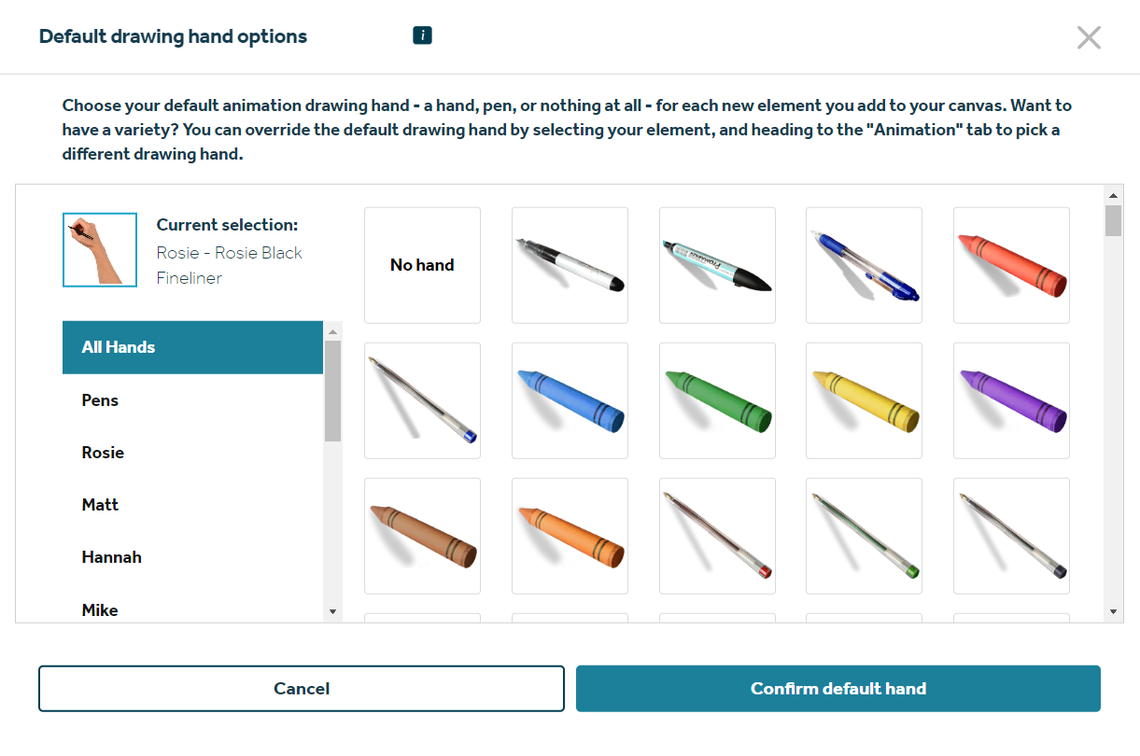
Animation – add a writing tool!

Slide 11
Audio – add voiceover, or music Suggestion: make a script, read it out loud, then sync the rest of your lesson around your voiceover – or it doesn’t really work (I learned this the hard way)

Slide 12
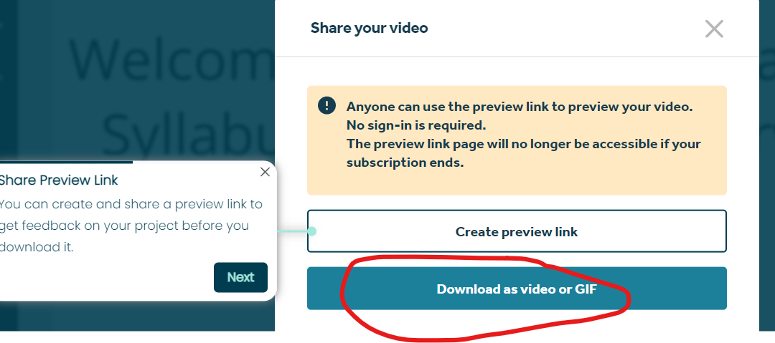
When you’re done – share your video make sure to download the video so that its existence doesn’t depend on a subscription!

Slide 13
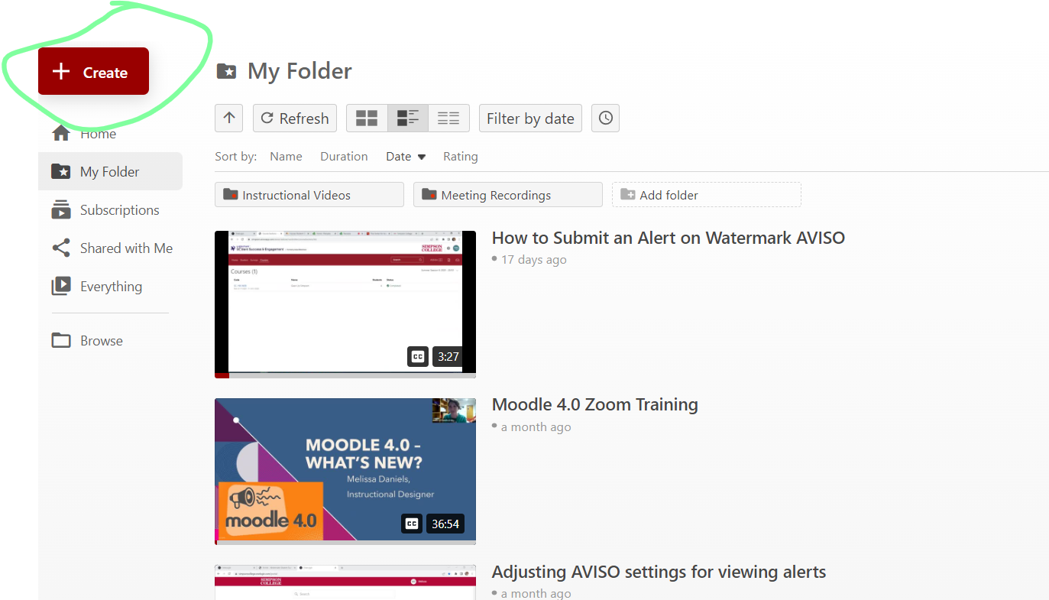
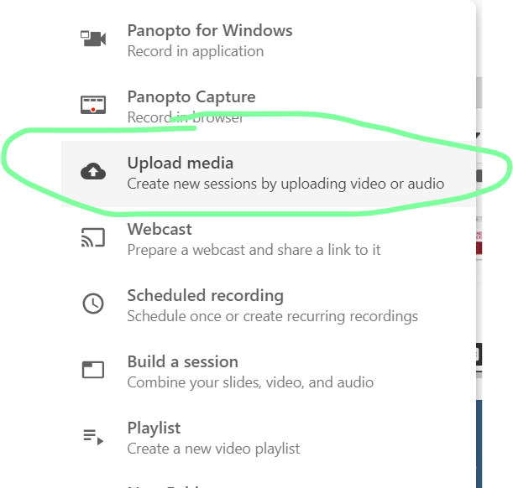
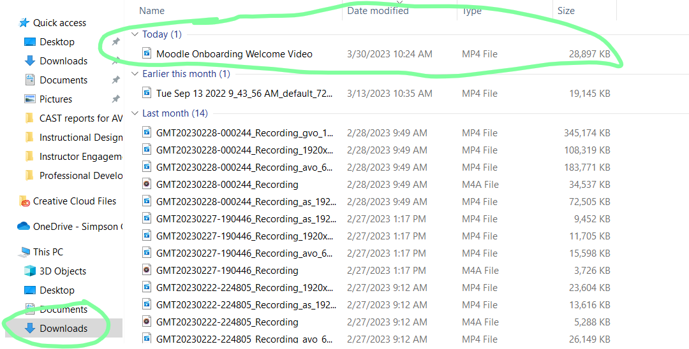
Then – go to Panopto and upload the video there – it can be found under downloads

Slide 14
it does take a little bit of playing around to figure everything out!
Suggestion: Use templates first to get used to the animation styles and methods
Browse the image library to see what might work for you
Write out a script if you’re using the voiceover
Use YouTube tutorials if you can’t figure out how to do something – there are a lot of them!

Slide 15
How do you get access to videoscribe?
Simpson has a subscription to Videoscribe!
If you’d like to create a video using Videoscribe, you need to e-mail Lynne Jensen (lynne.jensen@simpson.edu) so she can give you the Simpson User ID and password information for Videoscribe.

Slide 16
THANK YOU!
Melissa Daniels
melissa.daniels@simpson.edu

