Slide 1



Using Padlet and Nearpod

Slide 2



Agenda
The purpose of using tech apps as formative assessment
Padlet – what it is and how to use it
Nearpod – what it is and how to use it
Q&A
*NOTE*: This presentation will be interactive so you can actually play with these apps a little bit!!

Slide 3

Technology apps – why use them during in-person courses (as well as online)?
Easy way to monitor progress and collect data in real time
Allows different opportunities for discussion.
Allows for practical work with technology in a rapidly tech-progressive era
Varies the methods of engagement for students

Slide 4
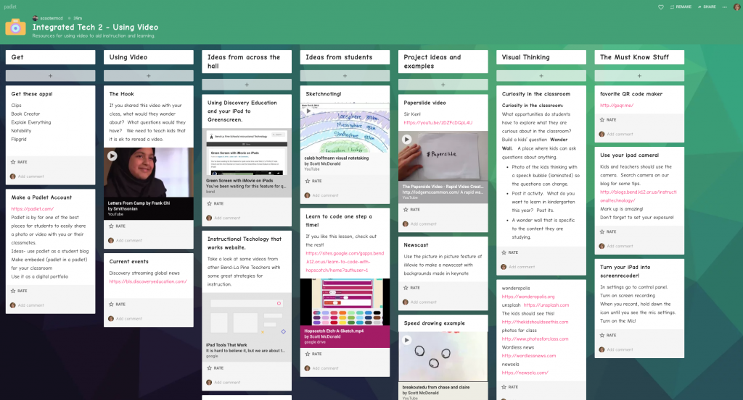
Padlet
https://padlet.com/
Padlet is a space in which students can make a quick note about something they have learned or experienced in class.
Think of it as a digital exit ticket – a quick way to compile informal bits of information.
Plus, it’s free!

Slide 5
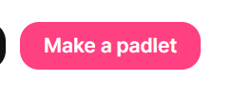
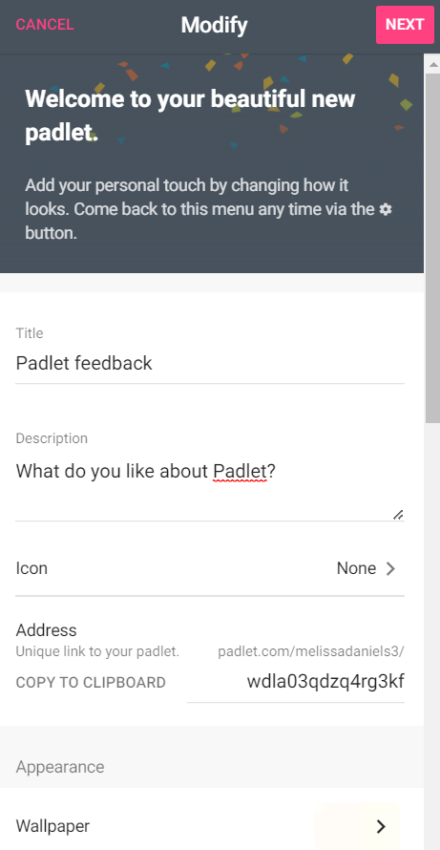
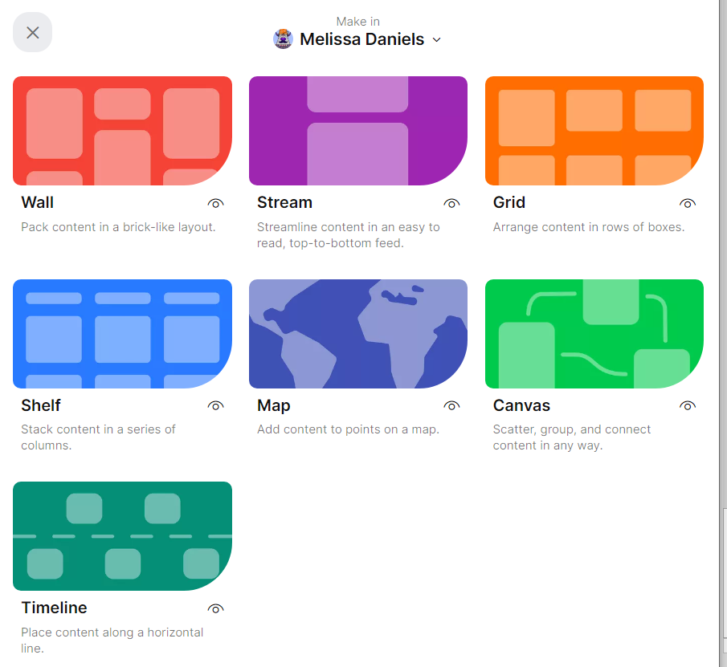
How to create a Padlet – VERY EASY!
Click “Make a Padlet”
Choose your layout!
Modify your Padlet – give it a title, a certain color, etc.

Slide 6
How to Create a Padlet
Make sure to copy the address of your Padlet - that is how you can display it to students!
Click next – and that’s it! Your Padlet is ready to go!

Slide 7
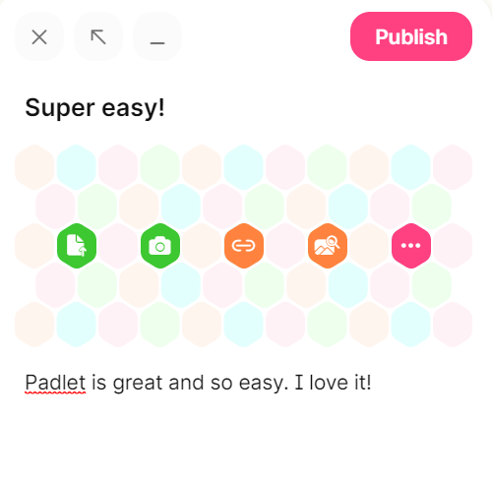
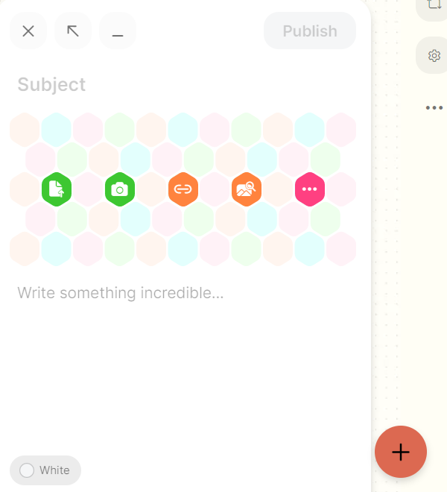
Writing on a Padlet
Then, click publish!
To contribute to a Padlet –
Click on the link provided
Press the + sign at the bottom of the screen
Students can add text, pictures, links, etc.!

Slide 8

Nearpod – an interactive way to present
Can be used in conjunction with PowerPoints you have already made
Adds options for interactive activities like polls, quizzes, doodles/drawings, etc.
Students can access Nearpod on their devices, while the instructor controls the content!
It’s free to use!

Slide 9
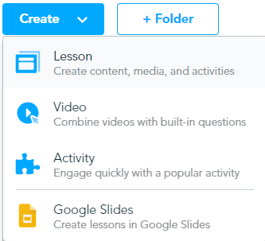
How to create a lesson:
Go to “Create” and select Lesson
You also have the option to upload videos and add built-in questions to the videos if you want students to interact with a video!

Slide 10
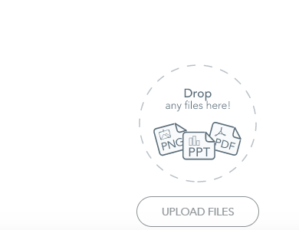
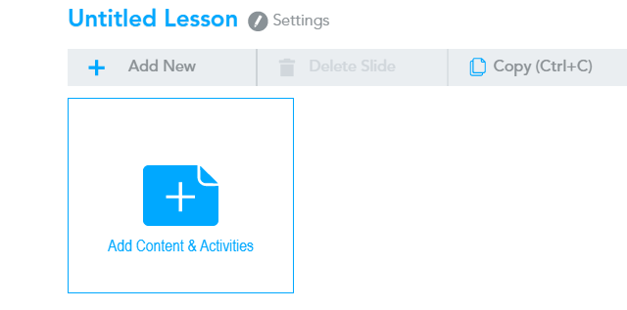
You can create the PowerPoint in Nearpod itself, OR you can drop an already-existing PowerPoint presentation into the website – whatever’s easier for you!
OR

Slide 11
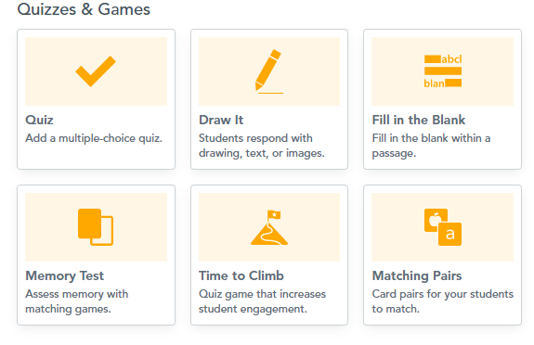
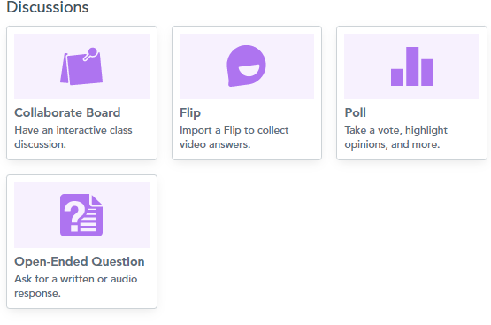
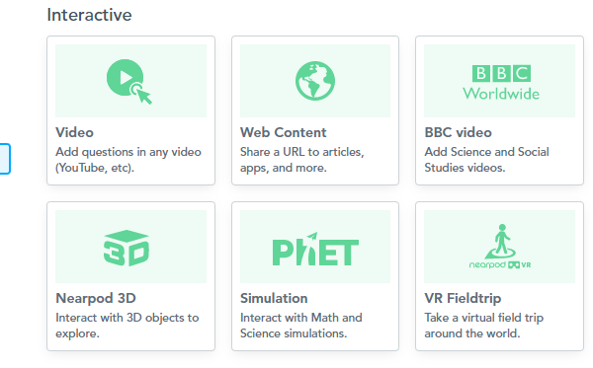
Within your PowerPoint on Nearpod, you can:
Or add activities such as quizzes, games, or interactive discussion options.
Add interactive content, such as videos, web content, etc….

Slide 12
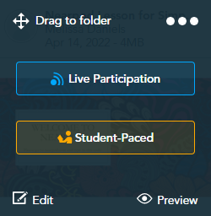
When you’d like to present your Nearpod to students:
Go to “My Lessons”, then “live participation” if you’d like to do this Nearpod WITH your students. If you are in a fully online class, then select “Student Paced”.

Slide 13
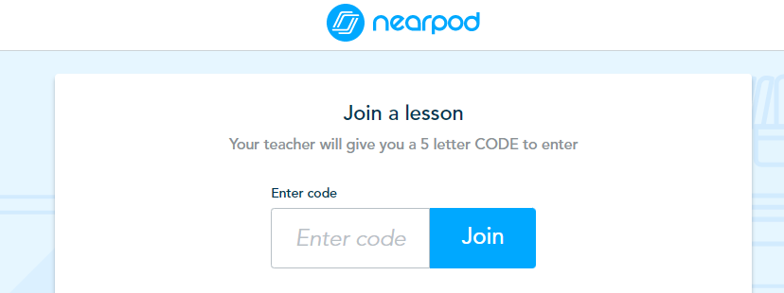
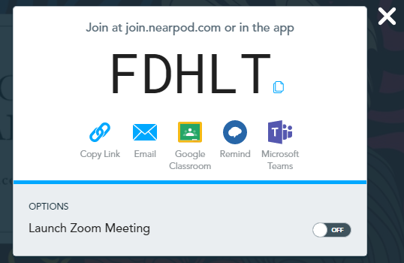
You will tell students:
Go to join.nearpod.com
Then click the code that generates for you on your side – should be a five-letter code
What they see:
What you see (or you can just display this on your screen as well):

Slide 14
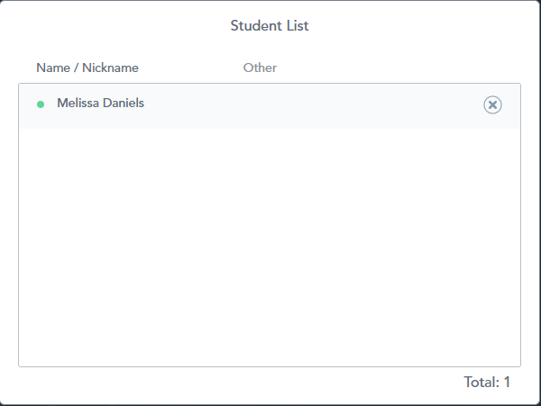

Once you have started the lesson, you can monitor the participants AND see if they’re still on your screen and not browsing somewhere else!
If the dot by their name is RED, they have left the Nearpod page. Depending on if you’re comfortable with your students, you can call them out and get them back on track.

Slide 15
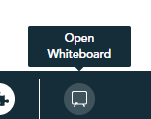
From there – run your lesson!
Some fun things to do:
There is a “whiteboard” option where you can write things down live during the Nearpod, if you’d like!
You can also add additional activities on the fly, if you want to.
Every time you move ahead in your slides, the students’ screens will automatically go to that next slide.
Mix it up with lots of different activities – makes things more interactive for students, and also a very easy way to check for understanding in a lesson.

Slide 16
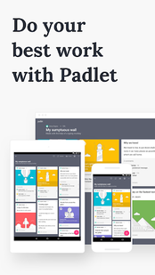
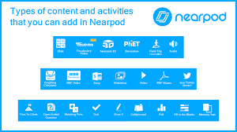
Note: Both of the websites I’m showing today do require a sign-up for you to create them.
However, sign-up is FREE, and students do NOT need to have an account to use either of these websites!!
These websites can also easily be utilized during in-person, hybrid, OR online courses – very versatile!

Slide 17
Any questions?
If you’d ever like to try anything like Padlet or Nearpod and need additional assistance, feel free to e-mail the instructional designer:
melissa.daniels@simpson.edu
I am happy to help you!

