Slide 1
The Workshop Activity
Melissa Daniels, Instructional Designer

Slide 2
Peer assessment
Peer assessment – when learners review and assess each other’s work with guidance from the instructor
Learners provide feedback on quality of peers’ work, and offers improvement suggestions
Benefits: it enhances and personalizes the learning experience, helps learners gain insight about their own work during peer comparisons
What is a good way to do this online?
Moodle has a potential way to achieve workshopping in class: the Workshop activity!

Slide 3
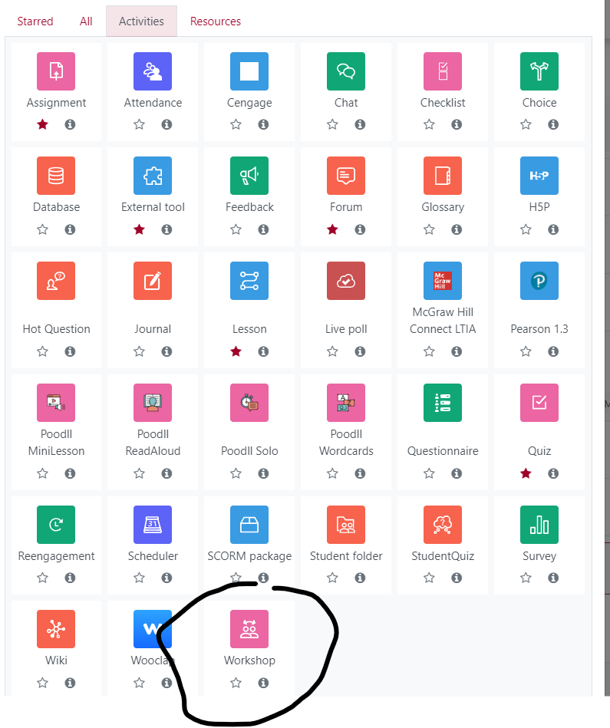
Setup – where is workshop?
With “Edit Mode” on:
Go to “Add an Activity”:
Click “Workshop” under “Activities”

Slide 4
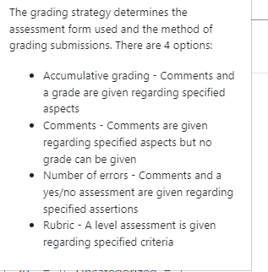
Some of the settings:

Slide 5
Some of the settings:

Slide 6
Some of the settings:

Slide 7
Some of the settings:

Slide 8
Phase interface – has lists of tasks for you to complete for each phase of workshopping!

Slide 9
Allocation settings – who is in charge of assessing whom?

Slide 10
Allocation settings – who is in charge of assessing whom?

Slide 11
Submission phase

Slide 12
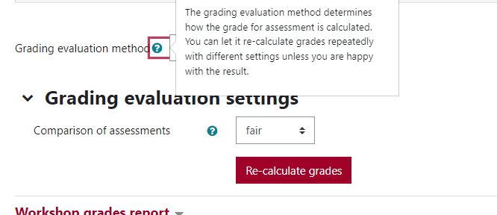
Evaluation phase

Slide 13
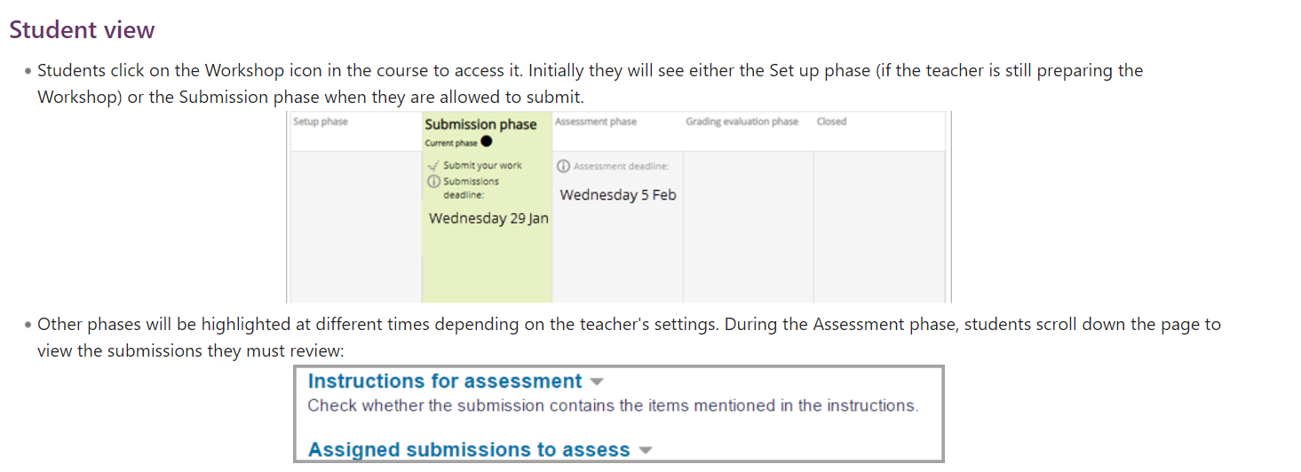
What does student view look like?

Slide 14
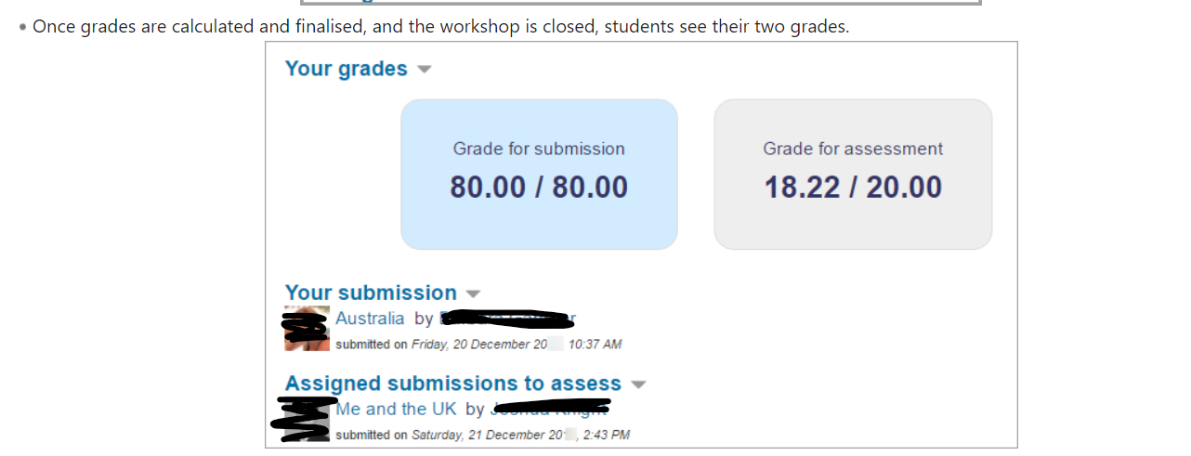
What does student view look like?

Slide 15
What’s nice about this workshop activity?
Once the set up is done, the rest should flow pretty easily
You can re-calibrate scores until you land on something that seems fair and accurate
You can be specific in what students need to look for, AND their feedback needs to be valuable because it becomes a grade for them!
Creates a workshopping atmosphere, even digitally.

Slide 16
Easy place to find more information:
You should all be registered for a Moodle course called “Advanced Features of Teaching and Learning – v 4.0”.
Details about how to set up a Workshop activity, with more detailed explanations about each component, can be found there!

Slide 17
THANK
Melissa Daniels
melissa.Daniels@simpson.edu
You

