Slide 1
Using Student Engagement Data in Moodle
Melissa Daniels

Slide 2


Agenda
A
Instructor Dashboard – where is it?
Different report options on Instructor Dashboard
Moodle reports – where are they?
Q&A

Slide 3
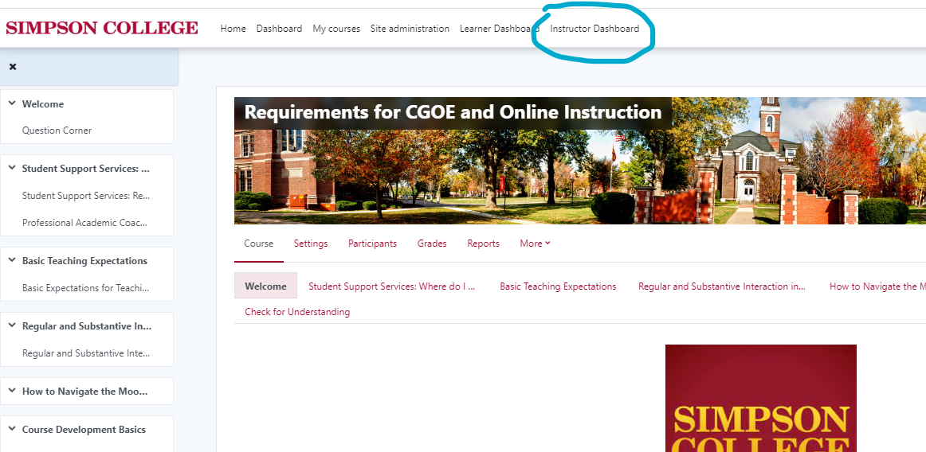
Instructor Dashboard
Click at the top of your screen on your Moodle Course to see your Instructor Dashboard.
This is a great way to monitor student activity in your class!

Slide 4
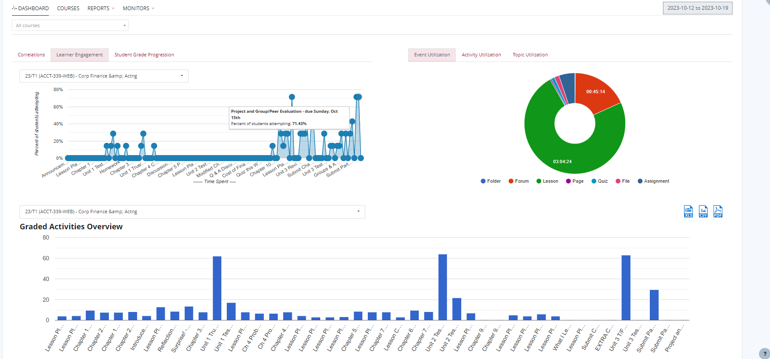
Instructor Dashboard – What you see right away
How many students participated in this activity
Amount of time spent in an activity
Points on an assignment

Slide 5
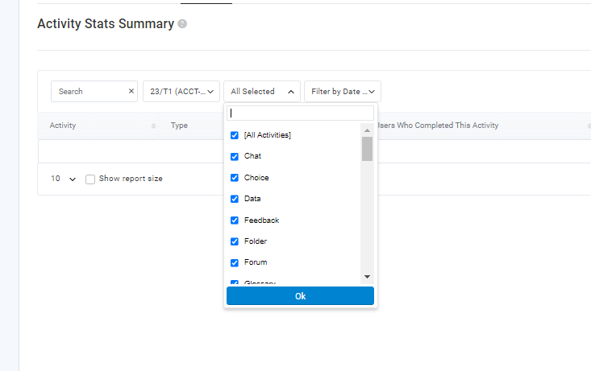
Instructor Dashboard
You can access various reports that can track the time a particular student has spent in a course, how much they’ve participated in a forum, and even see the most common times that students are active in your course.

Slide 6
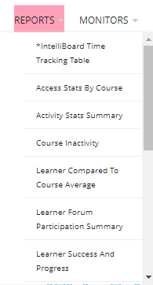
A lot of the best data comes from the “Reports” drop-down

Slide 7
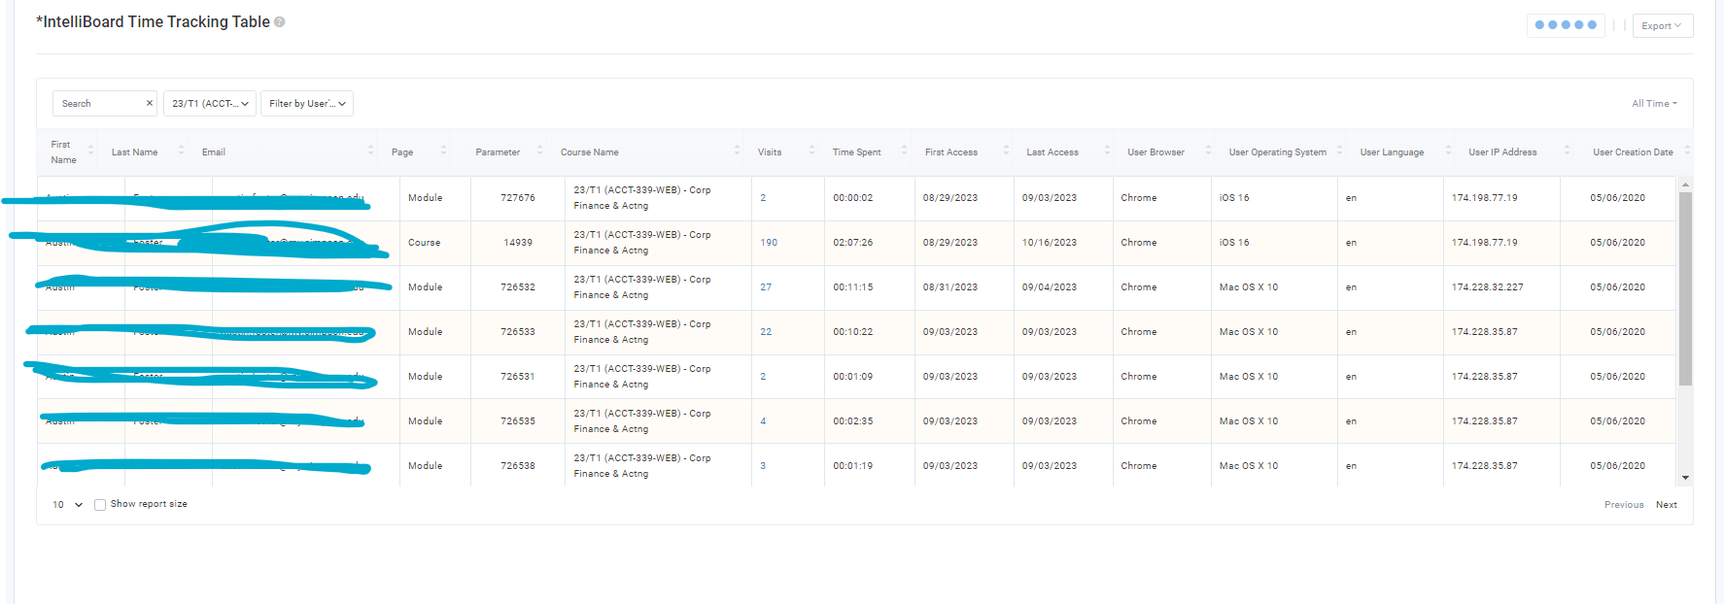
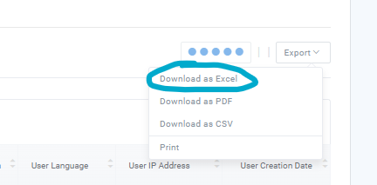
Time Tracking Table

Slide 8
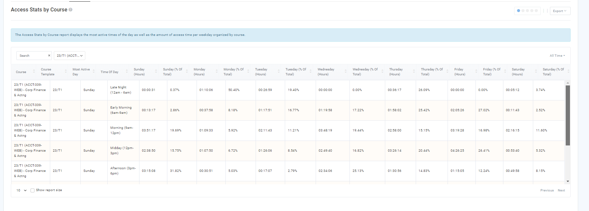
Access Stats by Course

Slide 9
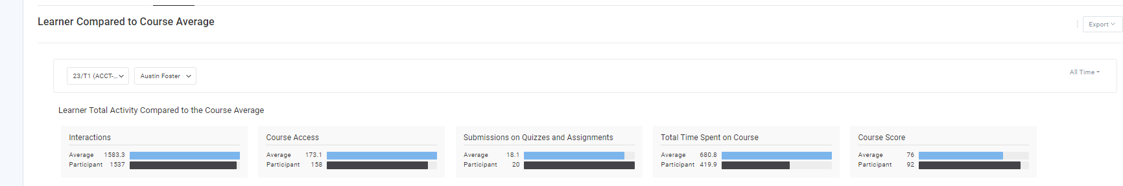
Learner Compared to Course Average

Slide 10
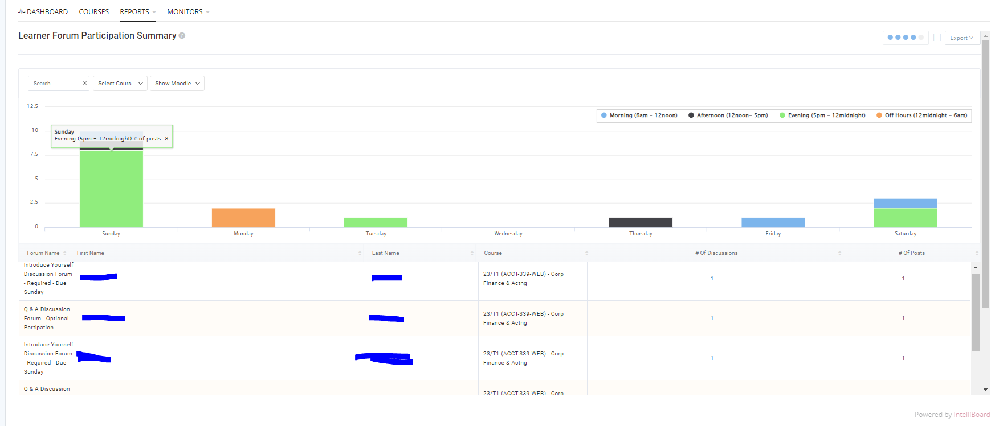
Forum Participation Summary

Slide 11
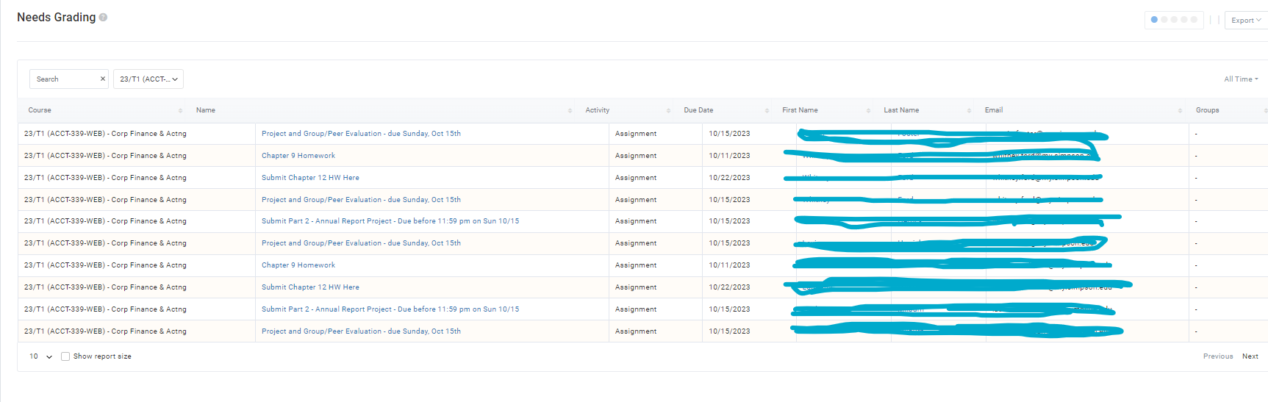
Find out what needs to be graded in a list that can be exported!

Slide 12
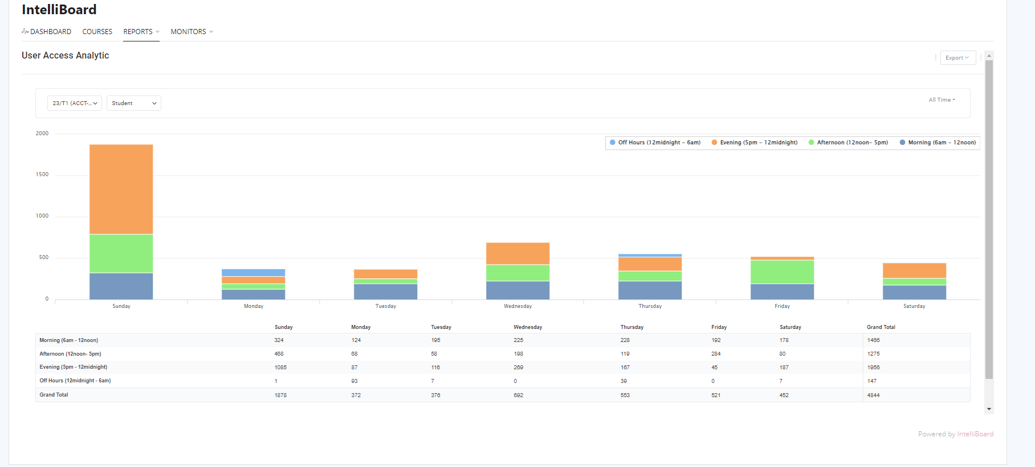
User Access Analytic

Slide 13
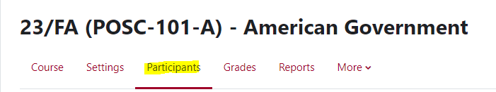
Another option to monitor student activity – through Moodle!
To see student activity in Moodle:
Open the course and go to participants – select the student
Under reports there are a few options to choose from!

Slide 14
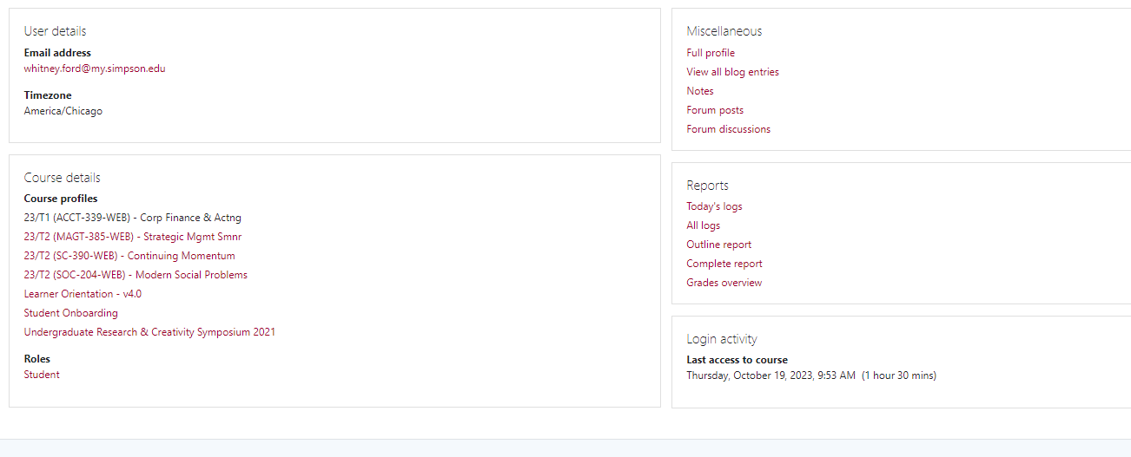








Moodle Reports and Monitoring
Clicking on the report options below will give you a summary of how many times a student viewed an activity and when, as well as a list of all their grades! You can also see when they last accessed the course.

Slide 15
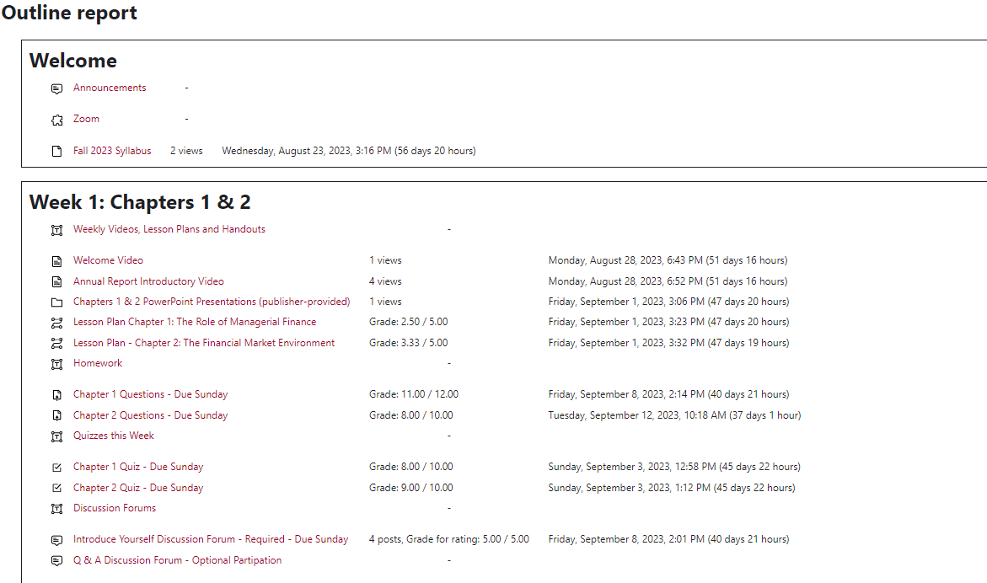
Outline Report

Slide 16
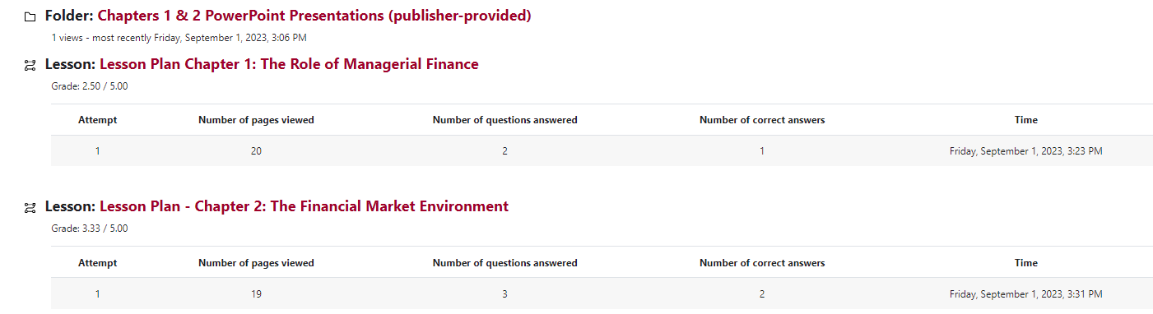
Complete Report – just more thorough, includes point allotment and feedback

Slide 17
Thank you
Melissa Daniels
Melissa.Daniels@simpson.edu

