Slide 1

How to Make and Upload a Video Using Zoom and Panopto
The Teaching and Learning Center

Slide 2

Agenda
Making a Video on Zoom
Making a Video using Panopto
How to Upload a Video to Moodle using Panopto
Q&A

Slide 3

Making a Video on Zoom
Very easy to do –
Just need to hit “Record” when you are running a Zoom meeting!
This can be found under the “More” Options – just record to the Cloud

Slide 4
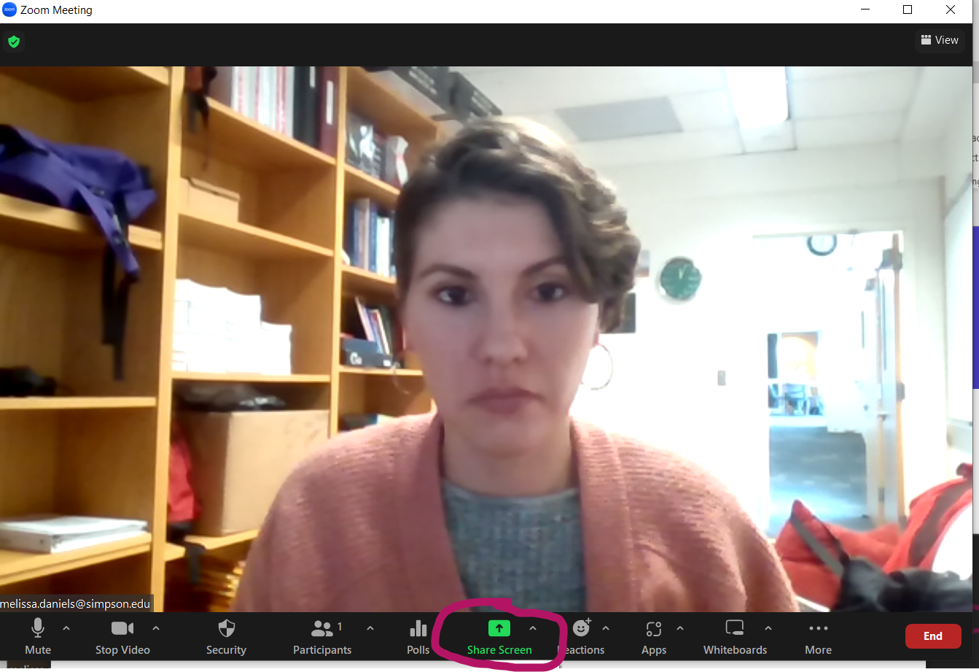
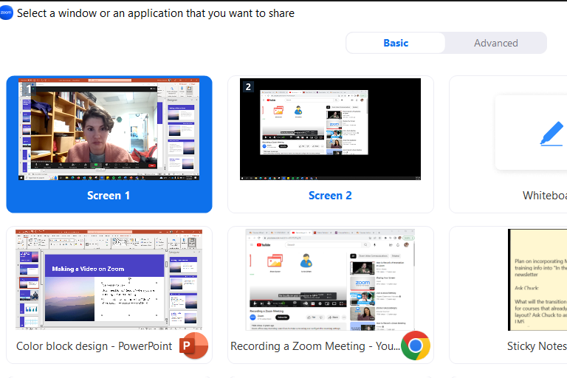

Steps to recording a presentation (or class):
1) Find “Screen Share” on the bottom – make sure you’re sharing the correct screen for your audience

Slide 5
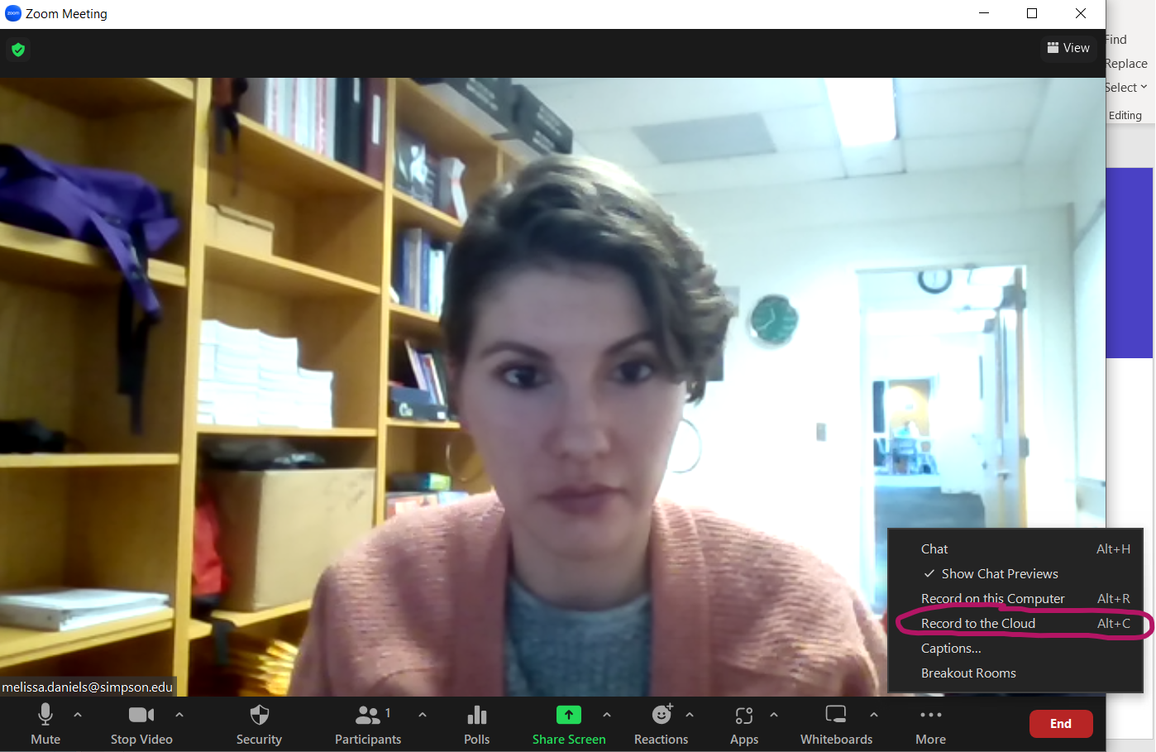
Steps to recording a presentation (or class):
2) Click on “More” on the very right-hand side of the Zoom screen to see the additional options. Click “Record to the Cloud” so it does not use as much storage space!
The recording will show up in
your e-mail shortly after you are
done with your session/class
and have ended your class.

Slide 6
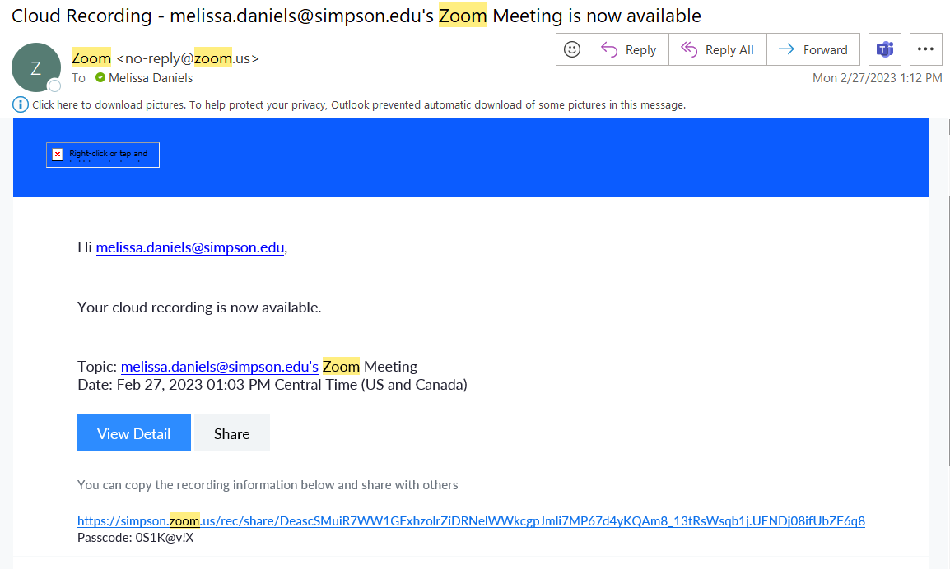
Your Zoom e-mail will look like this:

Slide 7
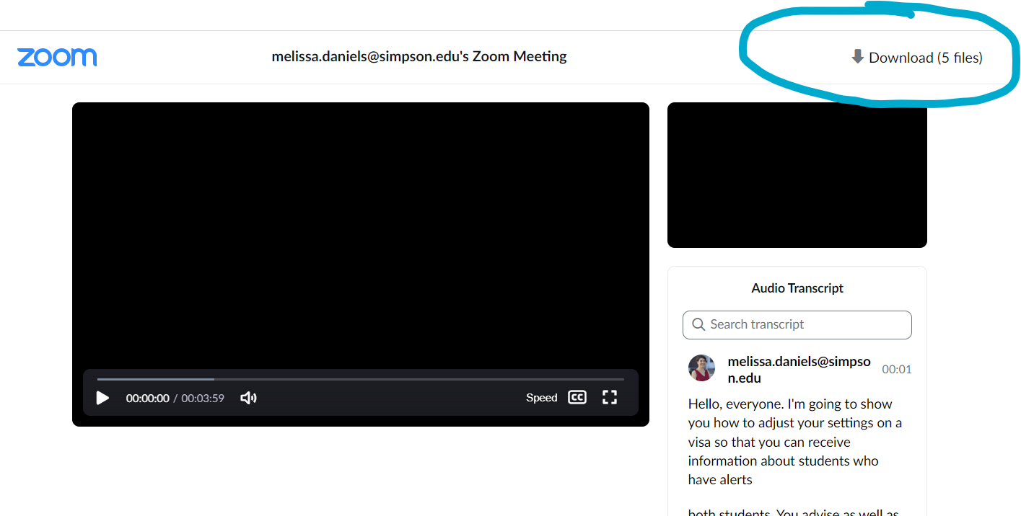
Click on the link and put in the password to get to your Zoom recording, then click “Download”

Slide 8
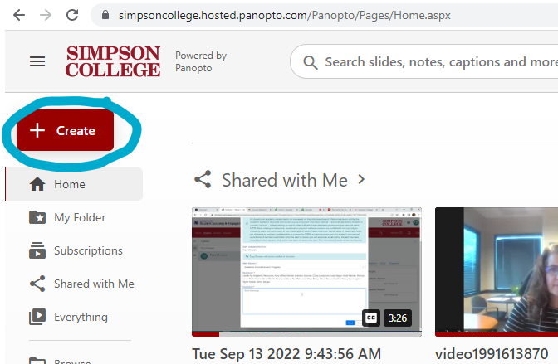
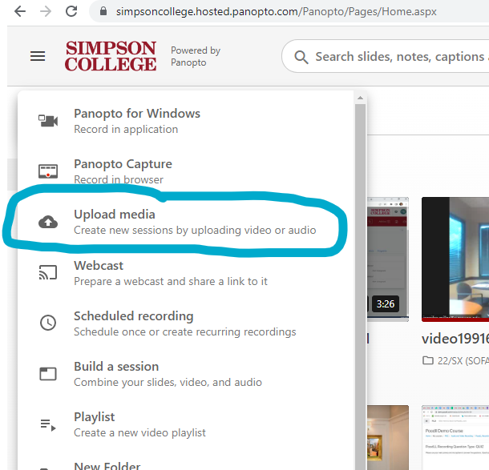
To get to Panopto in order to upload your Zoom video:
Go to https://simpsoncollege.hosted.panopto.com/
Type in your e-mail address if requested (first.last name)
When you get to the home screen, click “Create”,
then “Upload Media”

Slide 9
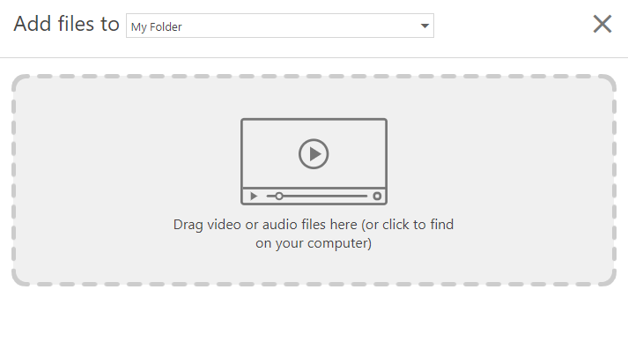
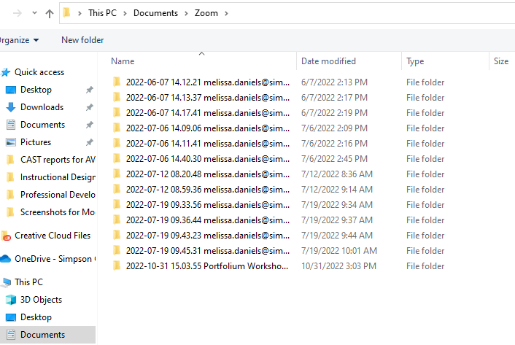
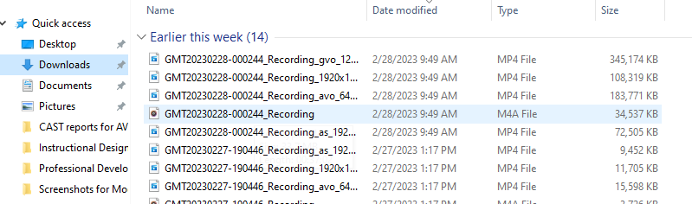
To get to Panopto in order to upload your Zoom video:
From there, click to find on your computer:
Look in “Downloads” to find the recording that you made (if you recorded to the cloud) or “Documents” – “Zoom” if you recorded to your computer

Slide 10
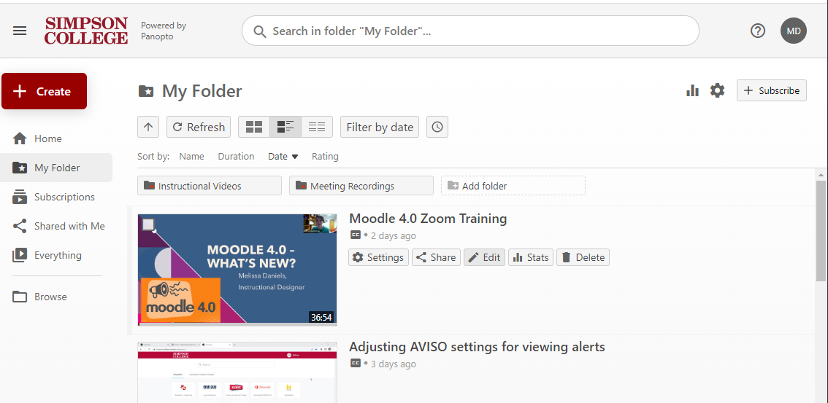
You can find your videos in “My Folder”, where you can edit and make sharing adjustments as needed!

Slide 11

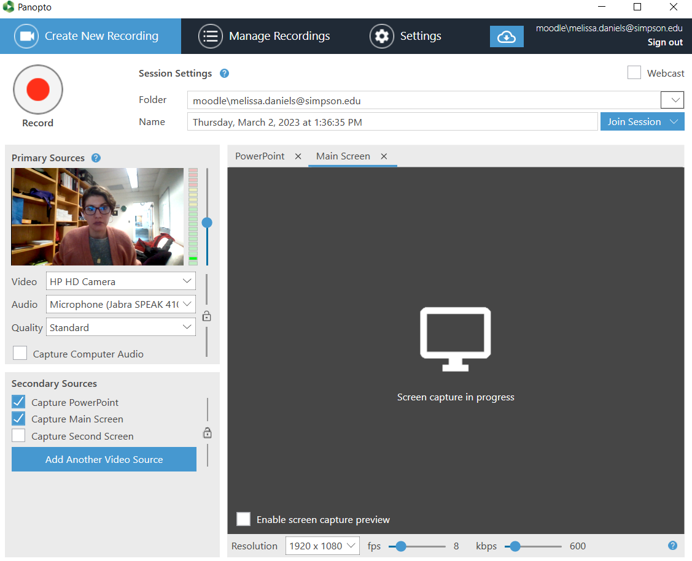
Recording video using Panopto
Click on Panopto icon (you should have this on your desktop)
When you do so, it will open up a screen that looks like this:

Slide 12
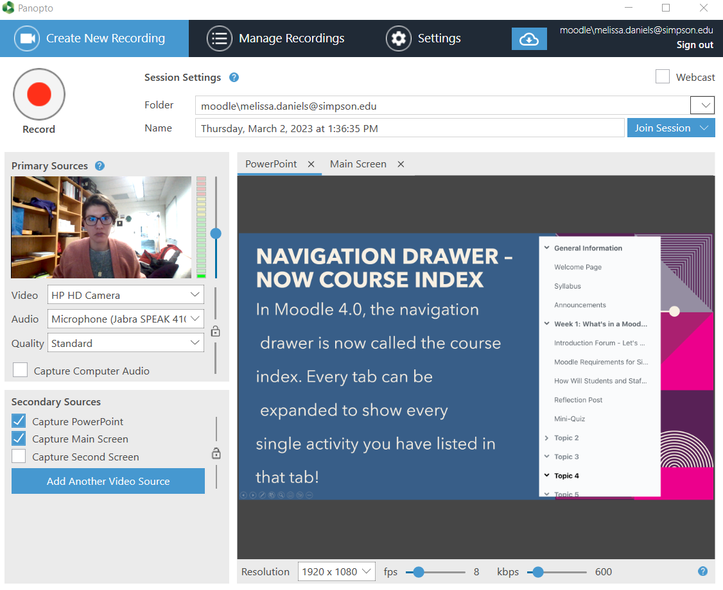
Recording video using Panopto
Get your PowerPoint set up, and put it into presentation mode – That way it will show up on the source screen!
When ready, hit record. This session will automatically go into a Panopto folder for you!

Slide 13
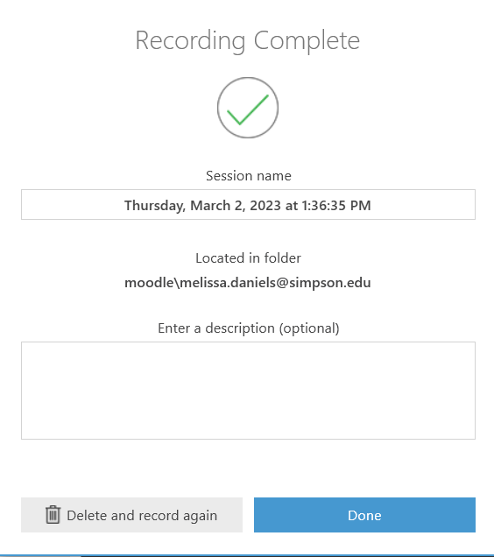
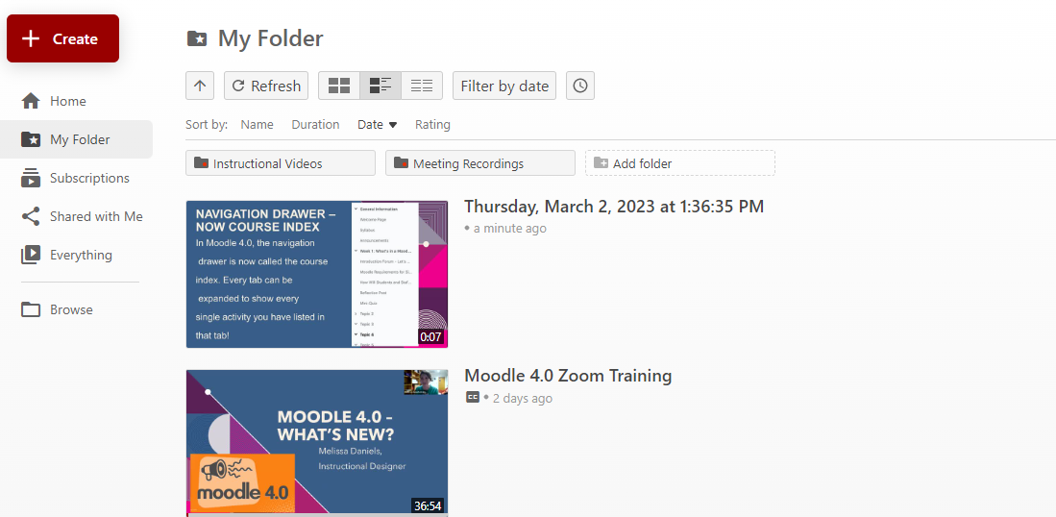

Recording video using Panopto
The nice thing about using the Panopto recorder, although it initially LOOKS more complicated, is that every recording goes directly into your folders on the Panopto storage site
(simpsoncollege.hosted.panopto.com)

Slide 14
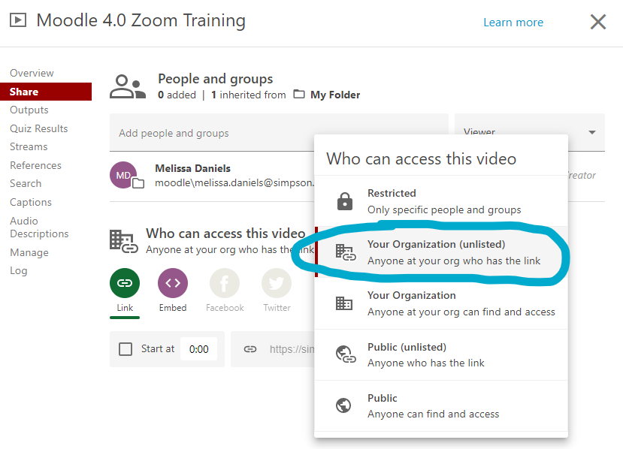
Important! Make sure you adjust your share settings for privacy to “Anyone at your org who has the link” – otherwise, it defaults to “Restricted”, so no one will be able to see it

Slide 15
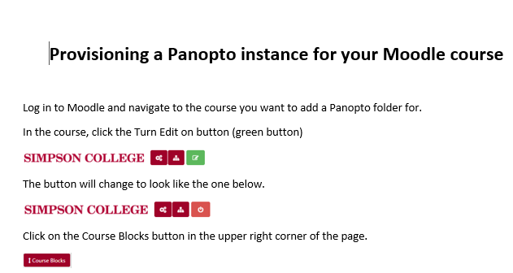
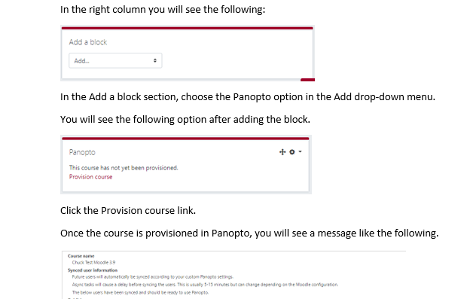
Adding videos to your class using Panopto
IMPORTANT – your course needs to be provisioned before you will be able to upload using Panopto – you will get a sad error message if you have not done this part!

Slide 16
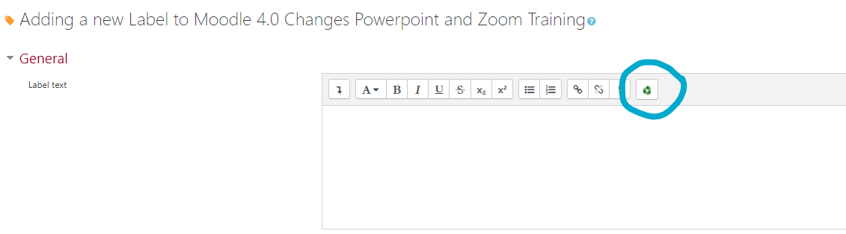
Adding videos to your class using Panopto
Within the text box on your Moodle page, click on the green Panopto icon.

Slide 17
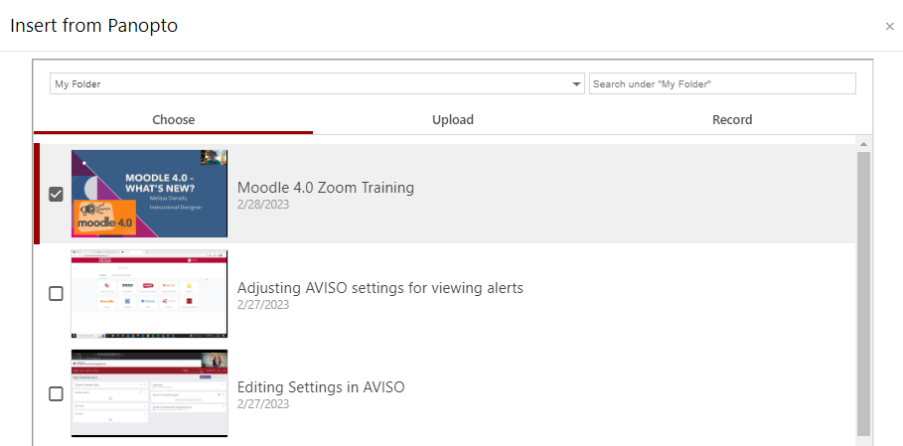



Adding videos to your class using Panopto
Go to “Choose”, then change to “My Folder” (or wherever you have decided to store your videos). Once you’ve selected one, click “insert” on the bottom.

Slide 18
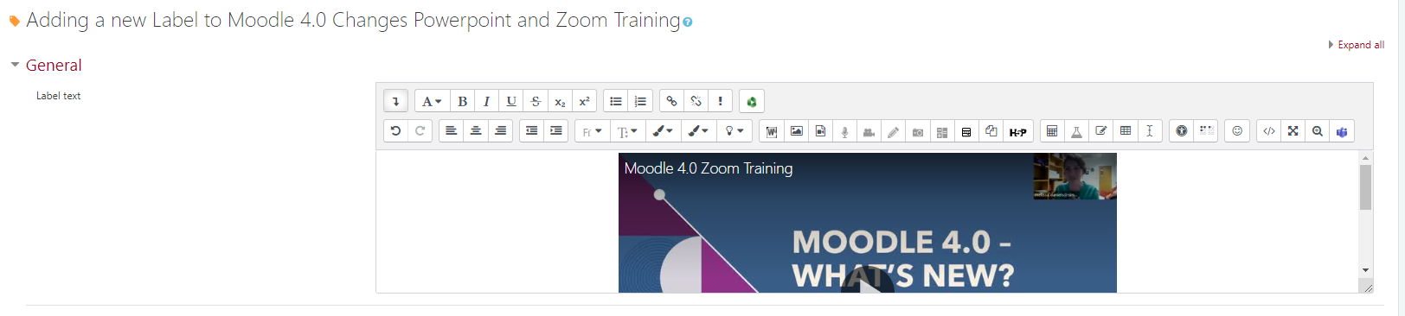
Adding videos to your class using Panopto
Once you’ve done that, your video should be present! Just click on the video and the center bars if you’d like to center your video.

Slide 19
Q&A
Any questions?

Slide 20


Thank you!
Melissa.Daniels@simpson.edu

