Slide 1
How to Create QR Codes to Save Paper
Melissa Daniels

Slide 2
Agenda
Why QR Codes?
When Could You Use QR Codes?
How to Make and Use a QR Code
Best Sites to Use for QR Codes
Q &A Time

Slide 3
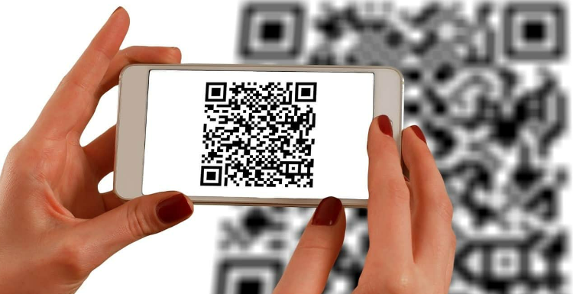
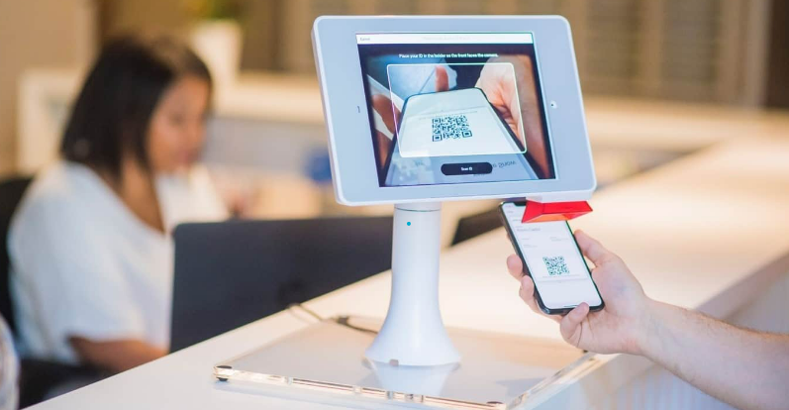
Why Use QR Codes?
Very quick access to information with just a scan of a camera phone
No more typing out a long web address on a PowerPoint and hoping that students will type it in correctly!
QR Codes are becoming more and more commonly used, especially in COVID-era times, as a way to not have to share paper or other materials

Slide 4
When Could You Use a QR Code in Your Classroom?
Sharing videos to enhance student learning
Taking Attendance
Exit tickets or Surveys
You could create a Google or Microsoft form with a link to attendance.
Students could scan the QR code and type in their names.
No more need for you to manually mark attendance each day – it’s already written on a form you can export!
Students could scan a QR code attached to a reading to get a video clip example of something you’re discussing
You could set up a “scavenger hunt” of sorts around your classroom/space where students use their phones to look at various QR codes and gather information!
QR codes are a great way to collect survey information using sites like SurveyMonkey (more on that later)
This would be a very easy way to do course evaluation forms as well

Slide 5
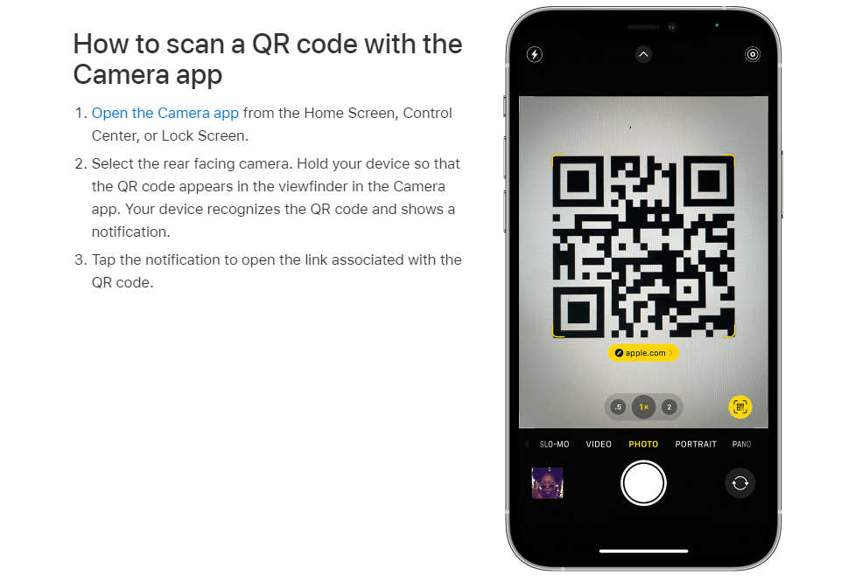
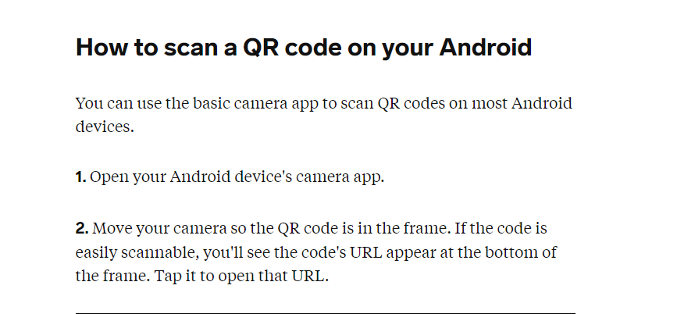
How do students/people open a QR code?
All you do is take out your phone, turn on the camera app, and hold it up to the QR code – it’ll populate the website, and then you’re there!

Slide 6
How to Make a QR Code if you are trying to share information (links, videos, etc.)
Find a FREE QR Generator website.
There are several! My personal recommendation: https://www.qrcode-monkey.com/
This one is ACTUALLY free – although it will try to redirect you to sign up for QR Code Generator for extra features, which are not free.
Click enter.
QR code generates!

Slide 7
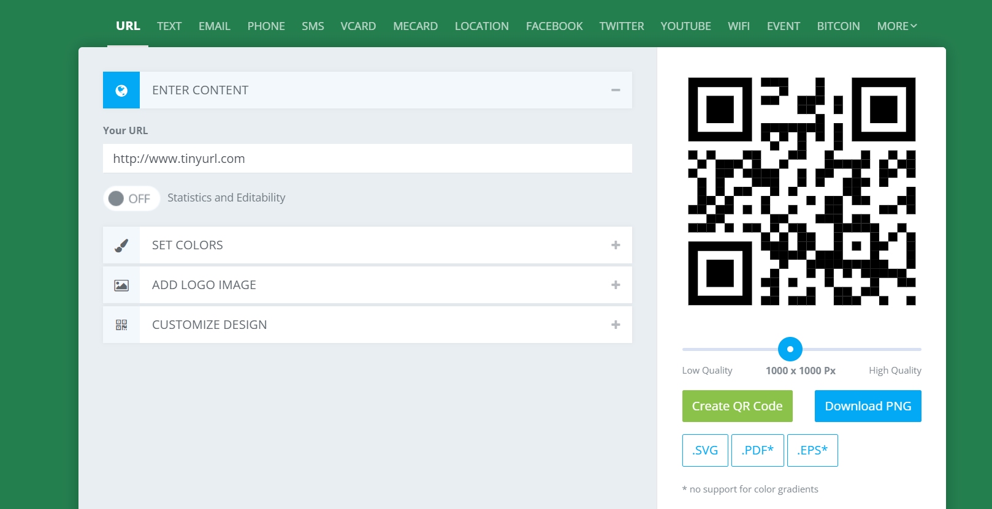


qrcode-monkey.com
Then, click “Download PNG” to download a copy of the QR code that you can copy/paste/add anywhere!
Once you type in the website, click “Create QR Code”

Slide 8
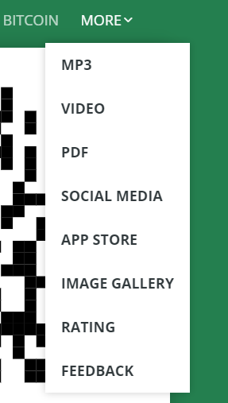
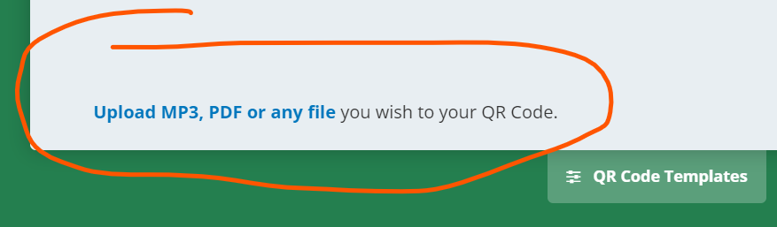
CAUTION! Certain areas of this website are NOT free:
Also not free ☹
Not free ☹ (technically links to a “free” trial period of another website, but won’t stay free forever)

Slide 9
Creating a survey? You can use Survey Monkey and create a QR code from there – we have a site license through Simpson!
You can join via this link to sign up under Simpson’s license:
https://www.surveymonkey.com/team/invitation/017b1255-29c3-41ce-af22-e851a918f6f1/
NOTE: We have not set up single-sign-on – so you do not need to use the same password that you have with Simpson College. These credentials with Survey Monkey are set up and maintained by YOU.
And – if you have an existing account through Survey Monkey, you can merge your existing account into Simpson’s license … it will prompt you to ask if you want to do that when you are signing up.

Slide 10
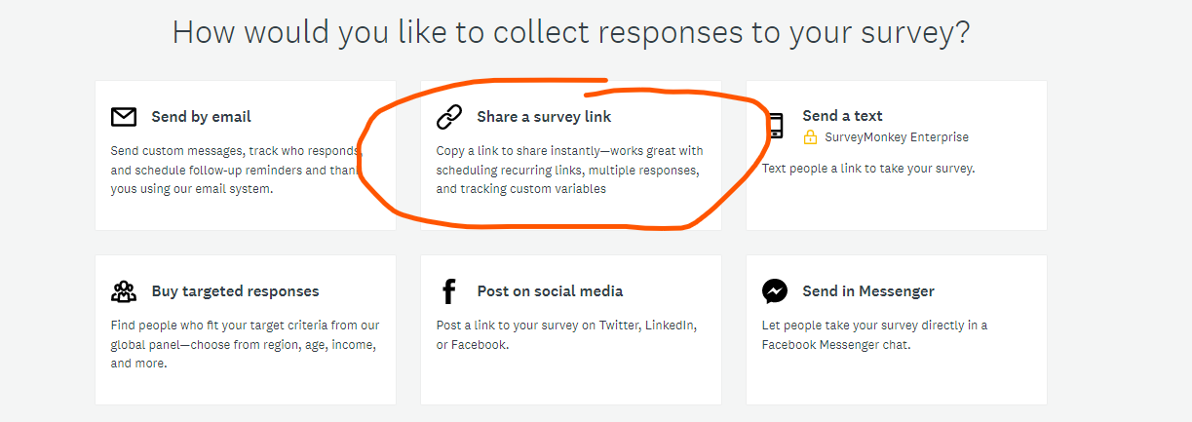
Once you create your survey:

Slide 11
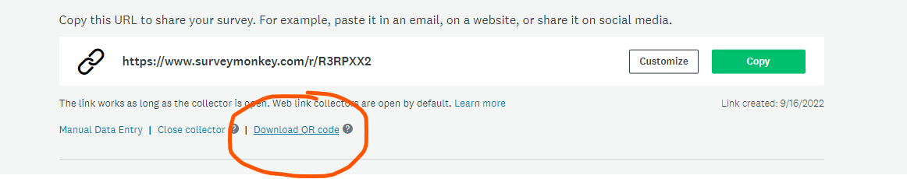
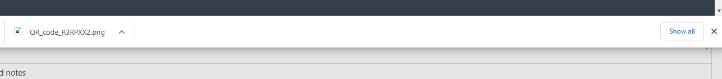

Then, click “Download QR code”
And that’s it! A QR code will automatically download at the bottom of your computer screen.

Slide 12
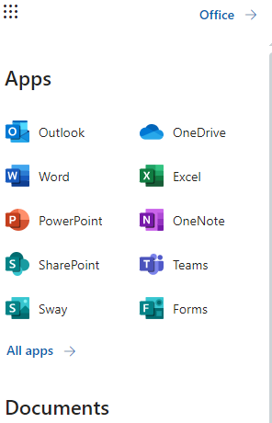

Another QR code option: Microsoft Forms
Microsoft Forms is part of your OneDrive account. Just click on the “waffle” on OneDrive to get to Forms.

Slide 13
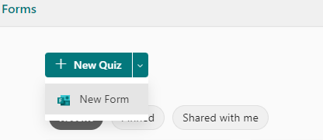

Once you’re there, click “New Form” if you want to make a survey.

Slide 14
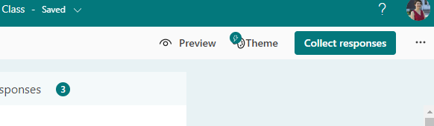

When the survey is complete, click “Collect Responses”

Slide 15
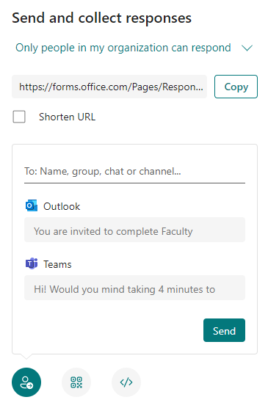
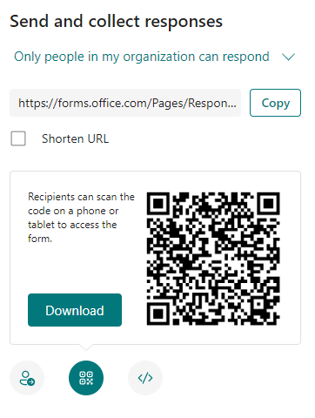

When you click on “collect responses”, you will have an option to create a QR code to display instead.

Slide 16
Note: Microsoft forms requires sign-in
Since students are logging in through their Microsoft devices, they WILL need to complete the sign-in process the first time they use the QR code.
It’s not an especially lengthy process, but just something to know about in advance ☺

Slide 17
Questions? Want to try a QR code sometime?
If you’d like to try some sort of activity using QR codes, or creating a survey using Survey Monkey or Microsoft Forms, don’t hesitate to reach out!
melissa.daniels@simpson.edu

