Slide 1
Creating Accessible PDFs and PowerPoints

Slide 2
Agenda :
The importance of accessibility in higher education – the “why”
Making accessible PDFs – tips and tricks
Making accessible PowerPoints – tips and tricks
Resources
Q&A

Slide 3
Accessibility – why is it so important in higher ed?
Accessibility in higher education:
- Ensures that any student can access digital content and information regardless of ability or disability
- Increases diversity of the students that can attend a higher learning institution
- Helps better prepare all students for the rapidly evolving digital world of the workplace and beyond
- There are federal laws which address accessibility: the Americans with Disabilities Act, and Section 504 of the Rehabilitation Act of 1973 – both state the basic expectation of accommodations, as well as ease of access to functional content online.

Slide 4
What are different types of accessibility tools that can be used?
Screen readers/read-aloud tools
Alt text (describing a picture in text for those that are visually impaired)
Changing text options
Parts of speech – can highlight different parts of speech and break down sentences more clearly
Line focus – can focus on only one line and hide the rest
Picture dictionary – lets students click on a word and it shows a picture of the word

Slide 5
Accessible PDFs
You can add accessibility tags to PDF files automatically when you save a file in PDF format.
Converting a Word document to a PDF? Perfect time to add these accessibility tags!
(What is an accessibility tag? Something that makes it possible to read information on different devices, such as large type displays, mobile phones, etc. – helpful for people who use screen readers and other assistive technologies)

Slide 6
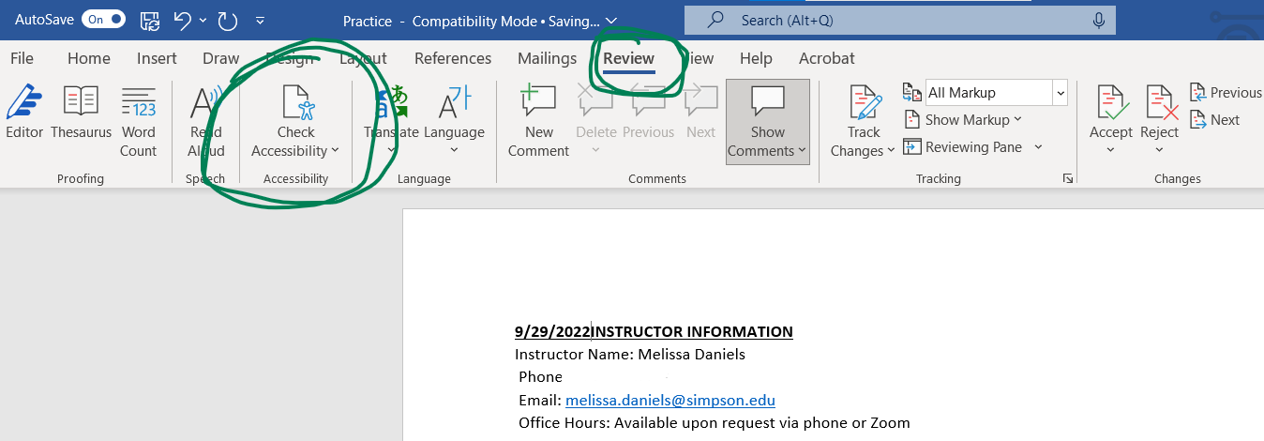
First – run accessibility checker in your Word document
How do you do this? Go to “Review” on Microsoft Word, then click “Check Accessibility”

Slide 7
You want the end result of your check to look like this:

Slide 8
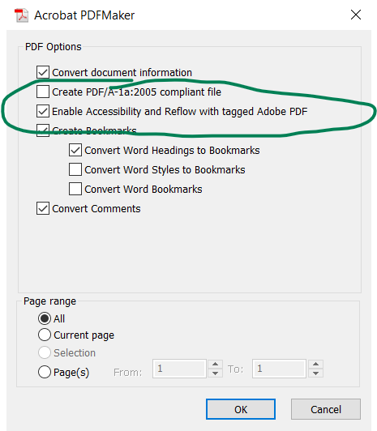
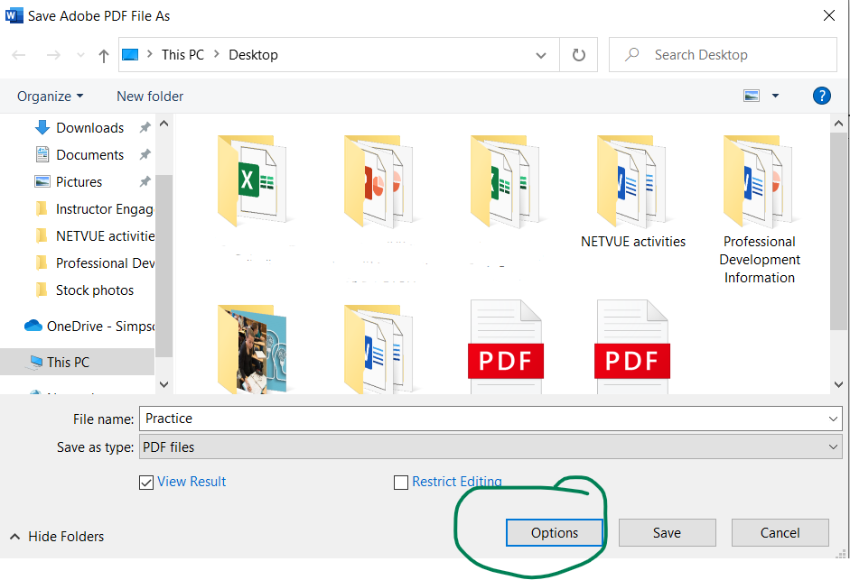
After this, select File> Save as Adobe PDF
Click on “Options” when you have the type saved as a PDF, and make sure “enable accessibility” is checked. Then click “Okay”!

Slide 9
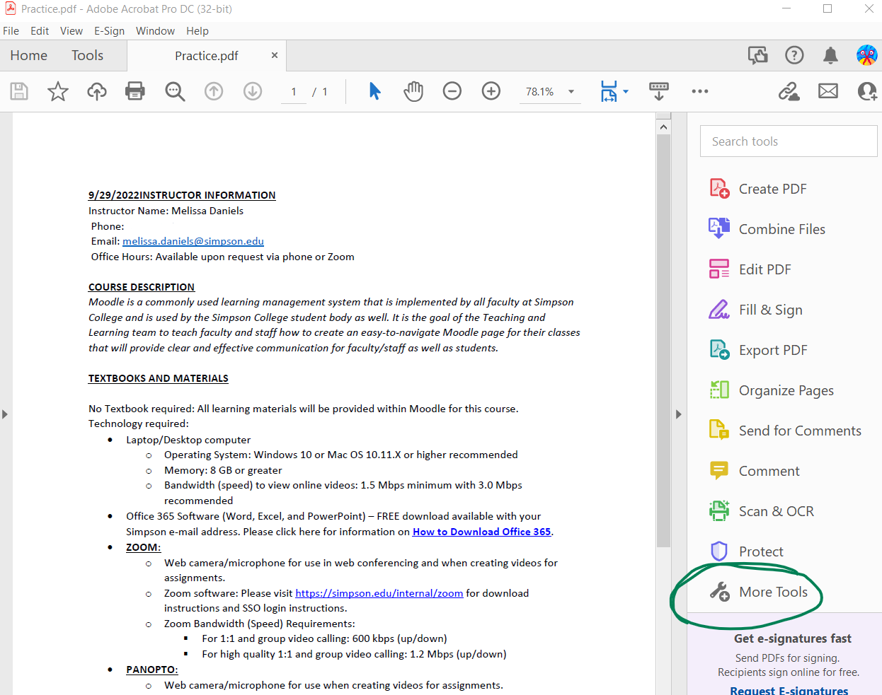
To add accessibility tool to Adobe Acrobat Pro (which everyone has on their Simpson computer):
Type in “Adobe Acrobat Pro” on your computer and select the PDF you want to look at.
On the side, you should see several tools. Click “More tools”.

Slide 10
Scroll down through the tools till you get near the bottom, where you will see a symbol that says “Accessibility”. Click “add” and it will go right onto your main side toolbar!

Slide 11
Now, when you click on the “accessibility” tool on the side, it will present you with several different options, such as adding tags, checking accessibility, adding reading options, and more.

Slide 12
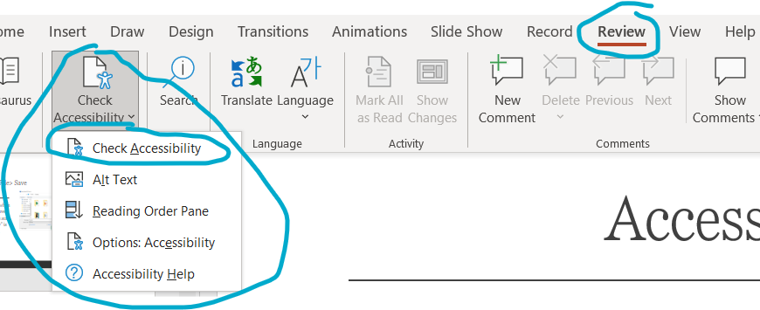
Accessible PowerPoints
One very easy thing to do to see if your PowerPoints are accessible is to use the Accessibility Checker.
This tool is located under “Review”, then “Check Accessibility” on the tool bar.

Slide 13
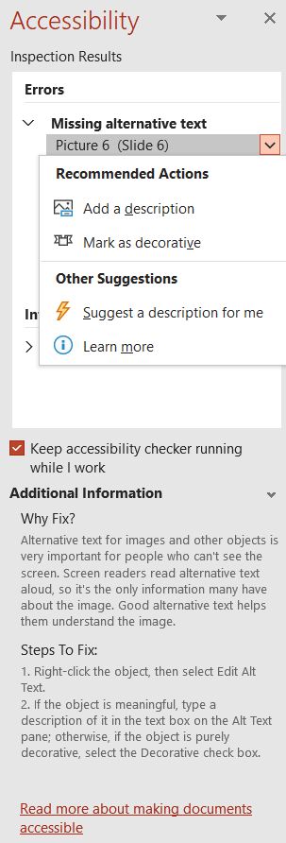
The Accessibility Checker will tell you:
-Any areas with accessibility issues
- Information about why it needs to be fixed
- Advice about ways to fix the PowerPoint

Slide 14
Need more resources about accessibility and PowerPoints? Check out the Microsoft resource page!
https://support.microsoft.com/en-us/office/make-your-powerpoint-presentations-accessible-to-people-with-disabilities-6f7772b2-2f33-4bd2-8ca7-dae3b2b3ef25#bkmk_acwin
This link has SO much information, and it’s presented well – if I presented it all right now, though, it might be overwhelming to see all at once!
Take a look at this link when you have some time and run through the tips that are presented to make sure that you are making your PowerPoints as accessible as possible.

Slide 15
The information listed under this resource:
Best practices for making PowerPoint presentations accessible
Check accessibility while you work
Create accessible slides
Avoid using tables
Add alt text to visuals
Create accessible hyperlink text and add ScreenTips
Use accessible font format and color
Use captions, subtitles, and alternative audio tracks in videos
Save your presentation in a different format
Test accessibility with a screen reader

Slide 16
People you can contact if you need additional help with accessibility:
Melissa Daniels (instructional designer) for help with Moodle accessibility issues: melissa.daniels@simpson.edu
Lynne Jensen (IT) and Robert Overturf (IT, microphone and other equipment) if you need additional equipment for accommodations: lynne.Jensen@simpson.edu, Robert.overturf@simpson.edu
Karen Lynch (Director of Student Accessibility Services) for general questions about providing accommodations for certain students: karen.lynch@simpson.edu

Slide 17
Thank you for your time!
Questions? E-mail a resource or check out the links provided! ☺
Powerpoint accessibility help:
https://support.microsoft.com/en-us/office/make-your-powerpoint-presentations-accessible-to-people-with-disabilities-6f7772b2-2f33-4bd2-8ca7-dae3b2b3ef25#bkmk_acwin
PDF Accessibility help:
https://helpx.adobe.com/acrobat/using/create-verify-pdf-accessibility.html

