Slide 1
H5P and poodll add-ons in your course
Teaching and Learning Center

Slide 2

H5P in moodle
What is H5P?
A plugin that allows the user to create and share interactive content that is responsive and mobile friendly

Slide 3

Examples of H5Ps you can create and use in your Moodle courses:
Flashcards
True/false questions
Memory Games
Drag and Drop/Fill in the Blanks
Multiple Choice Questions
Interactive Videos

Slide 4
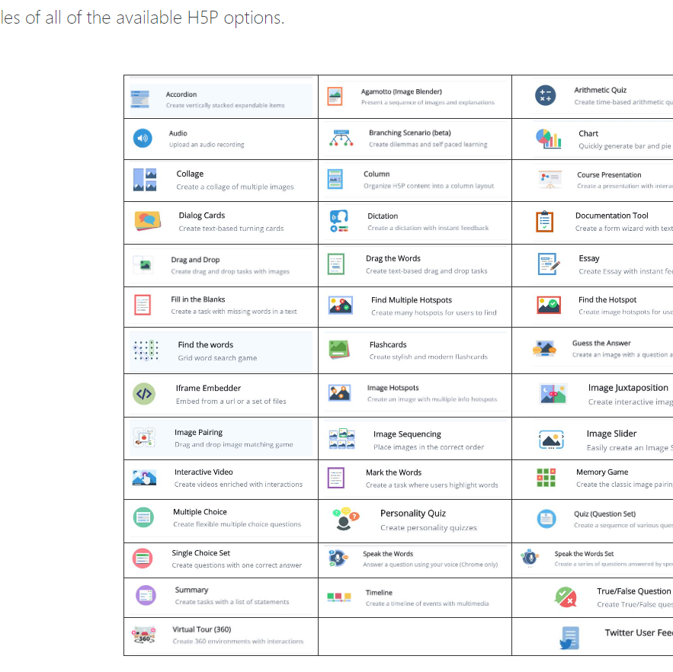
How do you learn about the different options, and see examples?
Go to the “Moodle Resources for Faculty” course
Click on tab that says “H5P Options”
Click the page that says “Click here for instructions and examples of all the available H5P options”
A HUGE list, with links to the tutorial site, opens up for you to explore!

Slide 5
How do you create the H5Ps and add them to your site?
IMPORTANT – you do NOT create the H5P add-ons on the H5P website!!
You do NOT need to create a free account or do ANYTHING on the H5P website besides use it to look at tutorials. (I learned this the hard way)
Creation and implementation of H5Ps can be fully done on Moodle!

Slide 6
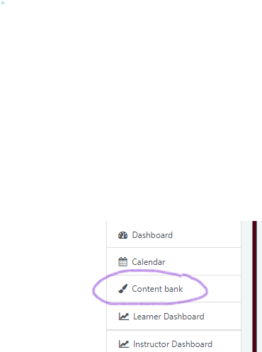
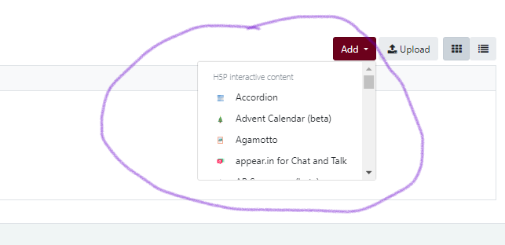
To create and add H5Ps:
Go to the course where you would like to add an H5P.
Click “Content Bank”.
Click “Add”, and it will
give you a list of H5P interactive content options!

Slide 7
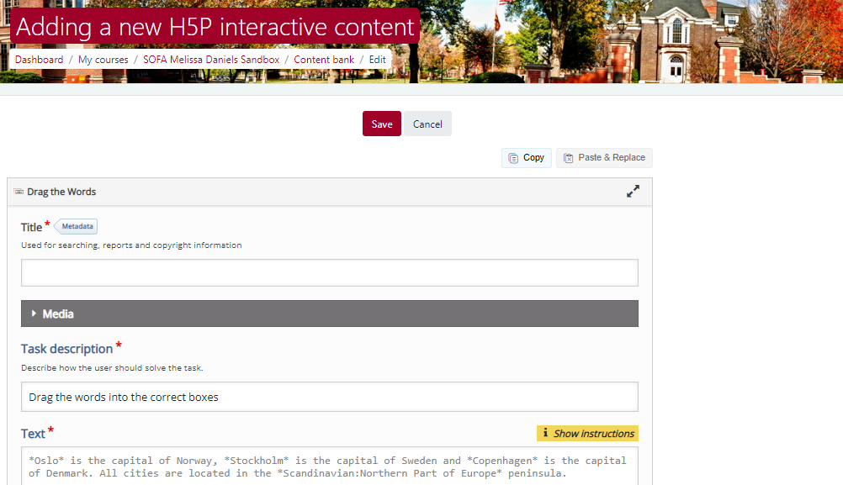
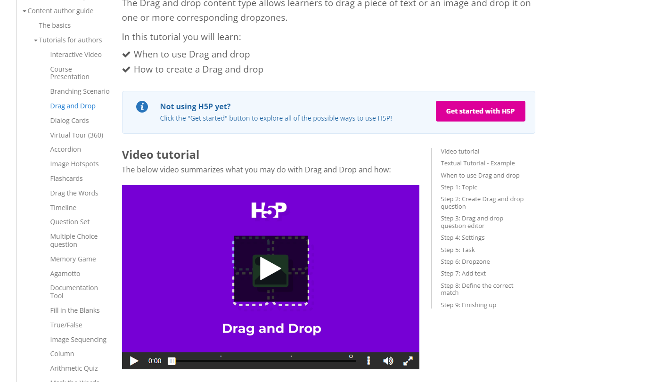
Suggestion: When creating new H5P content, have the directions about what to do on a separate tab (or a separate screen) so you can refer back to them easily!
The H5P website can be located by clicking on any of the icons located on the “Click here for instructions and examples of all the available H5P options” page.

Slide 8
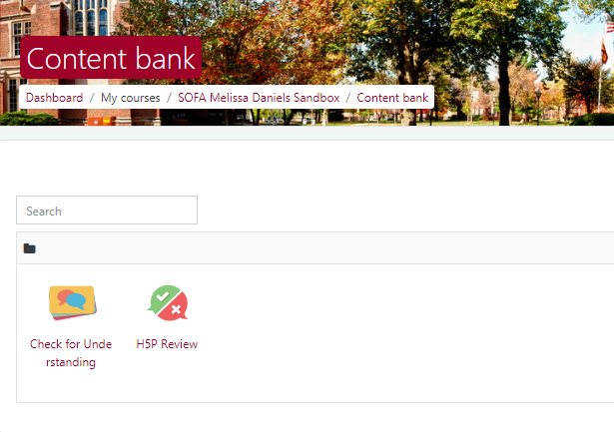
Once you’ve created an H5P activity….
All your H5P activities are stored in the Content Bank for use wherever you’d like!

Slide 9
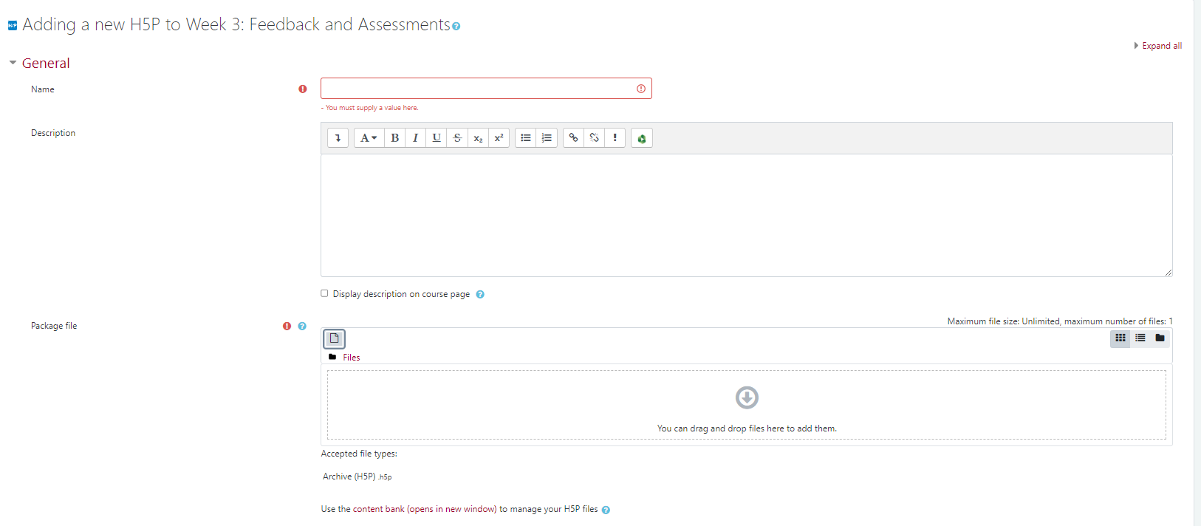
To add h5p content to your course:
Turn editing on
Go to “Add an Activity or Resource”
Click on “Activities” and then “H5P”

Slide 10
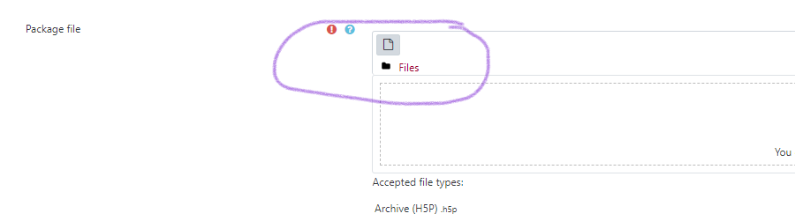
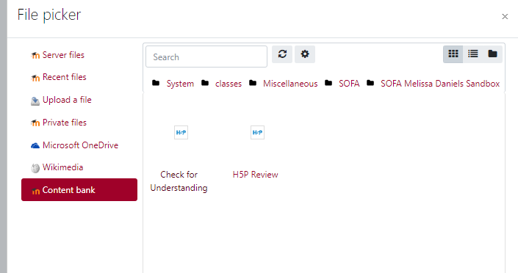
Once you’re in the activity…
Name your H5P activity
Click “Add” under files
Under file picker, go to “Content Bank”
and select the H5P you’d like
to add!

Slide 11
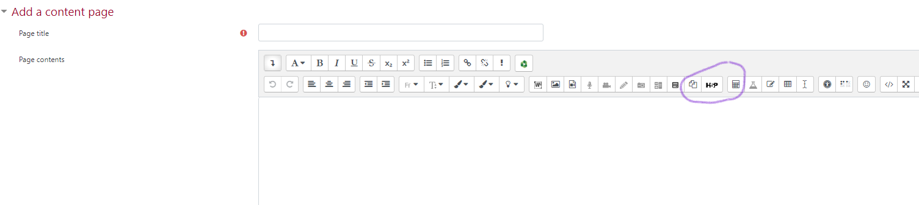
H5ps with existing content
You can also insert an H5P directly into a lesson or onto a page!
To do this, click on the “H5P” button on the expandable toolbar.

Slide 12
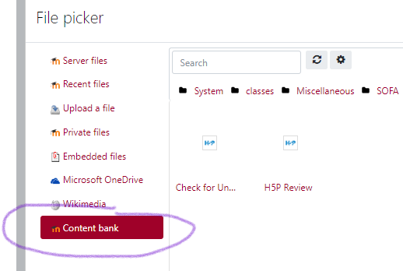
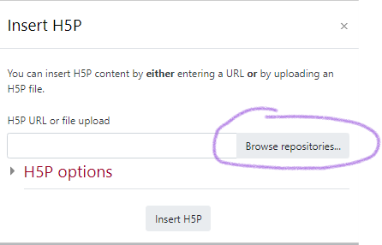
Inserting h5P into content
Once the H5P button has been clicked, then click “Browse Repositories”, then go to “Content Bank” again to select the H5P you created on Moodle.

Slide 13


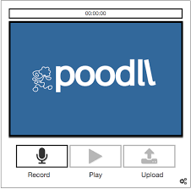
Poodll
(Not this kind, sadly)

Slide 14
Poodll in moodle
What is Poodll?
Similar to H5P – it is a set of plugins that add different audio and video recording options to your Moodle course
Also has widgets that can be added to enhance Moodle activities

Slide 15
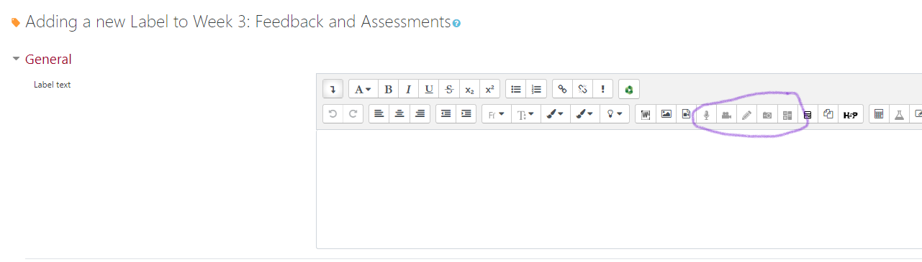
Where can you find the Poodll plug-ins?
When you add a resource or activity on Moodle, such as a page, a label, a lesson, or even a forum, you can access Poodll options on the extendable toolbar.
They look grey-ed out, so you may think that they don’t work, but that’s just the way they look! They are fully functional.

Slide 16
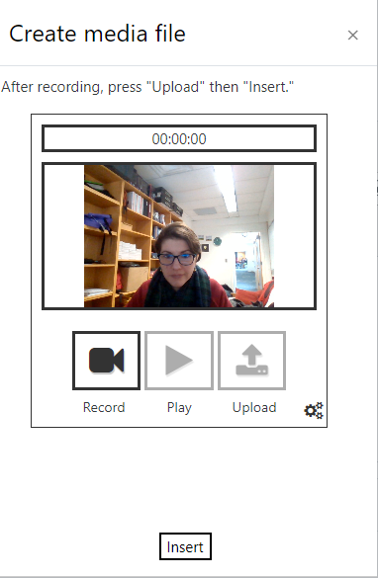
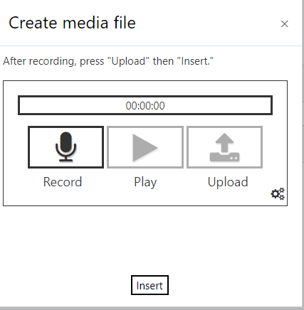
Things you can do with the recording options:
You can record audio or video for students to watch in forum posts, assignment descriptions, add to page resources – basically anywhere!
Note: These recordings can be no longer than 2 minutes long – they are only for brief descriptions or feedback.

Slide 17
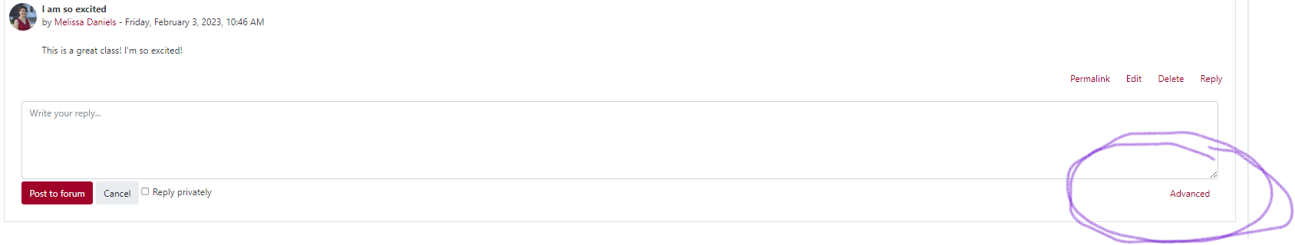
Students can respond to other people in a forum using Poodll record!
To do this:
When students go to an initial post they want to respond to, instead of “Reply”, they click “Advanced”.

Slide 18
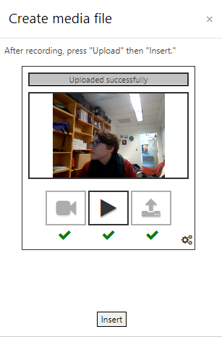
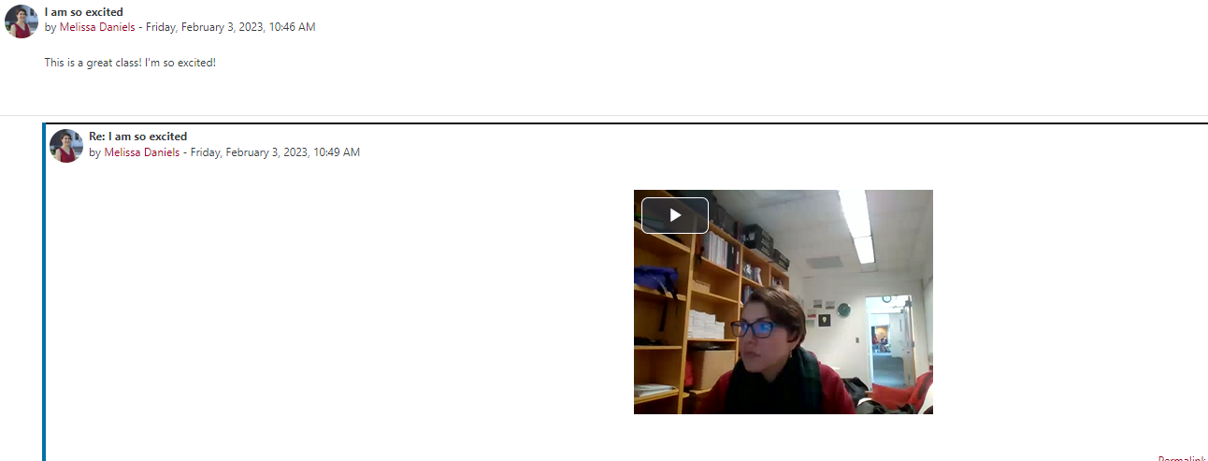
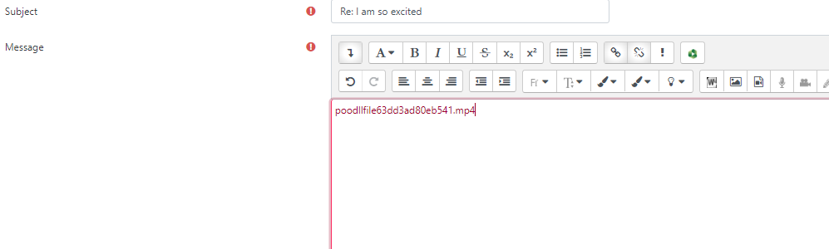
Students can respond to other people in a forum using Poodll record!
Once in advanced settings, use Poodll to record and insert a response. It will just look like a code, but when students hit save, their video reply will appear!

Slide 19
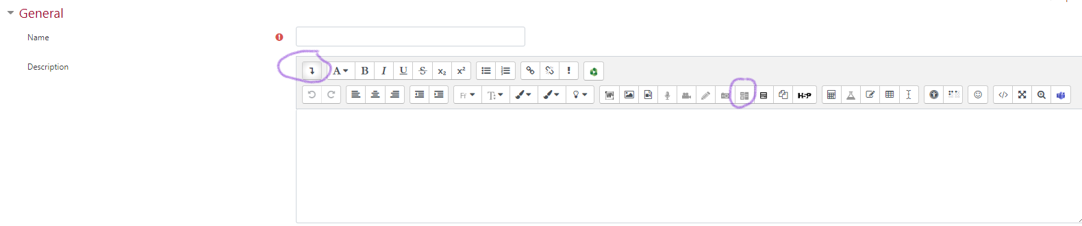
Moodle widgets
In addition to audio and video recording, Poodll also offers a variety of widgets that can add some pizzazz to your Moodle site.
These can be accessed by adding an activity or resource (label, page, lesson, etc.), extending the toolbar, and clicking the widget button. (It looks like a tiny grey plus/minus sign box.)

Slide 20
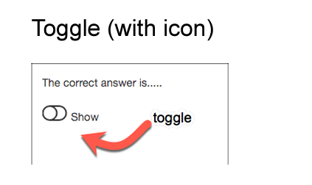
Moodle widgets
There are a TON of different widgets available
Most popular appears to be “Toggle With Icon” – the ability to minimize text on a page and click to show the text.
People often do this under a video, to show the full transcript of the video – or just if they want their page to look a little cleaner.

Slide 21
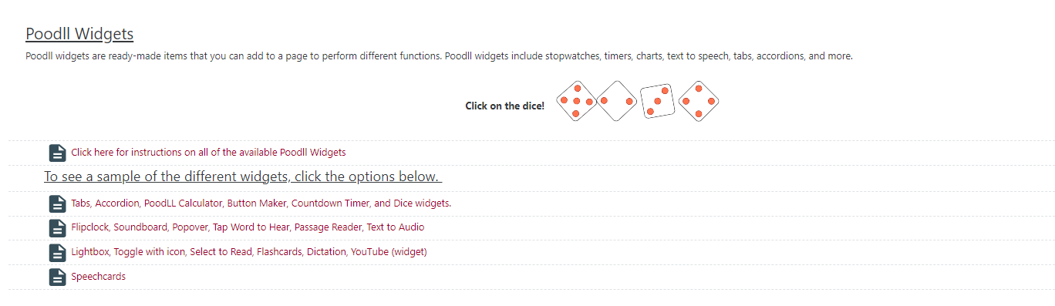
Moodle widgets
There are also widgets that include countdown timers, dice, text-to-speech, tabs, and more.
The “Moodle Resources for Faculty” page has a “Poodll Options” tab, which includes instructions for all the Poodll widgets that are available to you!

Slide 22
Where can you find out more?
Check out “Moodle Resources for Faculty” and find the tabs labeled “Poodll Options” and “H5P options” – lots of videos, pages of instructions, and examples of what these plug-ins look like!
Try to find an interactive option that you think would work well for your class – flashcards? Recorded/audio feedback? Drag and drop labeling?
If you ever have any questions, never hesitate to reach out to the instructional designer (that’s me!) at melissa.daniels@simpson.edu

Slide 23




Thank you!
Melissa Daniels
Melissa.Daniels@simpson.edu
moodle@simpson.edu

