Slide 1
Creating Engagement in Online Forums with Conversation Cue Cards
Melissa Daniels, instructional designer

Slide 2

Agenda
Conversation cue cards: what are they?
Managing “idea theft”
Video responses – a way to shake things up
Monitoring forums with ease
Q&A

Slide 3
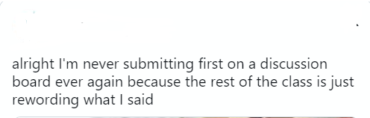
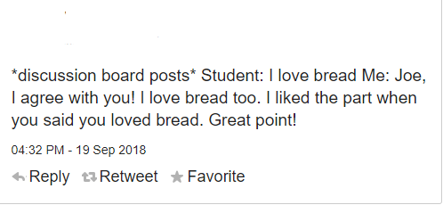
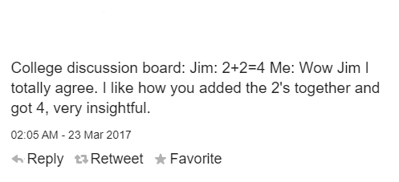
Online forums
Have you ever seen discussion posts that look like these?

Slide 4


Online forums: the issue
In an online course, forums are a great way to encourage conversation and create a sense of community.
However, sometimes, especially online, it’s hard to figure out how to start these conversations, or create a full, robust discussion, solely using an online format.

Slide 5
Possible solution?
Conversation cue cards – allowing students sentence starters to help propel the conversation forward!

Slide 6
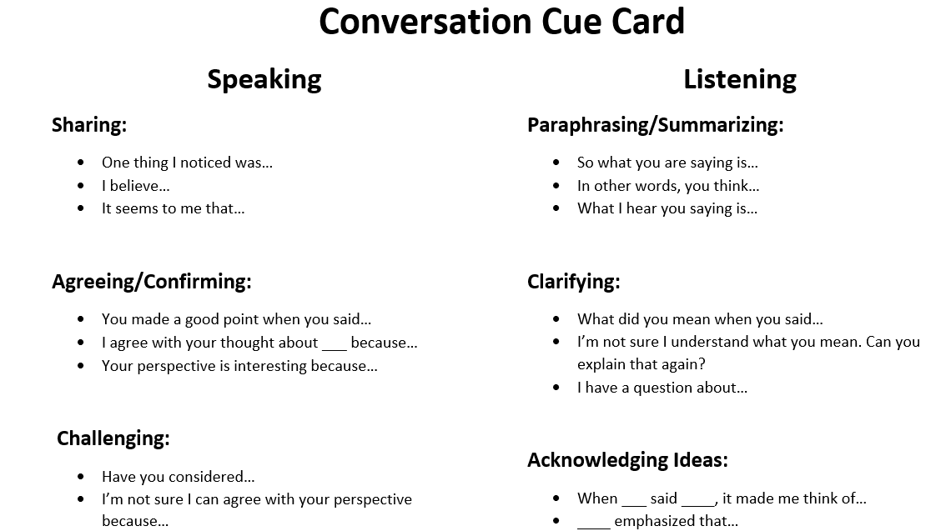

Slide 7

Benefits to utilizing a conversation cue card:
Makes it easier for students to continue a conversation and interact with others, allowing time to focus on content and not stress about format
Makes it easier for YOU, the instructor, to specify what you need students to be saying in their interactions – should they agree? Challenge? Be specific in what they like/don’t like?
Encourages civil methods of discourse instead of personal attacks

Slide 8

How can you use it?
Create a screen shot of the conversation cue card and place it in the description box along with the instructions (or link to it, if you have it saved in OneDrive!)
Be explicit in your instructions – do they have to use particular categories in their responses? Maybe one agree, one clarifying? Etc.
I would tell them to reference not only a specific part of someone’s post, but also the reasoning behind WHY they agree/disagree – otherwise it’s too easy for them. Make them explain their thinking a bit more.

Slide 9
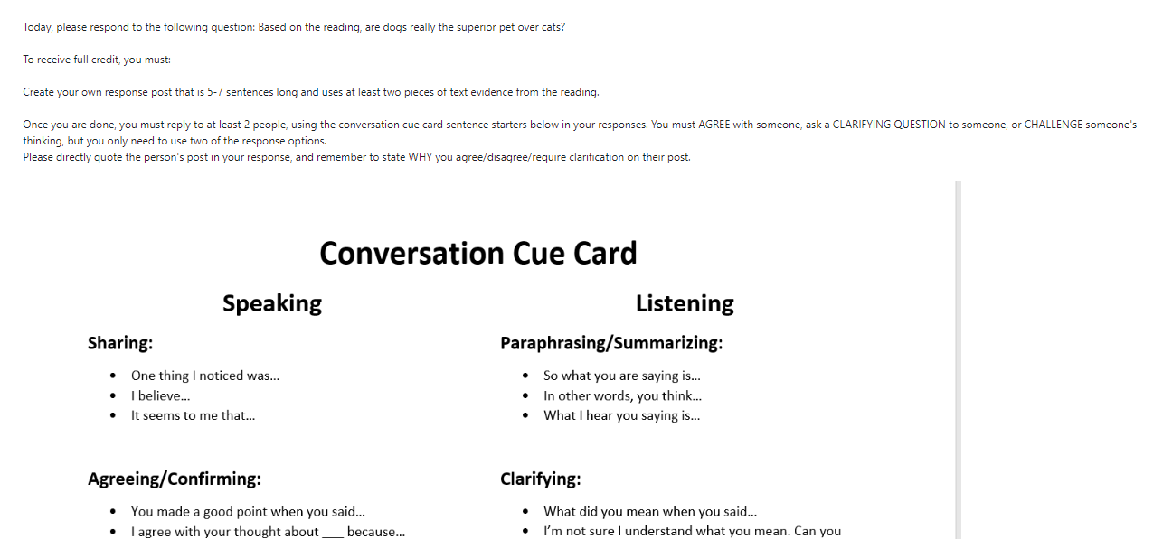
Example:

Slide 10

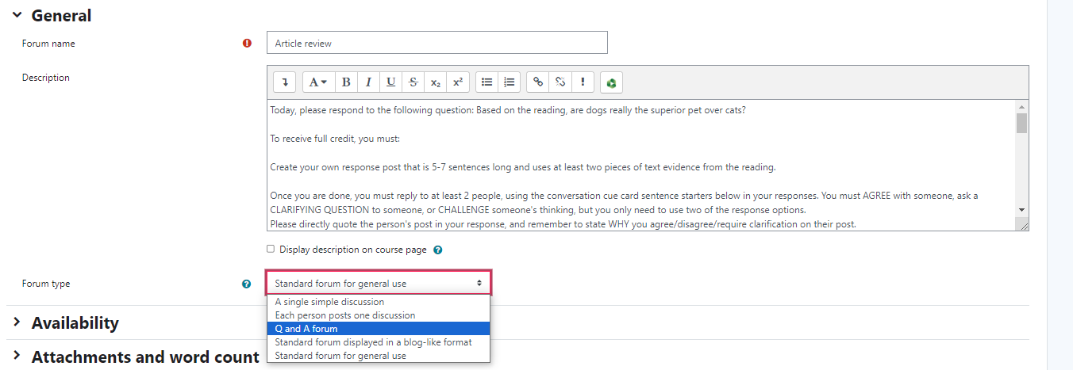
Concerned about idea theft?
Consider changing your forum setting to a “Q&A” forum instead of a standard forum.
In a Q&A forum, students have to first post their reply BEFORE they can view other responses – so there’s much less of a chance of just re-wording what someone else says!

Slide 11
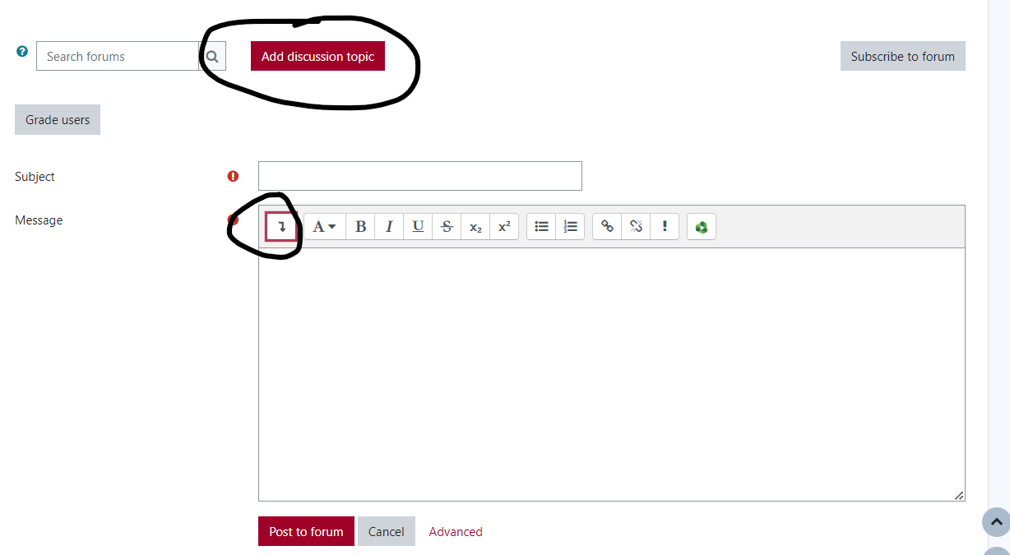
Another engagement idea: video responses
Video responses can make it feel more like students are part of a community classroom – not just responding to text on a screen!
No additional recording equipment needed besides what’s available on Moodle – students do not need to upload anything or use Panopto.
To do this: When they click “Add discussion topic”, they click the down arrow to expand the menu.

Slide 12
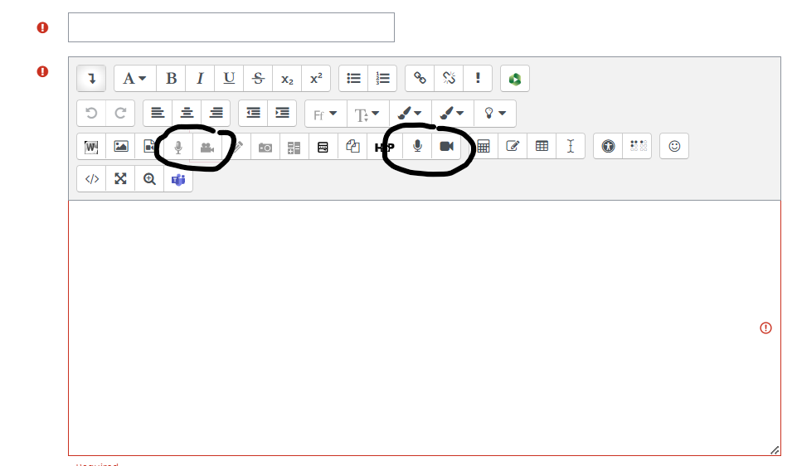
Another engagement idea: video responses
From there, students click on the dark OR light camera icon – they both work!
***The main difference is that the dark camera/mic icons have a 3 minute time limit. The light camera icon does not!***

Slide 13
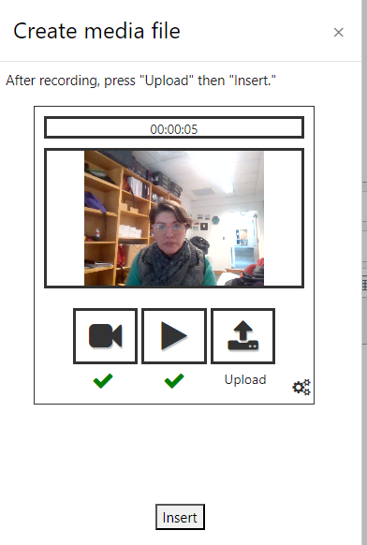
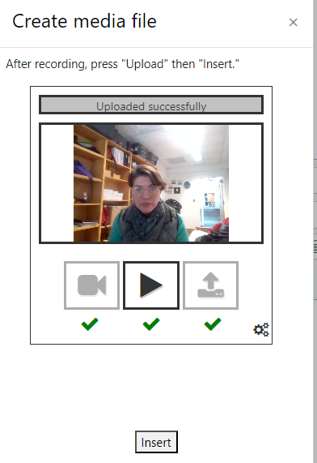
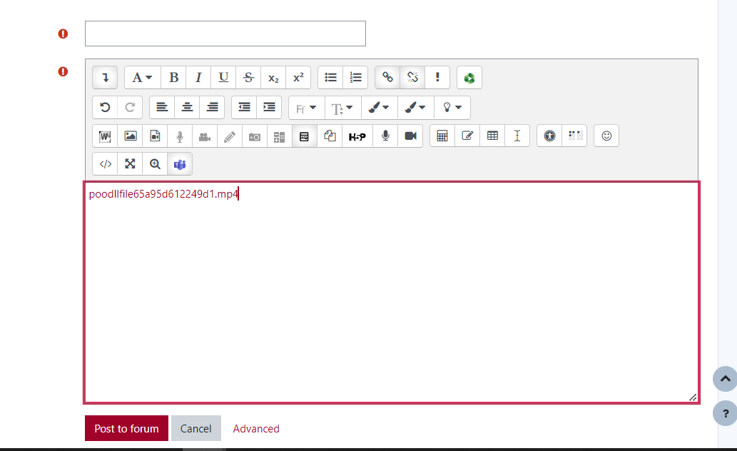
Another engagement idea: video responses
What the different recordings look like:
Light grey icon – no time limit, more steps to upload, looks like a random media file until you post

Slide 14
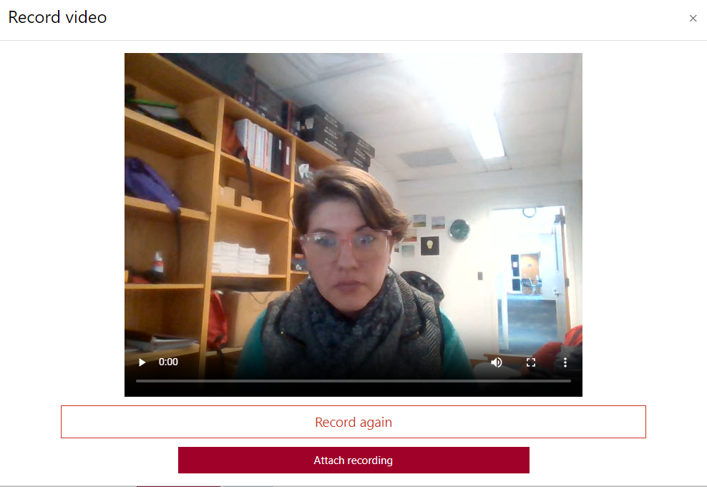
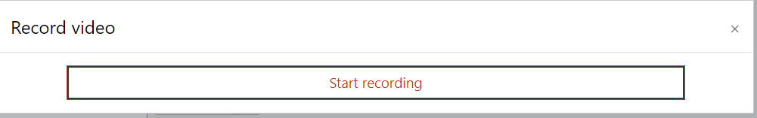
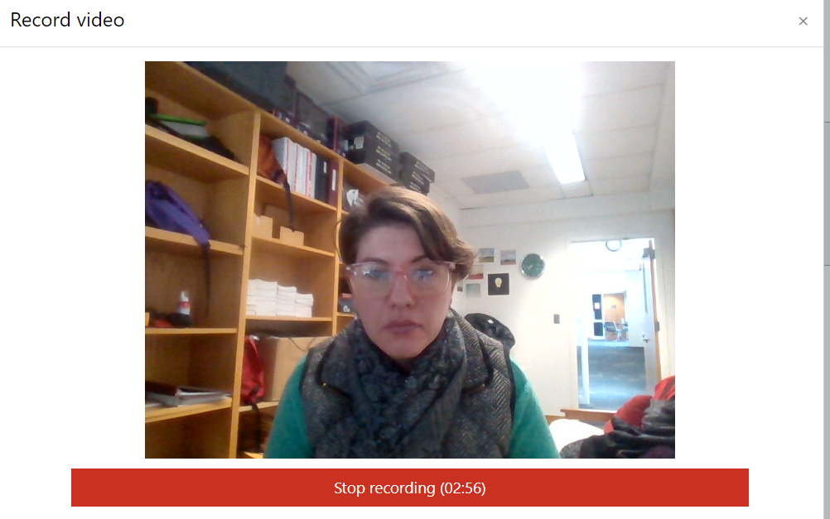
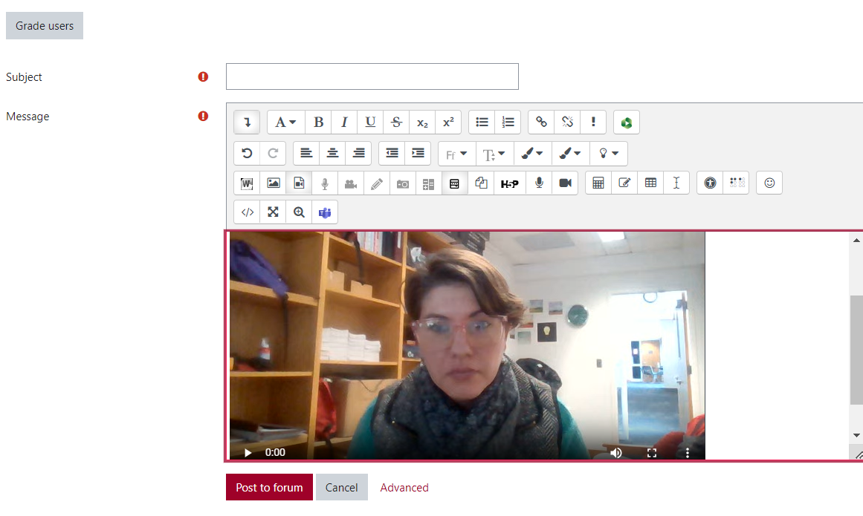
Another engagement idea: video responses
What the different recordings look like:
Dark grey icon – 3 minute time limit that starts immediately, shows up as a video image right away

Slide 15
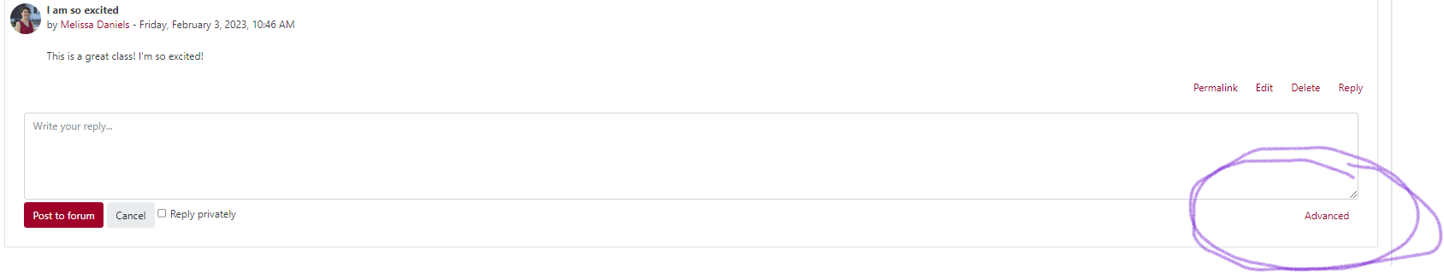
Another engagement idea: video responses
For students to reply with their own video comments:
When students go to an initial post they want to respond to, instead of “Reply”, they click “Advanced”.

Slide 16
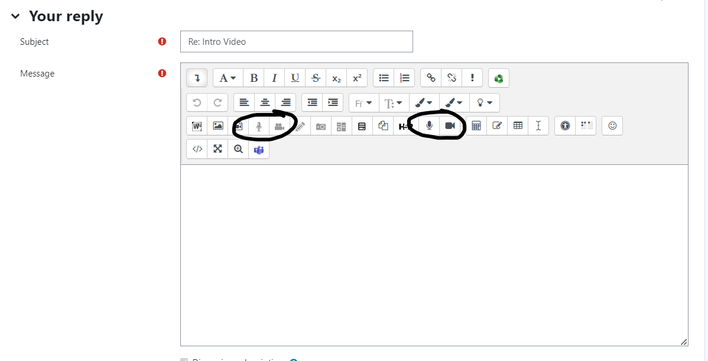
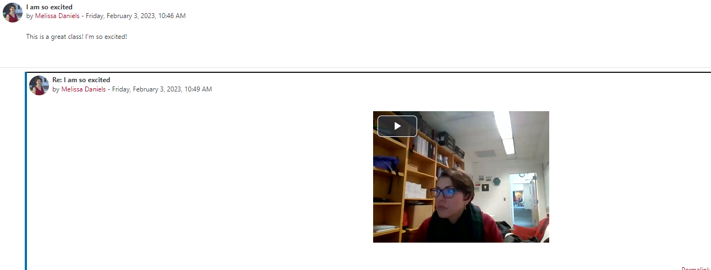
Once in advanced settings, they can record and insert a response, with the same options as the initial post.

Slide 17
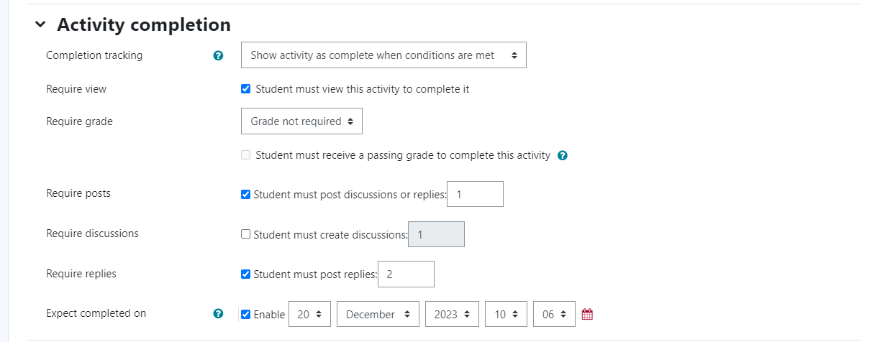
How do you make monitoring conversations/responses easier?
Make sure to activate the “Activity Completion” settings!
This is especially important for forums, because you can specify how many posts AND responses need to be made for a forum assignment to be considered completely done.

Slide 18
Q&A
Any questions?

Slide 19
Thank you!
Melissa Daniels
Melissa.Daniels@simpson.edu

Slide 20


Walt Disney
The way to get started is to quit talking and begin doing.

