Slide 1

Closed captioning and Panopto
Melissa Daniels, Instructional Designer at Simpson

Slide 2
What to expect in this presentation:
The “Why” behind Closed Captioning
The prep/tips and tricks
How to Record on Panopto
How to Caption Using Panopto
Using Captioning if you used Zoom
Adding transcript under a video
Additional resources

Slide 3

Closed Captioning for Panopto with Accessibility: Why is this necessary?
What are the benefits of closed captioning?
“More than 100 empirical studies document that captioning a video improves comprehension of, attention to, and memory for the video. Captions are particularly beneficial for persons watching videos in their non-native language, for children and adults learning to read, and for persons who are deaf or hard of hearing.”
From the National Library of Medicine
Also part of ADA Compliance!

Slide 4
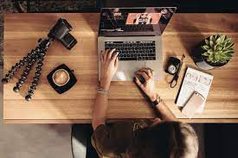
Captioning: Prep you can do beforehand to make your lives easier
Whenever possible, create a transcript or outline ahead of time. When using a transcript, it will make the closed captioning process quicker and easier as well.
Speak clearly and avoid background noise when recording your videos. The more clearly you speak and the less background noise, the more efficient captioning your videos will be.
Use a USB microphone whenever possible. The auto-captioning feature in both Panopto and YouTube is much more accurate if you use a USB microphone as opposed to your laptop microphone. This is because USB microphones are set to pick up primarily your voice and block out background noise, and your laptop microphone will equally record whatever noises are in the room (including any typing you are doing on your keyboard during the recording). (If you need to borrow/use a USB microphone for a class, let IT know!)

Slide 5
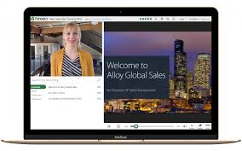
Panopto use: Tips and Tricks
Benefit of Panopto: You do NOT need to have Internet access to record!
If you do have Internet, your video will automatically upload into your library.
Some tips and tricks:
Make sure you have a strong internet connection (a wired connection is best) if you want to decrease upload time later
Use a high-quality USB microphone if possible
Find a quiet place without video or audio distractions in the background
If you are recording using your camera, make sure the background behind you is dark so that the camera will be able to focus on you and recording will not just be your silhouette

Slide 6

How to Record on Panopto:
first, click on the Panopto Icon on your computer.
It looks like this:

Slide 7
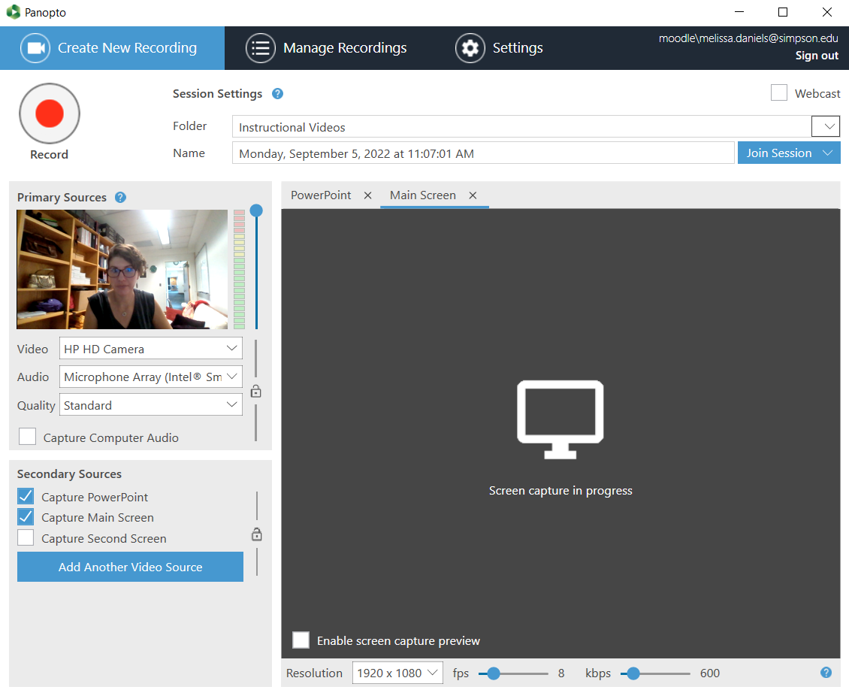
How to Record on Panopto:
This will open up the recording board!
You need to select whatever video and audio device you’re using (if you’re using a USB microphone, make sure that’s selected as audio!)
If you have any secondary sources you’re wanting to record as well (example, your PowerPoint AND you lecturing), make sure both secondary sources are selected.

Slide 8
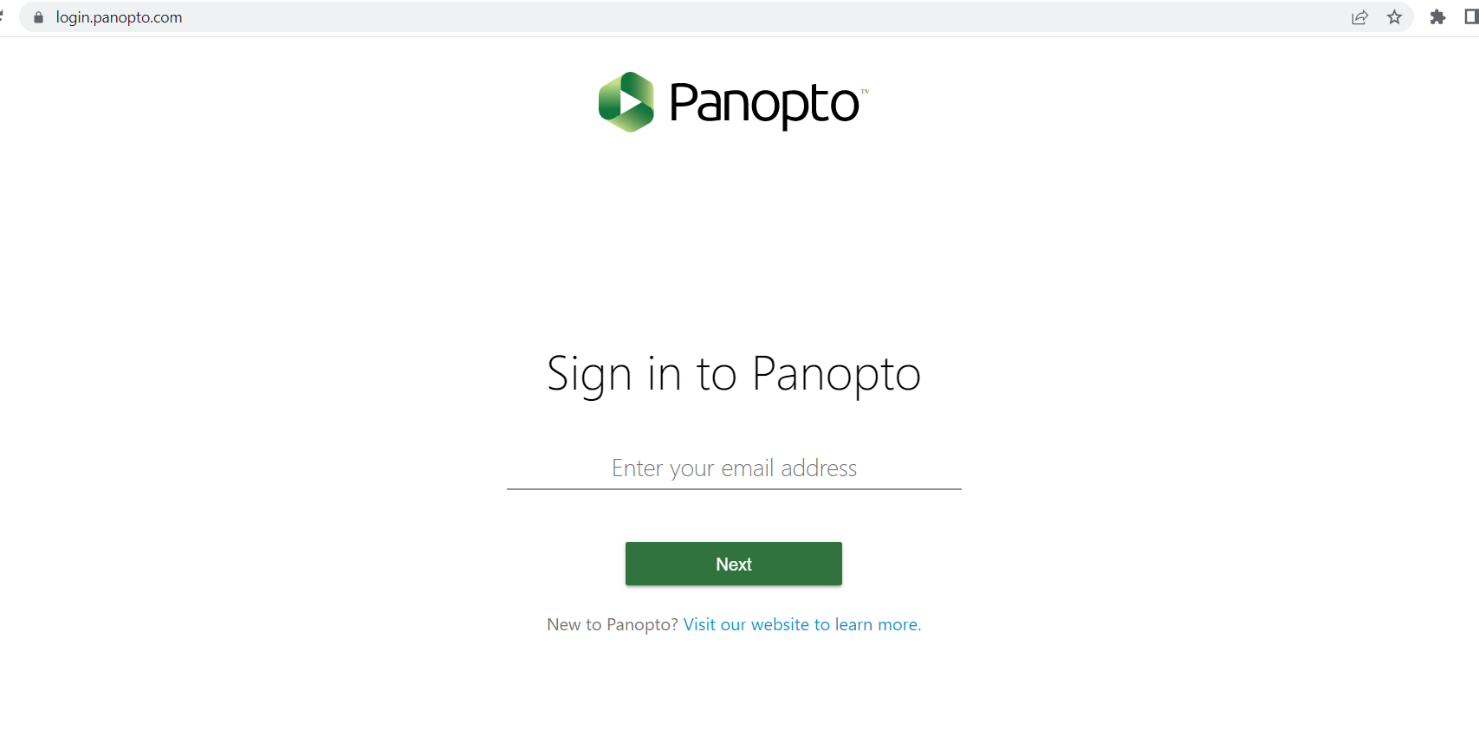
After recording = captioning!
You will need to login to your Panopto library:
a)Go to
https://login.panopto.com/
b) Use your Simpson user name and password to log in.

Slide 9
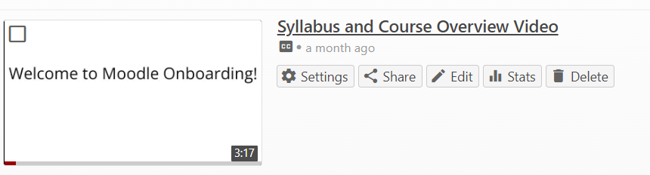

Adding captioning to your video
Find the video that you’d like to caption, and click on “edit” next to it.

Slide 10
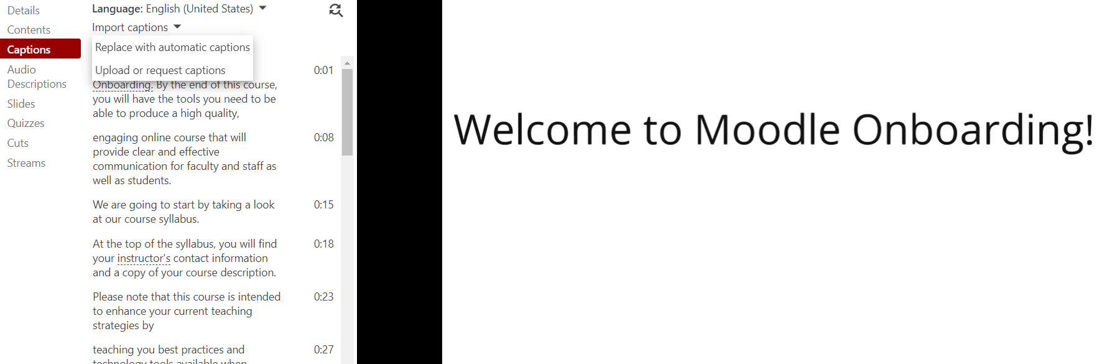


Adding captioning to your video
On the side, there is a “Captions” option.
Click on “Captions”, then “Import automatic captions”.
And that’s all there is to it!
*New in 2022! You are now able to set up a folder in Panopto and have the captions auto-generated in another language. If you recorded your video in Spanish and you would like the captions to be auto-generated in Spanish, place the video in a folder and update the settings of that folder to be 'Spanish.' Then every video (that is recorded in Spanish) will contain Spanish captions when the auto-captioning is enabled!

Slide 11
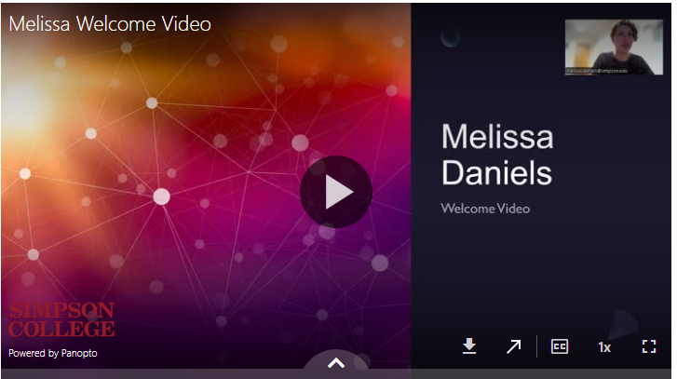

Did you record your presentation/video using Zoom instead? Never you fear, you can still add captions using Panopto’s editing app!
Because Panopto is what is used to upload all video types onto your Moodle page, you can still edit using Panopto software.
To add captions to a video on your website, even if you didn’t record it using Panopto the first time, simply click on the diagonal up arrow at the bottom of your video, and it will take you to Panopto’s editing software.

Slide 12
Adding a Transcript Under a Video Using the Poodll Toggle Function
Some students prefer to read transcripts while others have internet issues and cannot get the video to load on their device, so transcripts are the next best option. We’re going to watch a short video to learn how to add the Poodll toggle widget under your videos to help out those students who prefer that method and to provide access to those who may need it.
https://simpsoncollege.hosted.panopto.com/Panopto/Pages/Viewer.aspx?id=845b0c62-c91b-4e85-811c-abe00179c298

Slide 13
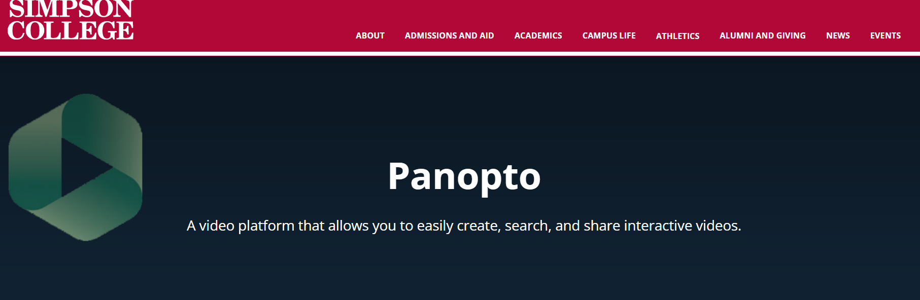
Resources
https://www.simpson.edu/internal/academic-technology-resources/panopto
That is the internal website Simpson uses for all things Panopto. Get familiar with it because it’s a treasure trove of information!

Slide 14
More questions while you’re trying to record or caption videos using Panopto? Contact:
Melissa Daniels, Instructional Designer (melissa.daniels@simpson.edu)
Chuck Johnson, Moodle Support Staff (chuck.johnson@simpson.edu)
Robert Overturf, “Mic Guy” (robert.overturf@simpson.edu )
Moodle Support e-mail (Moodle@simpson.edu)

