Slide 1


What you Need to Know about ChatGPT
Mark Pleiss, melissa daniels, colin payton

Slide 2

Deter: Ways to prevent student use of ChatGPT

Slide 3

Small, in-class assignments
Works well in order to collect writing samples more quickly to get a first glance at what students' writing looks like – makes it easier to detect AI presence
Start with this low-stakes work, and continue compounding the work to make a larger assignment
Example: splitting a big paper into smaller, bite-sized paragraphs that end up coming together to make the big paper
This Photo by Unknown author is licensed under CC BY-SA.

Slide 4

Make sure to enforce the "why" behind writing
Reinforce to students why the ability to write is important in today's society
Make sure to find the value in writing
Tell your students that writing is a life skill, as well as one that is needed for many jobs
Make sure to ask the "why" to yourself as well – is writing absolutely necessary in order for the student to demonstrate what they've learned?
This Photo by Unknown author is licensed under CC BY.

Slide 5

If possible, create alternatives to writing assignments that can also demonstrate student learning
Examples:
Podcast
In-class debate
Visual aid/graphic novel or cartoon depiction of literature
Reacting games
Videos

Slide 6

Content knowledge: It's all yours!
Test information about your content on ChatGPT before showing it to your students – not all content is accessible to ChatGPT (such as many peer-reviewed articles)
Maintain your familiarity with the content over which the students are writing
Oftentimes, the writing LOOKS pretty at first glance, but ChatGPT can mix up crucial details – its knowledge is still a bit limited!
This Photo by Unknown author is licensed under CC BY-SA-NC.

Slide 7
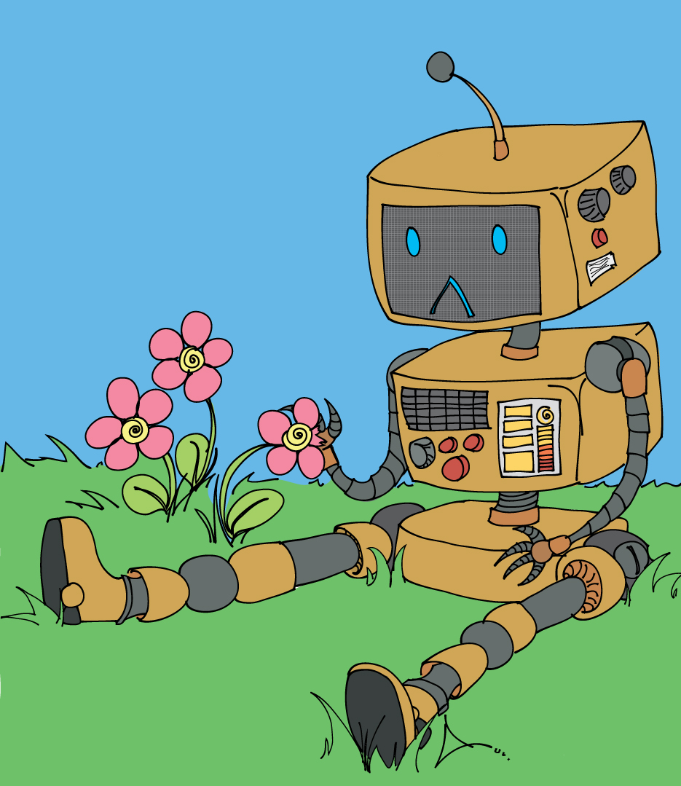
When creating writing assignments:
Try to make your writing tasks fun and original, so that students don't want to have a robot write their assignment – try to incorporate their current passions and interests, or make some sort of interpersonal connection
Assign originally written questions with very specific guidelines, so it's harder to replicate with AI
Put a prompt into ChatGPT before assigning it, in order to see the response it produces
That way, you will recognize a similar answer in your class if someone tries to use it
This Photo by Unknown author is licensed under CC BY-NC-ND.

Slide 8

Additional ideas:
If you do an in-class writing-based exam, use the Lockdown Browser
Add an in-class self-reflection at the end for students to write about their process - if they didn't craft their own writing, it should become pretty apparent if they can't reflect on their writing, either!
This Photo by Unknown author is licensed under CC BY.

Slide 9





AI Detection Software: What's out there?

Slide 10
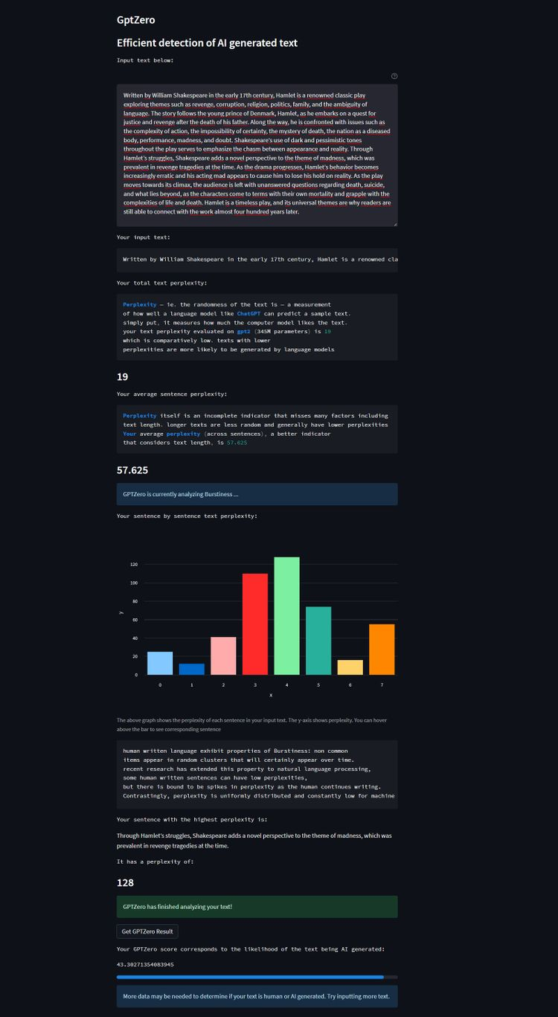
GPTZero: What does it do?
https://gptzero.me/
Examines two variables in any piece of writing it examines.
First: looks at a text's "perplexity," which measures its randomness: Human-written texts tend to be more unpredictable than bot-produced work.
If a text is very familiar to the GPTZero app, and has low "perplexity," it was likely machine-generated

Slide 11

Next: "burstiness"
Burstiness = variance, or inconsistency, within a text
Human-generated articles generally have MORE burstiness
Then, at the end, it tells you the likelihood of being generated by AI
This Photo by Unknown author is licensed under CC BY-SA.

Slide 12
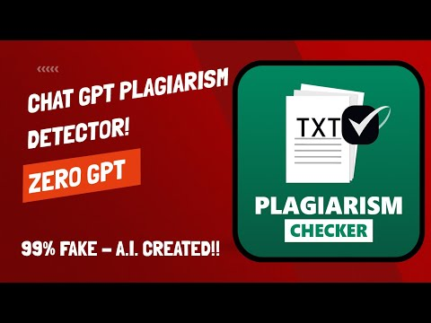
This video will walk you through the GPTZero process:

Slide 13

Another deterrence method: ChatGPT itself!
ChatGPT will tell you if something that was written came from ChatGPT.
You can copy/paste a piece of writing, put it into ChatGPT, and say “Did this come from ChatGPT” and it will say yes.
(It hasn’t figured out about lying....yet)
This Photo by Unknown author is licensed under CC BY-SA-NC.

Slide 14
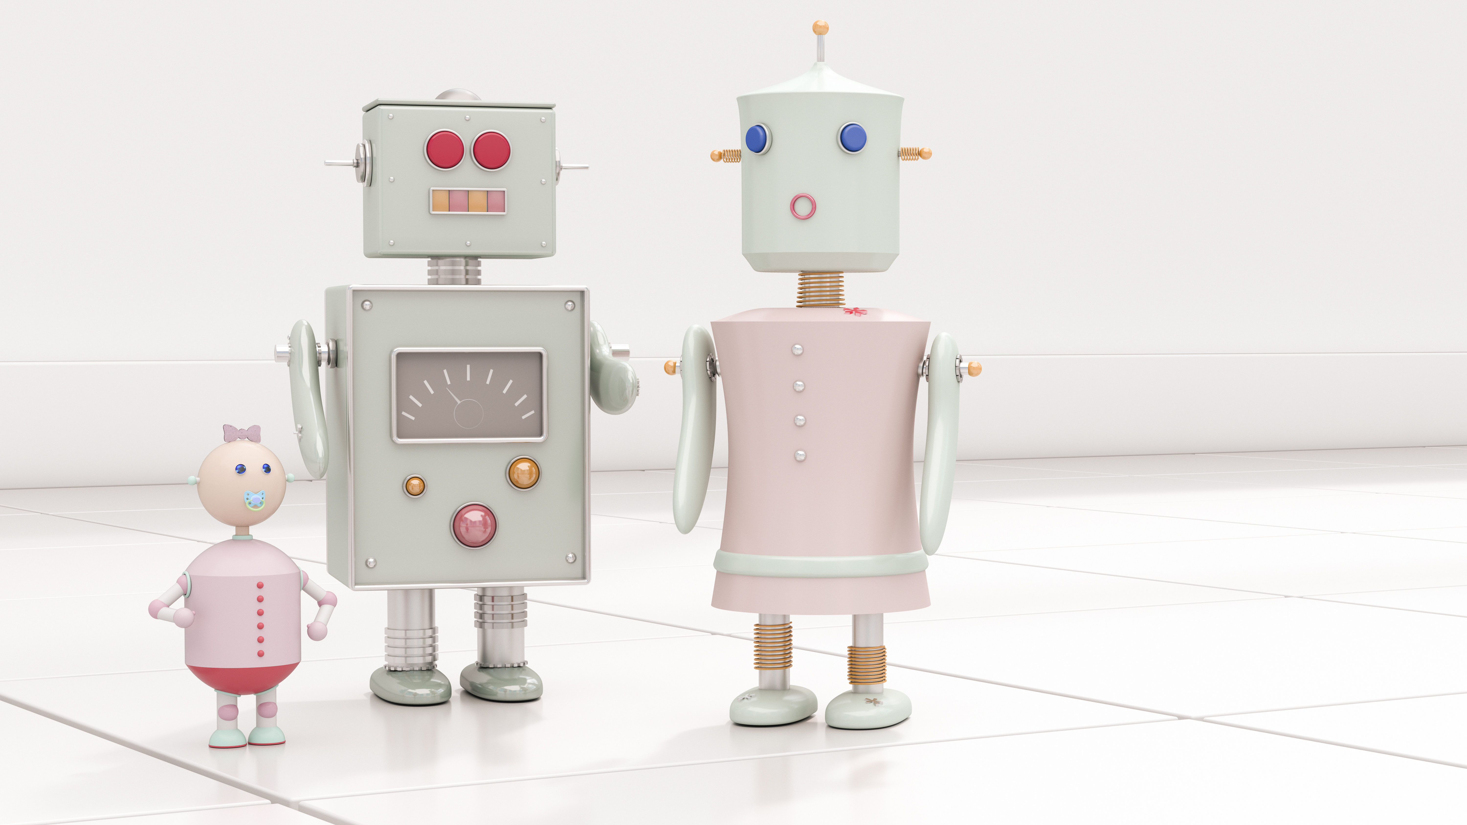
Incorporate: Ways to use ChatGPT in your classrooms

Slide 15

Acceptable uses of A.I.
Developing a topic for writing
Generating search terms and finding databases for research
Receiving general feedback on writing
Receiving alternatives to common turns of phrase
Asking for it to identify and explain your own grammar and spelling mistakes

Slide 16

Unacceptable uses of A.I.
Writing entire essays
Completing unfinished portions of an assignment
Generating any sentences that you use substantially or in whole in your own writing
Finding sources or formatting citations
Uses that violate the spirit of using writing as a means of learning and developing your mind

Slide 17
Technique 1: Fact checking
Analyzing bad or inaccurate texts is a strong way to have students learn a content matter.
Ask A.I. to answer an essay or exam question based on the texts in the class.
Have students work independently or in groups to analyze
Push students to explain gaps, inaccuracies, and to reference check for source credibility
From Ethan Mollick, "How to... use AI to teach some of the hardest skills"

Slide 18
Technique 2: Co-writing to teach description and details
Analyzing bad or inaccurate texts is a strong way to have students learn a content matter.
Have students ask A.I. to write an essay on something they know very well (can be scaffolded with a "literacy narrative")
Have students coach the A.I. to write a better version of the paper, including more and more details from their topic.
From Ethan Mollick, "How to... use AI to teach some of the hardest skills"

Slide 19
Technique 3a: Brainstorming topics
ChatGPT is, at heart, a chat bot. Use it to help students think through ideas
Prompts for getting started:
  What are some specific topics related to X?
  I'm struggling to write my college essay on free speech in sports. What are some controversial topics?**
From Ashley Squires, Avila University Writing Center, "Developing topics with ChatGPT"

Slide 20
Technique 3b: Brainstorming topics
ChatGPT is, at heart, a chat bot. Use it to help students think through ideas
Prompts for understanding the basics:
  Summarize the debate on X.
  What are common arguments for/against X?
  What alternatives are there to the topics you have just discussed?
From Ashley Squires, Avila University Writing Center, "Developing topics with ChatGPT"

Slide 21
Technique 3c: Brainstorming topics
ChatGPT is, at heart, a chat bot. Use it to help students think through ideas
Prompts for research:
  What are some search terms related to X?
  What databases can I use to investigate X?
  Are there any journalistic outlets or non-profits that work with X?
From Ashley Squires, Avila University Writing Center, "Developing topics with ChatGPT"

Slide 22
Technique 4: Stasis Questions
Stasis theory — four questions that lead from idea to action:
  Fact: Does something exist?
  Definition: What do we call it?
  Quality: Is it good or bad? (or any other qualitative question)
  Policy: What should we do about it?
Have students ask ChatGPT to define the stasis questions on a topic.
Use ChatGPT help students find out what is and is not controversial about a topic.
From Ashley Squires, Avila University Writing Center, "Developing topics with ChatGPT"

