Slide 1
Calendly
Melissa Daniels, instructional designer

Slide 2
Calendly – what is it?
Calendly is an appointment scheduling software that makes it easy to figure out office hours, advising appointments, and more.
Sign-up is free and can be done through Microsoft, so you can use your school e-mail to make things easier.

Slide 3
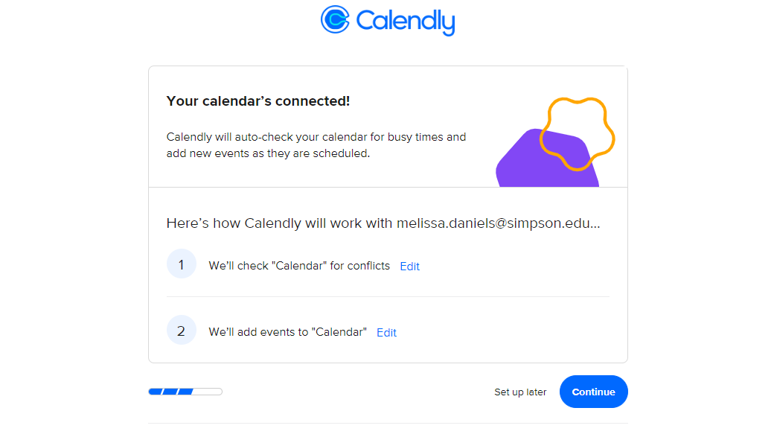
Set-up
Set-up is incredibly easy – you sign in through Microsoft (preferred) or Google, and it automatically connects with your calendar!

Slide 4
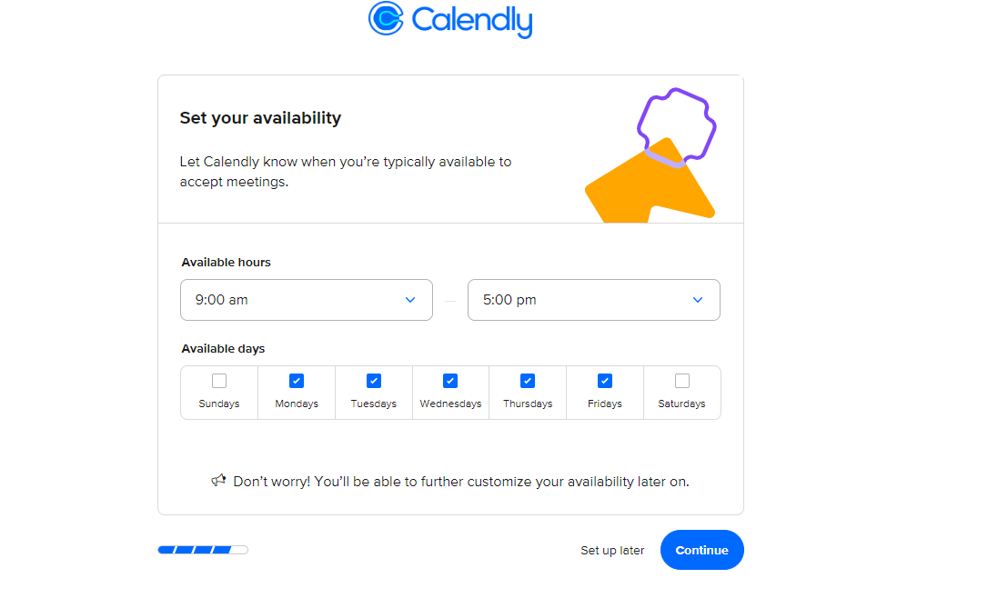
Set-up
Once you sign up, you can set your availability.
This way, you can determine what days and times you are generally available – and this can be customized further later on.
You can then “personalize your experience” – specfifying what type of field you are in (in your case, education!)

Slide 5
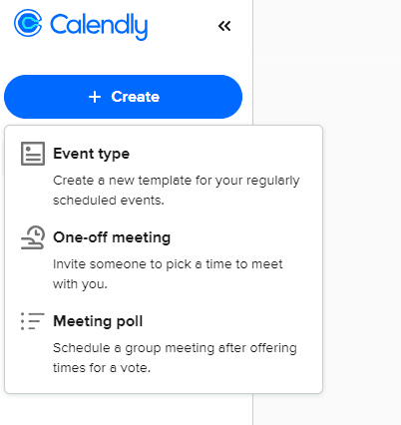
Creating an event
Click “Create” on the left-hand side of the page
You can create templates for regularly scheduled events (like office hours), or invite someone to a one-off meeting that’s more specific.

Slide 6
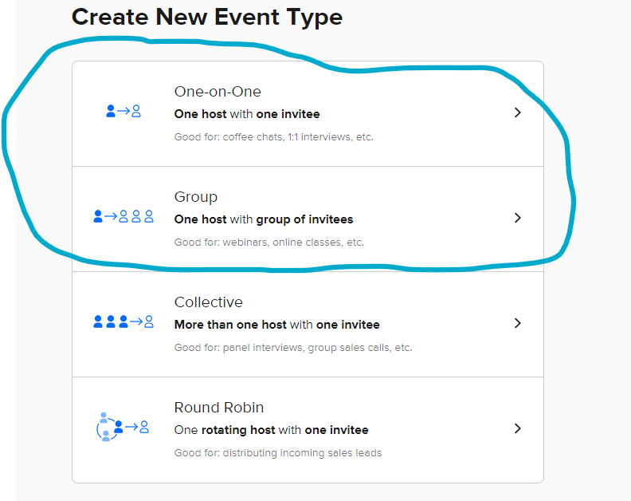
Creating an event
When you create a new event, you’ll have a range of options provided.
The best options for you are probably: one-on-one (for individual appointments), or group (if you have any online classes and want to do some sort of virtual office hours option).

Slide 7
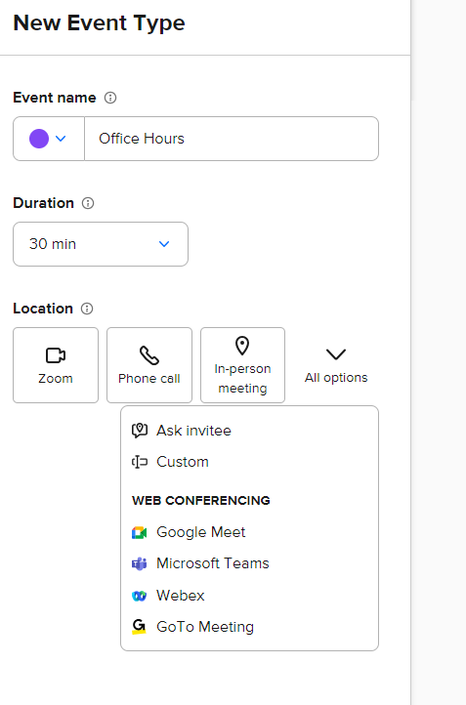
Creating an event
From there, you can customize your event name, the duration of this meeting, and the modality in which you will meet: via Zoom, phone call, in-person, and others.
Just click whichever modality you’d prefer to use and you can add location, Zoom link, etc.

Slide 8
Your calendar will now look like this:
Is this too broad for you? For most people, yes, but never fear….
This is where you can customize your availability!

Slide 9
Event details:
Option to add specific description or instructions/details your invitee needs to know.

Slide 10
Scheduling Settings:
This one is particularly important. This is where you can customize your hours much more specifically.
You can also select how far in advance invitees can schedule a meeting.

Slide 11
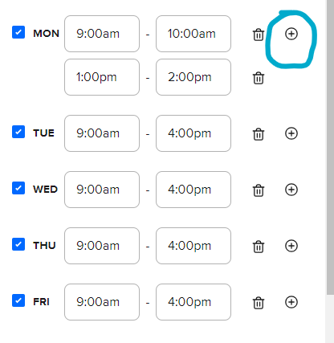
Scheduling Settings:
To change your availability, click on your name and the right-hand arrow, and it will expand to show available hours.
From there, you can click on the plus sign next to the day to add additional time increments.

Slide 12
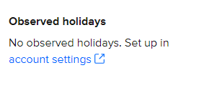
Scheduling Settings:
Something else that’s nice – you can set date-specific hours in advance.
Example, you have an appointment and won’t be available your regular time – you can customize that in your calendar and not worry about students signing up on that day.
You can add observed holidays as well!

Slide 13
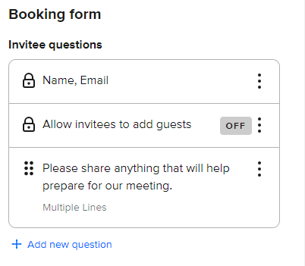
Booking page options
On this page, you can customize your event link – this is so students can go directly to something like office hours instead of having to find the correct event on your Calendly page.
The booking form is a preview of what students will have to fill in when they book a time with you. This is really nice because you can preview what they want to talk about beforehand.

Slide 14
Communications
On this page, you can set automatic communications for your events.
Recipients receive calendar invitations right after booking, but you can also add e-mail reminders that people can receive before the event – probably not a bad idea in many cases!

Slide 15
Your calendar is customized – now what?
Time to add it to wherever you communicate with students!
(Hint….Moodle would be a great option here ☺ )
From the top left-hand side, hit “Share”:

Slide 16
Your calendar is customized – now what?
Click “Copy link” on the pop-up that shows up:

Slide 17
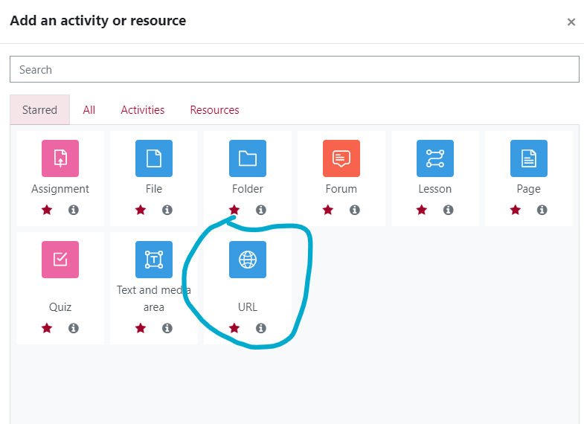
Your calendar is customized – now what?
Turn “edit mode” on in your Moodle course, and add an activity/resource – click “Add a URL”

Slide 18
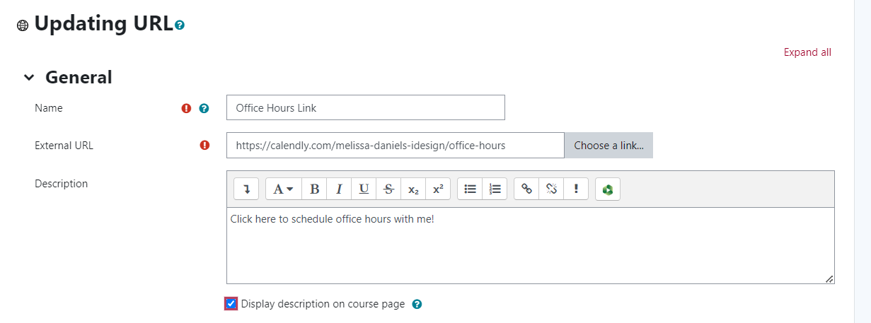
Your calendar is customized – now what?
Paste the link from the Calendly page into the URL space and add a brief description.
Then hit Save!

Slide 19
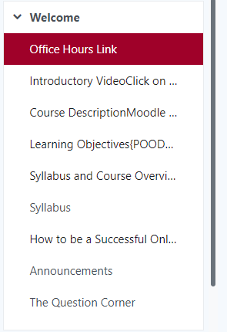
Suggestion:
Put the office hours link somewhere near the top of your welcome page, or somewhere highly visible to students.
Make sure they know where it is!

Slide 20
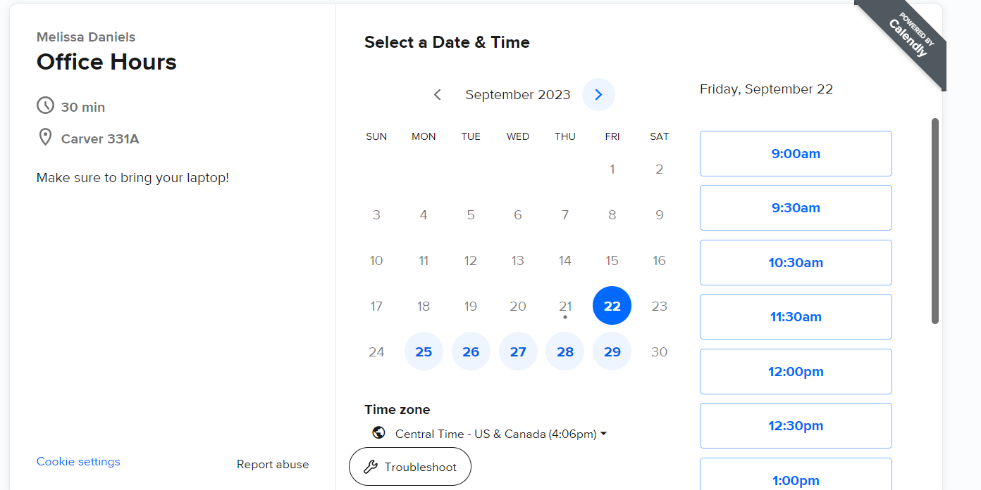
What do students see when they click on the link?
The customized link takes them directly to your appointment page, where they can select a date and time that works for them.

Slide 21
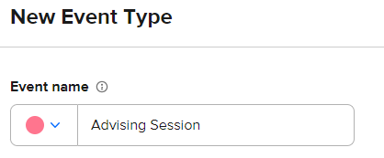
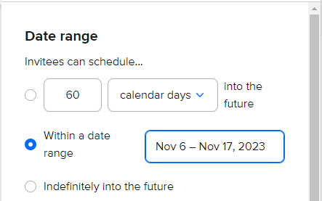
What about advising sessions?
Create a SEPARATE event type for advising appointments.
Color-code it differently than office hours.
This might be a good place to specify a date range scheduling window for students.

Slide 22
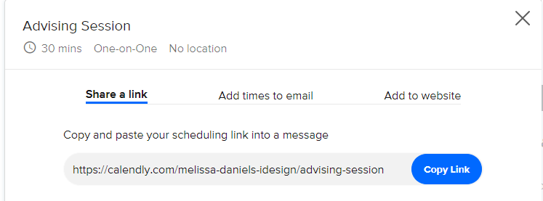
What about advising sessions?
When sharing with students, you have the option to copy that link, and share it in an e-mail (or however you choose to communicate with your advisees).

Slide 23
Calendly is easy to use for you and students alike – try it out!
Highly customizable
Free to use
Can even view analytics reports if you want to see what dates/times are regularly scheduled

Slide 24
Thank you!
melissa.daniels@simpson.edu

