Slide 1
Portfolium for Assessment
Training Session

Slide 2
Portfolium Features
Student and faculty e-portfolios
Pathways (badges)
Assessment

Slide 3
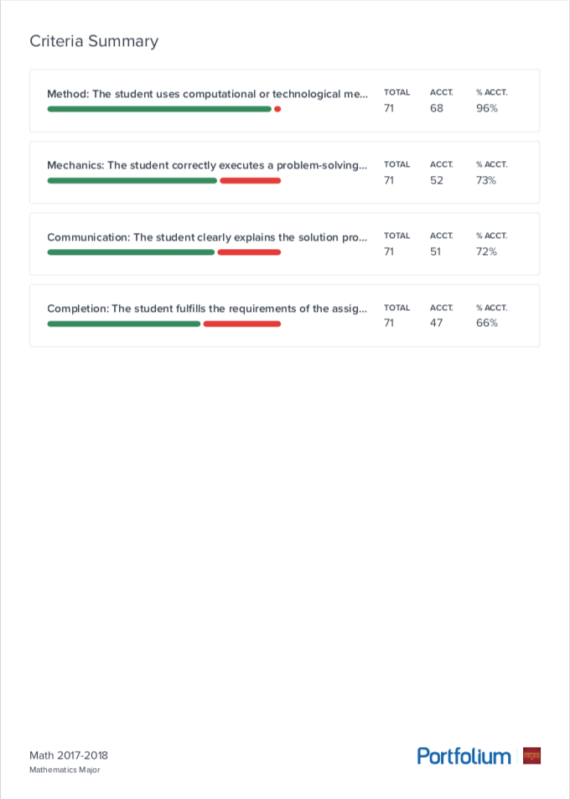
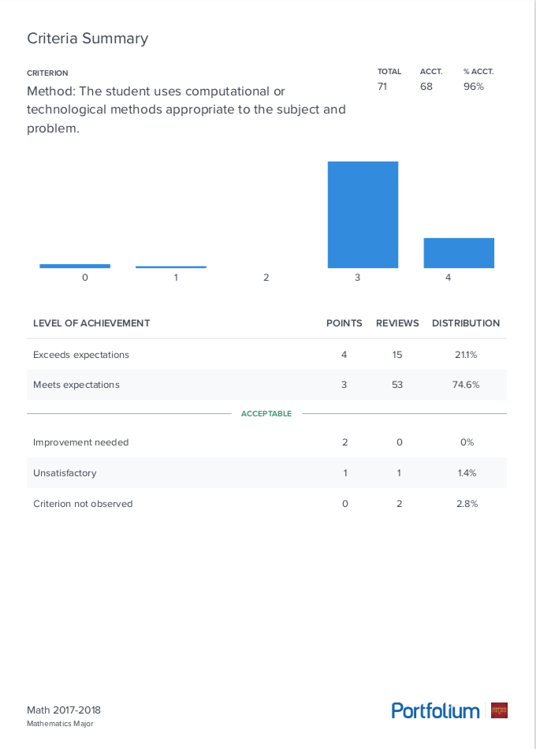
Program Assessment: Report
Notes:
Also shows reviewers, all collections, scoring status, reviewer stats

Slide 4
Portfolium for Assessment Workflow
Set up Student Learning Outcomes
Set up Rubrics
Create Program Assessment
Set Team and Roles
Add Artifacts and build Sample Sets
Score Artifacts
Generate Report
One-time Tasks!

Slide 5
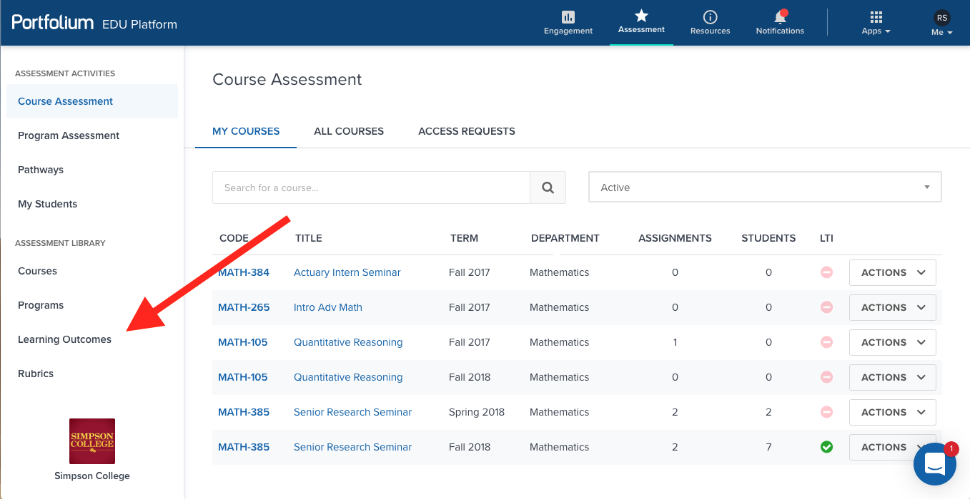
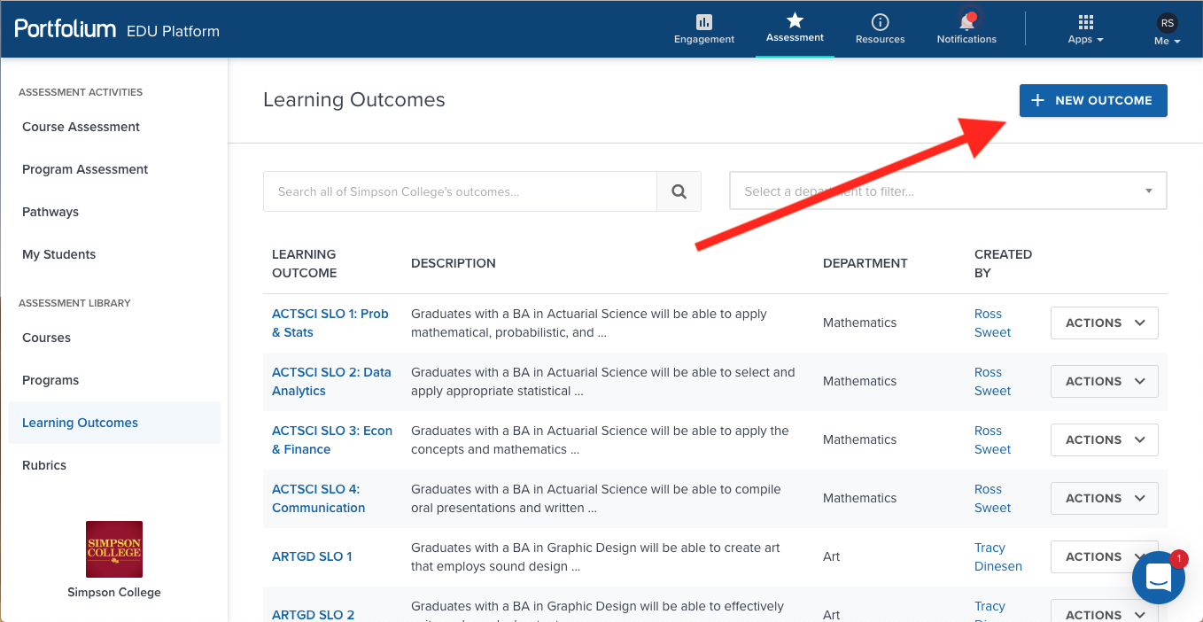
Student Learning Outcomes
edu.portfolium.com
Portfolium login
“Learning Outcomes” in left menu
“New Outcome” button
Title: Recommended “PROGRAM SLO #: Name”
Description: as on Assessment Plan
Department
Click “Save”

Slide 6
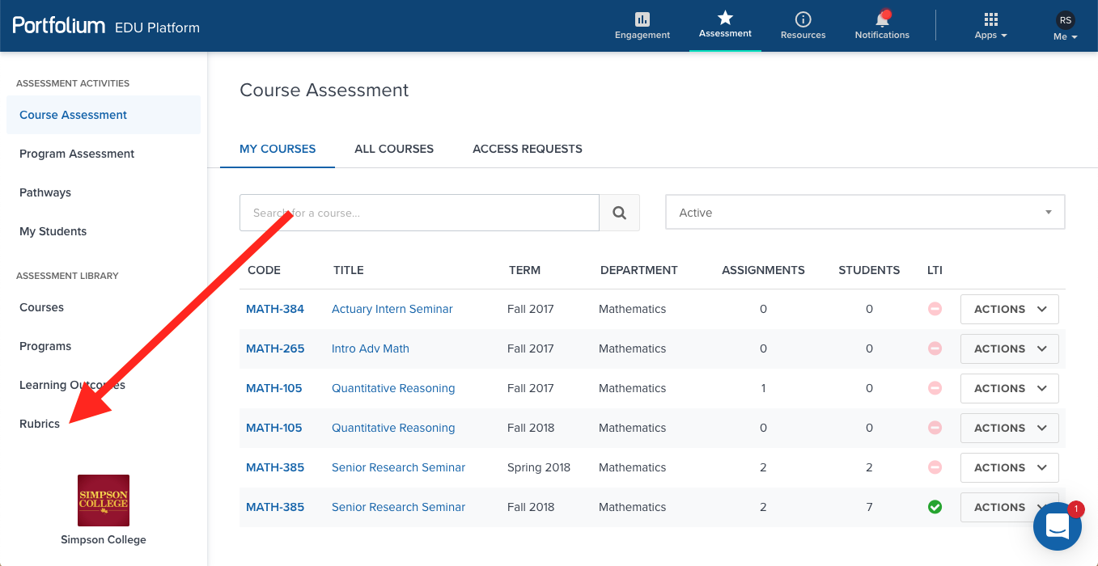
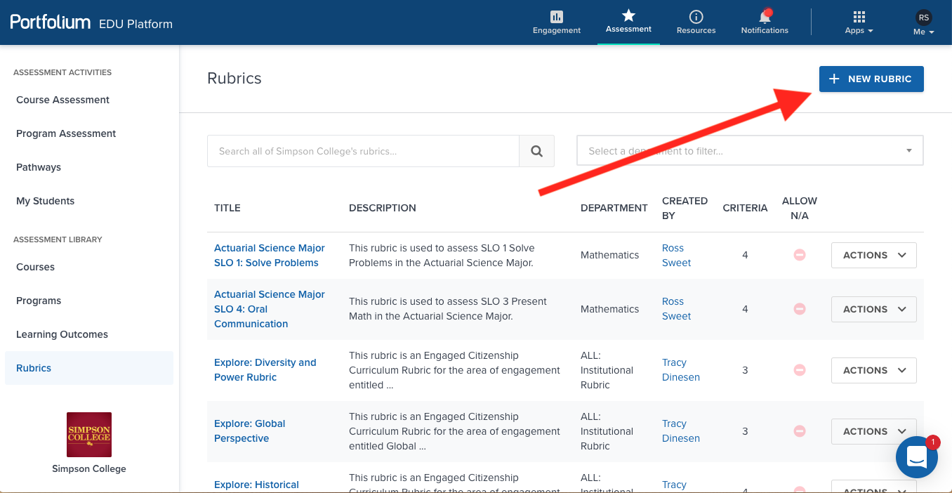
Rubrics
“Rubrics” in the left menu
“New Rubric” button
Details tab
Title: “Major SLO #: Name”
Description

Slide 7
Rubrics
New Rubric
Criteria tab
Name from SLC Assessment Rubric
Choose Learning Outcome
Edit levels of achievement, description, points
Choose Acceptable Level based on Assessment Plan
Example (Actuarial Science Major SLO 1: Solve Problems)

Slide 8
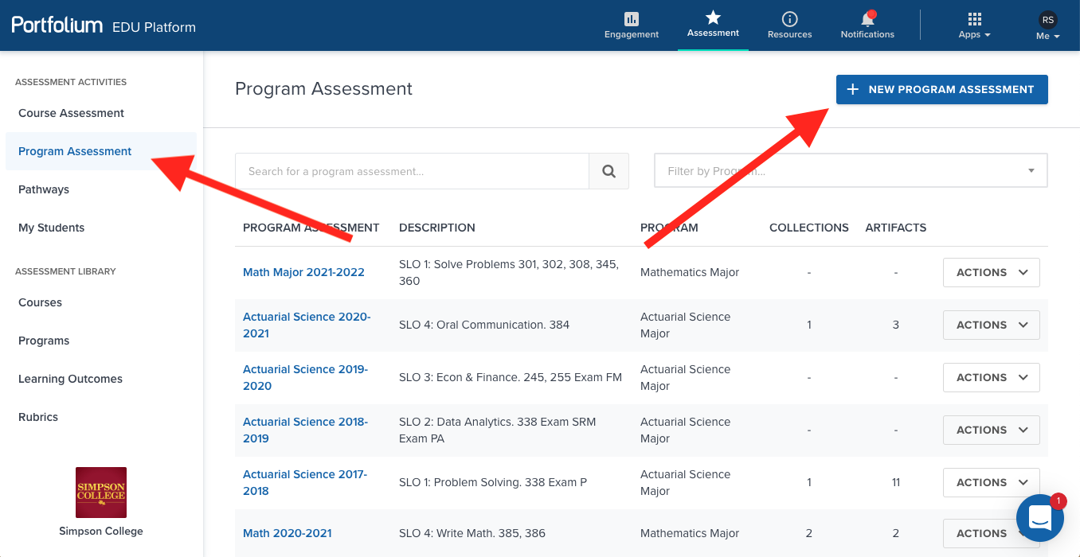
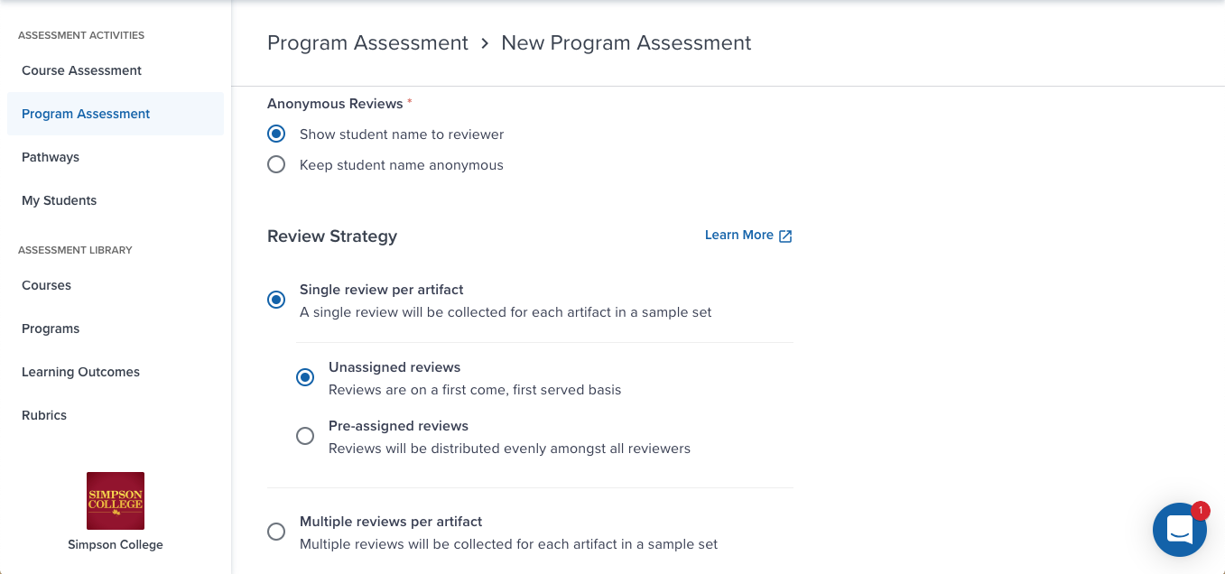
Program Assessment
“Program Assessment” in left menu
“New Program Assessment” button
Title: Major 20XX-20YY
Program
Anonymous reviews?
Review strategy
Click “Create Program Assessment”

Slide 9
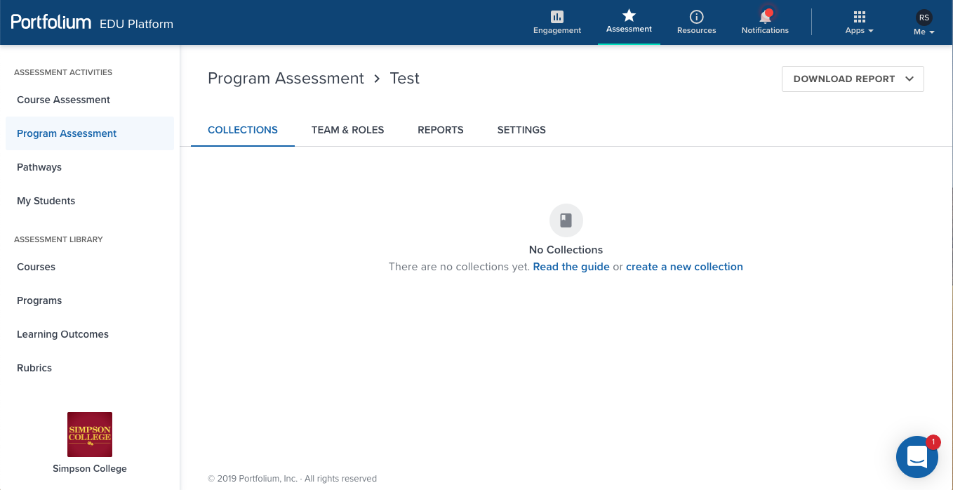
Program Assessment: Roles
“Team & Roles” tab
“Add Role” button
Add all faculty in the department
Add administrators if needed
Account needed first
Choose “Coordinator” and “Reviewer”
Coordinators can upload and create
Reviewers can score

Slide 10
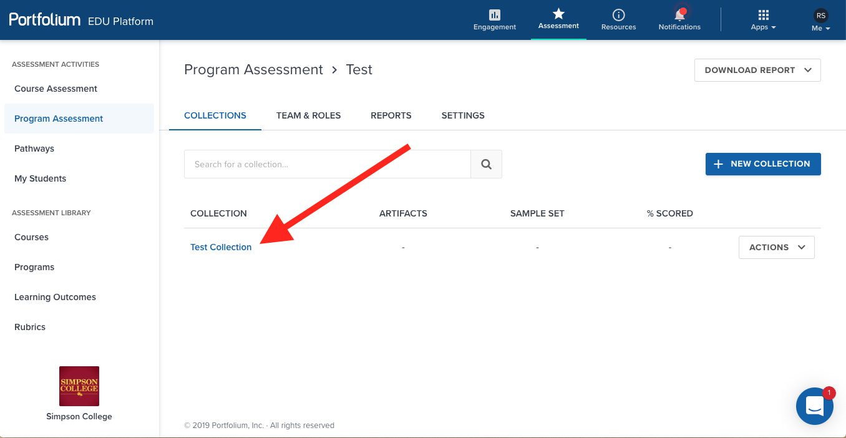
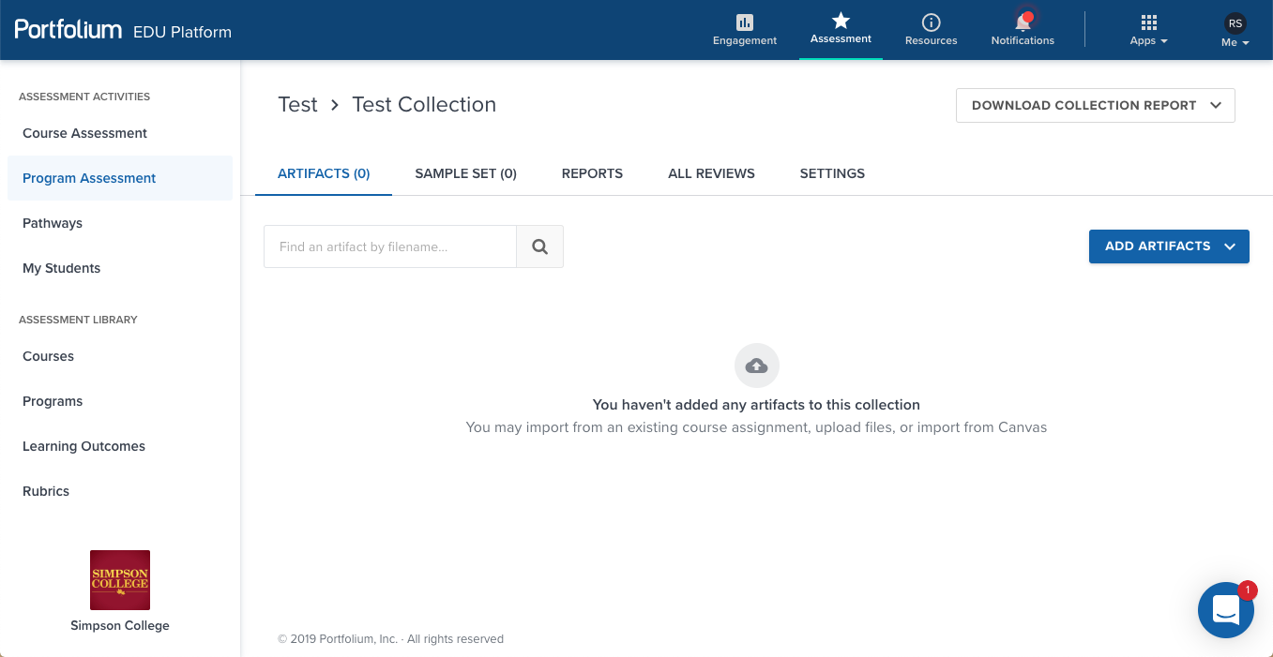
Program Assessment: Collections
”Add New Collection” button
One collection for each artifact type
Name: Course 20XX-20YY
Choose Rubric for scoring
Click “Create Collection”
You are redirected to main page
Click on the collection
“Add Artifacts” button
Upload artifacts directly
Import from Portfolium courses
Notes:
All team members will get email notifications when new artifact batches are added to collections.

Slide 11
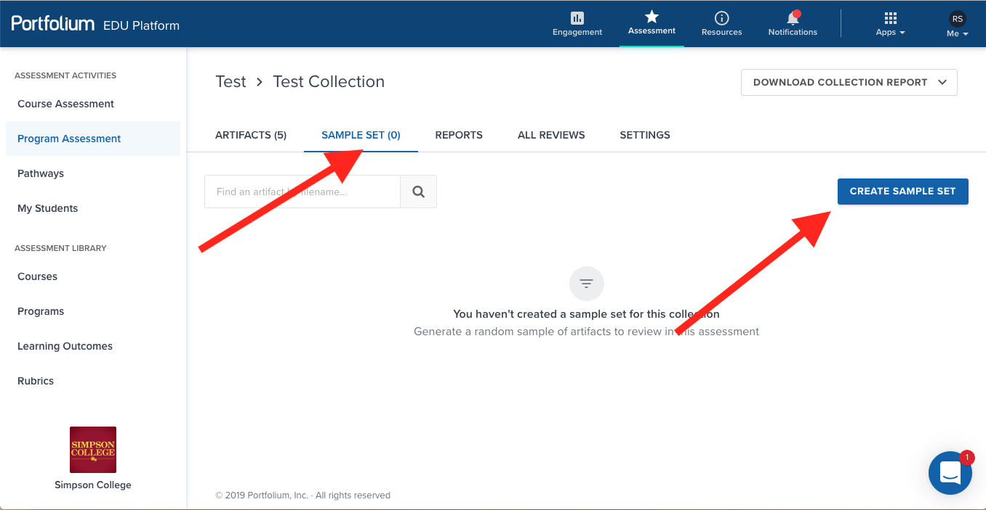
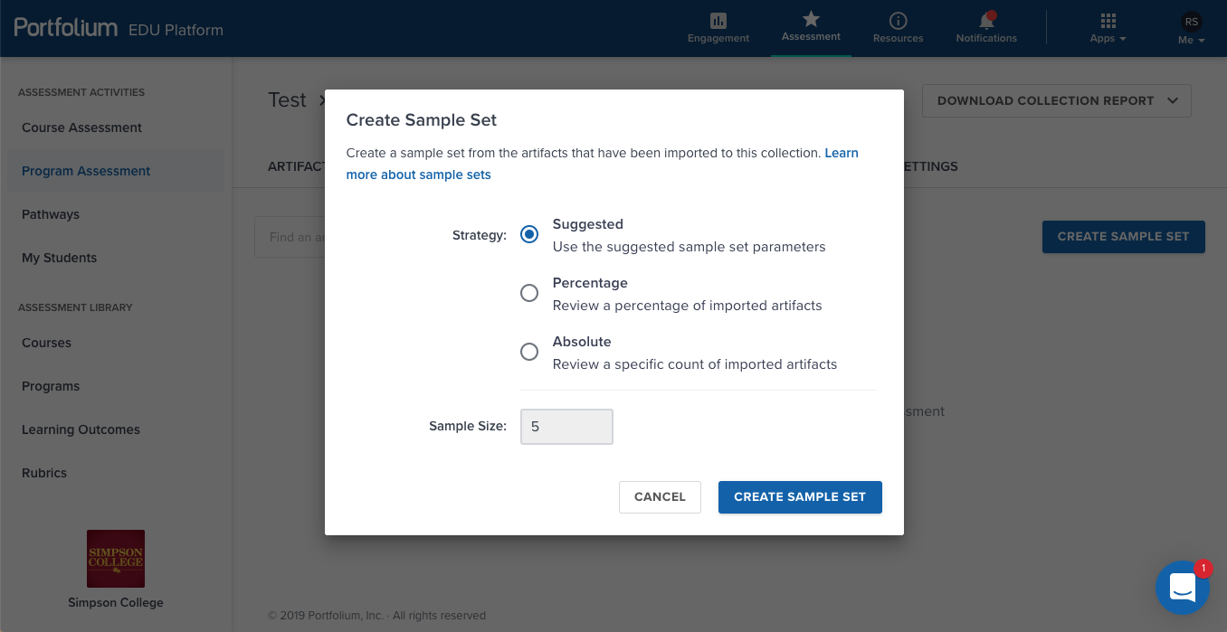
Program Assessment: Sample Set
In a collection, “Sample Set” tab
“Create Sample Set” button
Make sure all artifacts are chosen
Suggested: double check size
Percentage: 100%
Absolute: number of artifacts

Slide 12
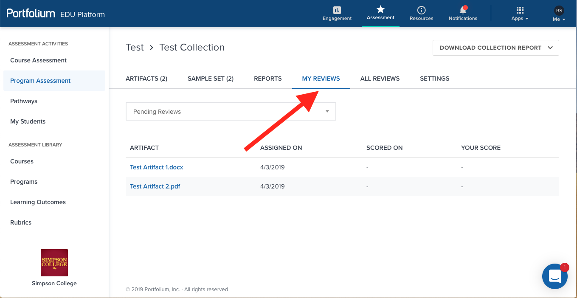
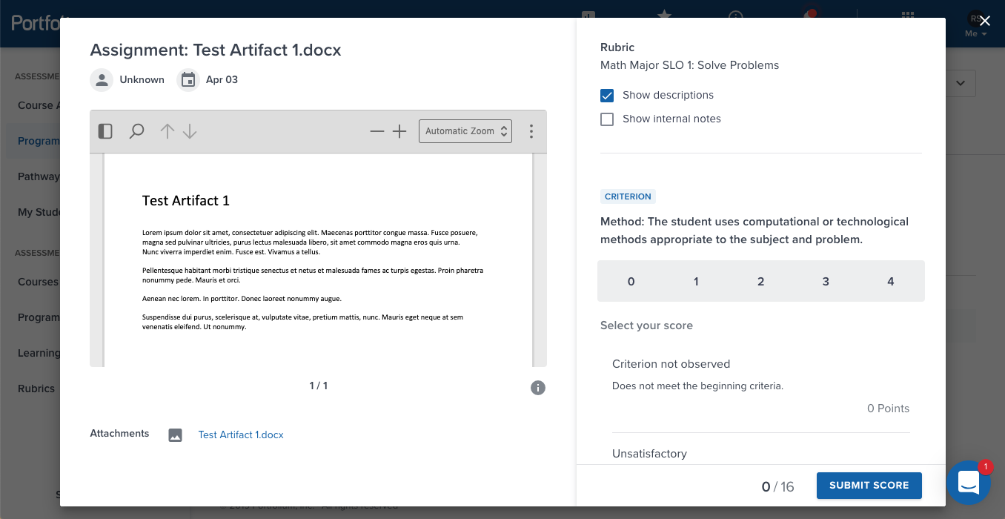
Program Assessment: Scoring
In a Collection, “My Reviews” tab
Click on an artifact
Choose score for each rubric category
YOU CANNOT CHANGE A SCORE AFTER SUBMISSION!
Notes:
If you click on an artifact in the main Sample Set page, the rubric scores cannot be selected.

Slide 13
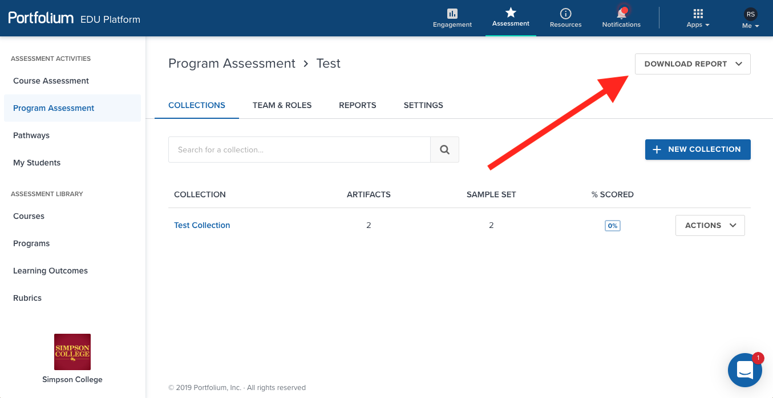
Program Assessment: Report
Main program assessment page
“Download Report” menu
CSV gives raw data
PDF gives report
SLIC Assessment Reports
Include the Portfolium report
Part 2 of the SLIC report

Slide 14
Program Assessment: Report
Notes:
Also shows reviewers, all collections, scoring status, reviewer stats

